Slide 1

Formal SignWriting
Basics, Software, Visuals, and Searching

Slide 2

Steve Slevinski
Sign language user, friend of the deaf, and SignWriting Evangelist
Creator of SignPuddle
Sutton SignWriting Encoder of 2010, 2012, and 2017
System Administrator of SignWriting.org
Author of the Sutton SignWriting Packages
https://steveslevinski.me/

Slide 3
Sutton SignWriting
Sutton SignWriting is the universal and complete solution for written sign language. It has been applied by a wide and deep international community of sign languages.
Sutton SignWriting is an international standard for writing sign languages by hand or with computers. From education to research, from entertainment to religion, SignWriting has proven useful because people are using it to write signed languages.

Slide 4
Formal SignWriting
Formal SignWriting is one particular computerized encoding for Sutton SignWriting. The design is based on character processing with regular expressions. With Formal SignWriting, each sign is written as a two-part word of time and space.
Where as American Sign Language is a natural language, Formal SignWriting is a formal language. A formal language uses words and punctuation to form text. Each word is expressed as a string of characters. Well-formed words are governed by the structural rules of the grammar. A formal language is useful in mathematics, computer science, and linguistics.

Slide 5
Formal SignWriting Design Principles
Complete: Sutton SignWriting is a complex script with unique requirements and processing. Formal SignWriting supports all of the structures inherent to the script.
Universal: Sutton SignWriting can be used to write any sign language, natural or constructed. Formal SignWriting supports all sign languages without requiring the addition of new characters or updated fonts.
Empowering: Sutton SignWriting is flexible enough to let each writer decide how they want to write their signs. Formal SignWriting enable the writers to decide for themselves the spelling of their respective signs.
Possible: Sutton SignWriting is a practical script that makes it possible to write sign language. Formal SignWriting is a practical encoding because it works with existing font technologies across operating systems.

Slide 6
Table of Contents
Basics: characters sets, two-part word, sorting, and punctuation
Software: core, font-db, font-ttf, sgnw-components, and signmaker
Visuals: SVG with fonts, self-contained SVG, and the styling string
Searching: query language, regular expressions, and transformations

Slide 7
Basics: Character Sets
Formal SignWriting in ASCII (FSW)
Formal SignWriting in ASCII (FSW) was released in January 2012 and has been stable since. FSW only uses characters from the ASCII subset of "ABLMRS0123456789xabcdef“
SignWriting in Unicode (SWU)
SignWriting in Unicode (SWU) was first published in October 2016 and officially submitted to the Unicode Technical Committee in July 2017. SWU is not part of the Unicode standard.
SignWriting in Unicode (SWU) is an experimental Unicode design that is supported by the Sutton SignWriting community. This alternate encoding overwrites the Sutton SignWriting block in Unicode and uses plane 4 for the SignWriting symbols.

Slide 8


Basics: Character Sets
Formal SignWriting in ASCII (FSW)
AS10011S10019S2e704S2e748M525x535S2e748483x510S10011501x466S2e704510x500S10019476x475
SignWriting in Unicode (SWU)
U+1D800 U+40012 U+4001A U+4B6A5 U+4B6E9 U+1D803 U+1D91F U+1D929 U+4B6E9 U+1D8F5 U+1D910 U+40012 U+1D907 U+1D8E4 U+4B6A5 U+1D910 U+1D906 U+4001A U+1D8EE U+1D8ED

Slide 9
Basics: Character Sets
Description | FSW Characters | SWU Characters
Sequence Marker | A | U+1D800
Signbox Markers | B, L, M, R | U+1D801 to U+1D804
Numbers | 250 to 749 | U+1D80C to U+1D9FF
Symbols | S10000 to S38b07 | U+40001 to U+4F428

Slide 10
Basics: Character Sets
FSW String | SWU Character | SWU Glyph
A | U+1D800 | 𝠀
S10011 | U+40012 | 񀀒
S10019 | U+4001A | 񀀚
S2e704 | U+4B6A5 | 񋚥
S2e748 | U+4B6E9 | 񋛩
M | U+1D803 | 𝠃
525 | U+1D91F | 𝤟

Slide 11
Two-Part Word of Time and Space
Temporal Prefix - The temporal prefix is a one-dimensional list of symbols that is written by an author. The arrangement of the symbols is based on a particular theory of sorting. The order of the symbols in the temporal prefix is significant because sorting is possible with a binary string comparison. The temporal prefix is neither formatting nor style and represents meaning not found in the spatial signbox.
Spatial Signbox - The spatial signbox is a two-dimensional cluster of symbols. The position of each symbol is determined by the writer and defined using Cartesian Coordinates that represent the top-left of the symbol image. 2-dimensional space does not have a normative 1-dimensional order. When symbols overlap, the relative order of the overlapping symbols is important. Symbols written first appear underneath symbols that are written later. Otherwise, the exact string order of the spatial symbols is unpredictable. The spatial signbox is neither formatting nor style and represents meaning that is beyond the temporal prefix.

Slide 12
FSW: Two-Part Word
1)
AS10011S10019S2e704S2e748M525x535S2e748483x510S10011501x466S2e704510x500S10019476x475
---
Time: AS10011S10019S2e704S2e748
Space: M525x535S2e748483x510S10011501x466S2e704510x500S10019476x475
---
Time: A S10011 S10019 S2e704 S2e748
Space: M 525x535 S2e748 483x510 S10011 501x466 S2e704 510x500 S10019 476x475
---
Time: Sequence Marker and List of Symbols
Space: M (525,535) S2e748 (483,510) S10011 (501,466) S2e704 (510,500) S10019 (476,475)
---
Space: Middle Lane Signbox Marker, Max Coordinate, List of Symbols with Top-Left Coordinates
2)
3)
4)
5)

Slide 13




SWU: Two-Part Word
1)
---
Time:
Space:
---
Time: Sequence Marker and List of Symbols
Space:
---
Space:
---
Space: Middle Lane Signbox Marker, Max Coordinate, List of Symbols with Top-Left Coordinates
2)
3)
4)
5)

Slide 14
FSW: Punctuation
1)
S38800464x496
---
S38800 464x496
---
S38800 (464,496)
---
Punctuation Symbol, Top-Left Coordinate
---
Max Coordinate = (1000-464, 1000-496)
---
Max Coordinate = (536, 504)
2)
3)
4)
5)
6)

Slide 15

SWU: Punctuation
1)
---
(464, 496)
---
Punctuation Symbol, Top-Left Coordinate
---
Max Coordinate = (1000-464, 1000-496)
---
Max Coordinate = (536, 504)
2)
3)
4)
5)

Slide 16
Software: Development Packages
@sutton-signwriting/core - a javascript package for node and browsers that supports general processing of SignWriting text.
@sutton-signwriting/font-db - a javascript package for node that generates SVG and PNG images for individual symbols, complete signs, and structured text using pure SVG.
@sutton-signwriting/font-ttf - a javascript package for the browser that generates SVG and PNG images for individual symbols, complete signs, and structured text using TrueType Fonts.
@sutton-signwriting/sgnw-components - a javascript package for the browser that includes a collection of web components built with https://stenciljs.com/
https://github.com/sutton-signwriting/
https://www.npmjs.com/search?q=sutton-signwriting

Slide 17
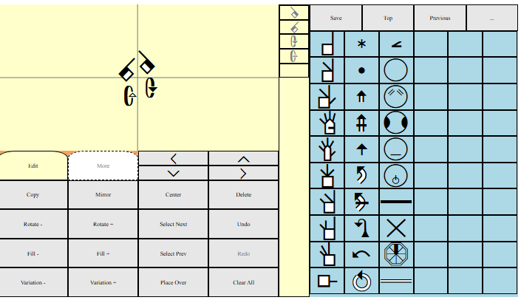


SignMaker: iframe Editor using postMessage and addEventListener
@sutton-signwriting/signmaker - an online editor that can be accessed directly, embedded in an iFrame, and downloaded. It uses both Formal SignWriting in ASCII (FSW) and SignWriting in Unicode (SWU) character sets, along with the associated style string.
<iframe style:"width:640px;height:360px;" src:"https://www.sutton-signwriting.io/signmaker/index.html"></iframe>
https://www.sutton-signwriting.io/signmaker/
https://www.sutton-signwriting.io/signmaker/demo.html

Slide 18

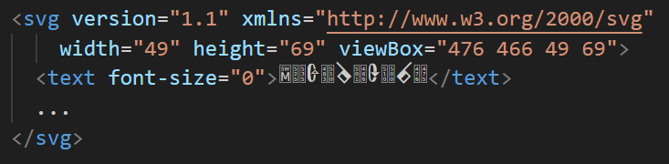
Visuals: Common SVG Wrapper
1)
2)
3)
Max Coordinate – (525,535)
Min X = min(483, 501, 510, 476) = 476
Min Y = min (510, 466, 500, 475) = 466
Width = Max X – Min X = 525 – 476 = 49
Height = Max Y – Min Y = 535 – 466 = 69
4)

Slide 19
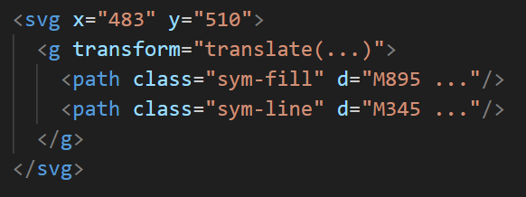
Visuals: Self-Contained SVG
1)
2)
3)
Each symbol gets an <svg> group

Slide 20
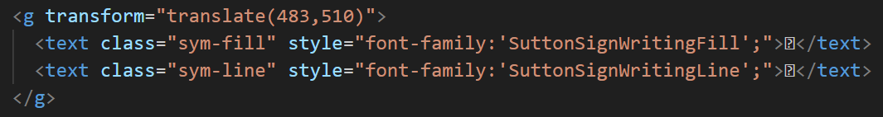
Visuals: SVG with Fonts
1)
2)
3)
Each symbol gets a <g> group

Slide 21
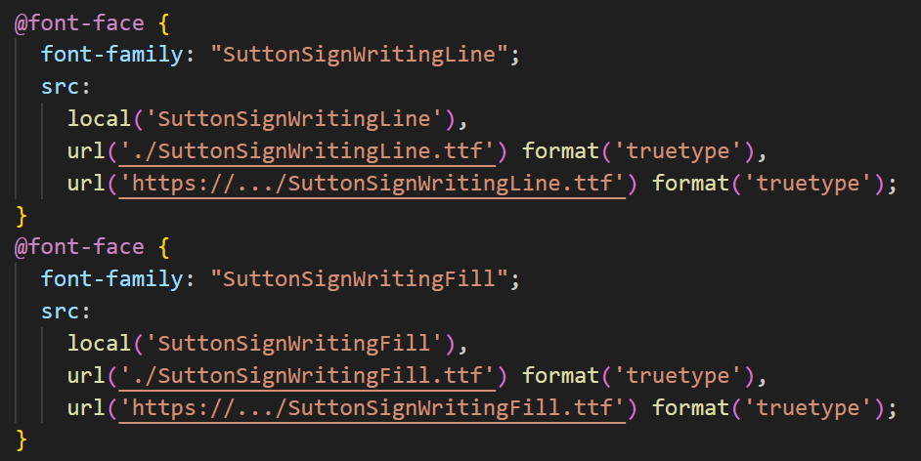
Visuals: CSS for SVG with Fonts

Slide 22
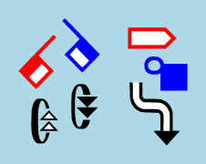
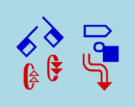
Visuals: Styling String
Colorize
Padding
Background color
Detail color for line and fill
Zoom level
Colors for individual symbols
Class names for SVG
ID name for SVG
https://www.sutton-signwriting.io/core/#style

Slide 23
Visuals: Styling String parse and compose
style.parse('-CP10G_blue_D_red,Cyan_’)
return {
'colorize': true,
'padding': 10,
'background': 'blue’,
'detail': ['red', 'Cyan’]
}
style.compose({
'colorize': true,
'padding': 10,
'background': 'blue’,
'detail': ['red', 'Cyan’]
})
return '-CP10G_blue_D_red,Cyan_’
https://www.sutton-signwriting.io/core/#styleparse
https://www.sutton-signwriting.io/core/#stylecompose

Slide 24
Searching: Query Language
The query language of Formal SignWriting allows for precise searching of signs written in either FSW or SWU. A query string is a concise representation for a much larger and detailed set of regular expressions. The regular expressions can be used to quickly and accurately search large files and databases containing Formal SignWriting.
https://www.ietf.org/archive/id/draft-slevinski-formal-signwriting-09.html#name-query-language

Slide 25
Searching: Query Language Possibilities
Search the temporal prefix or the spatial signbox
Search for exact symbols
Search for symbols with any fill or any rotation
Search for symbols near a coordinate within a specified range
Search for a range of symbols
Search for any symbol within a list of individual symbols
https://www.sutton-signwriting.io/core/#fswquery
https://www.sutton-signwriting.io/core/#swuquery

Slide 26
Searching: Regular Expression Basics
Character | Description | Example
* | Match a literal 0 or more times | ABC* matches AB, ABC, ABCC, ...
+ | Match a literal 1 or more times | ABC+ matches ABC, ABCC, ABCCC, ...
? | Match a literal 0 or 1 times | ABC? matches AB or ABC
{#} | Match a literal "#" times | AB{2} matches ABB
[ ] | Match any single literal from a list | [ABC] matches A, B, or C
[ - ] | Match any single literal in a range | [A-C] matches A, B, or C
( ) | Creates a group for matching | A(BC)+ matches ABC, ABCBC, ABCBCBC, ...
( | ) | Matches one of several alternatives | (AB|BC|CD) will match AB, BC, or CD
(?: ) | Creates a non-capturing group | A(?:BC) will match ABC as one group

Slide 27
Searching: Regex Number Searching
Find a number from 423 to 612
Incremental Step | Regex
Find a number from 423 to 429 | 42[3-9]
Find a number from 430 to 499 | 4[3-9][0-9]
Find a number from 500 to 599 | 5[0-9][0-9]
Find a number from 600 to 609 | 60[0-9]
Find a number from 610 to 612 | 61[0-2]
Final Regular expression
(42[3-9]|4[3-9][0-9]|5[0-9][0-9]|60[0-9]|61[0-2])

Slide 28
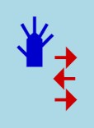
Transformation: FSW to Query String
FSW of AS14c20S27106M519x529S14c20482x471S27106504x489
Exact Symbols in temporal prefix: QAS14c20S27106T
General Symbols in temporal prefix: QAS14cuuS271uuT
Exact Symbols in spatial signbox: QS14c20S27106
Exact Symbols near coordinates: QS14c20482x471S27106504x489
https://www.sutton-signwriting.io/core/#fswqueryfsw2query

Slide 29





Transformation: SWU to Query String
SWU of
Exact Symbols in temporal prefix:
General Symbols in temporal prefix:
Exact Symbols in spatial signbox:
Exact Symbols near coordinates:
https://www.sutton-signwriting.io/core/#swuqueryswu2query

Slide 30
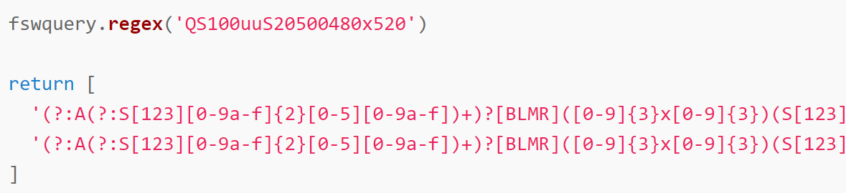
Transformation: FSW Query String to Regex
https://www.sutton-signwriting.io/core/#fswqueryregex

Slide 31
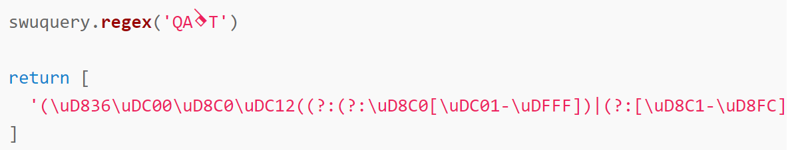
Transformation: SWU Query String to Regex
https://www.sutton-signwriting.io/core/#swuqueryregex

Slide 32
Transformation: Regex to FSW or SWU
Wherever regular expressions are supported, the regex created can be used to search text for matching signs written in either FSW or SWU.

Slide 33
Would you like to know more?
The SignWriting Stream:
https://www.youtube.com/channel/UCXu4AXlG0rXFtk_5SzumDow

Slide 34
Would you like to know more?
About SignWriting Software:
https://www.sutton-signwriting.io/
Technical Specification:
https://www.ietf.org/archive/id/draft-slevinski-formal-signwriting-09.html

Slide 35
Would you like to know more?
About Me:
https://SteveSlevinski.me/
Email:
slevinski@signwriting.org
Online Chat:
https://gitter.im/sutton-signwriting/community

Slide 36
Would you like to support our work?
Use SignWriting and enjoy!
Discuss and build on our work.
Consider financially supporting our work.
https://www.patreon.com/signwriting

