Slide 1
Two Systems of
FSC (featural syllabographic characters)

Slide 2
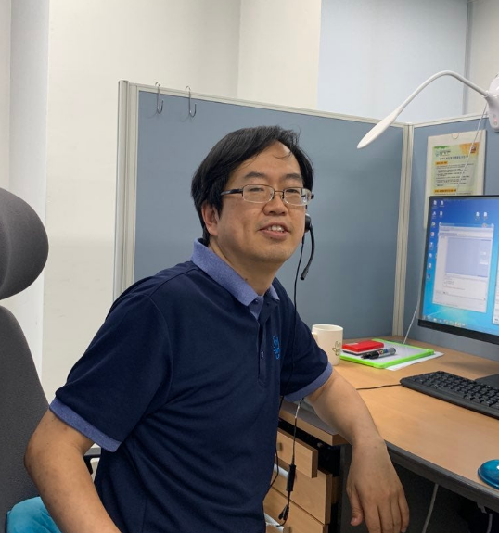

Jongtae Kim
Working at TRS in Seoul
As a Korean Sign Language Interpreter

Slide 3
What is the SignWriting?
What does it mean in graphetics?

Slide 4
Two Systems have the same characteristics.
syllabographic characters
featural characters

Slide 5
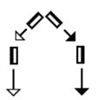
syllabographic
Hangul vs SignWriting
집
It means the house in Korean.
It means the house in SignWriting.

Slide 6
syllabographic
ㅈㅣ
ㅂ
first letter
middle letter
집
last letter
We don’t write it like ㅈ ㅣ ㅂ.
No Serial notation

Slide 7




syllabographic
We write it like this.

Slide 8
syllabographic
Similarity Hangul and SignWriting
: Syllabographic character
집
One syllable
psudo one syllable

Slide 9
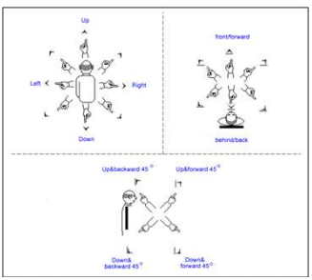


syllabographic
Serial notation of HamNoSys
: All I one notation
It has two characteristics. (handshape and origination)

Slide 10
syllabographic
 | Shape of hands | Place of hands | Origination of hands | Movement of hands | Non-Manual Signals
Shape of handshape | ○ |  | ○
Face, body, arms |  | ○
Movement, Dynamics |  |  |  | ○
Non-Manual Signals |  |  |  |  | ○

Slide 11

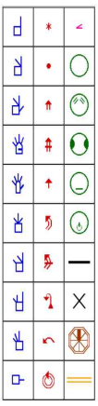
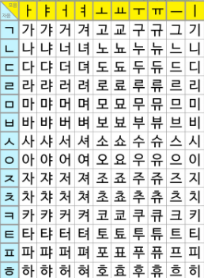
featural
Similarity Hangul and SignWriting
: Featural character
Basic form
ㄴ ㄷ ㄹ

Slide 12
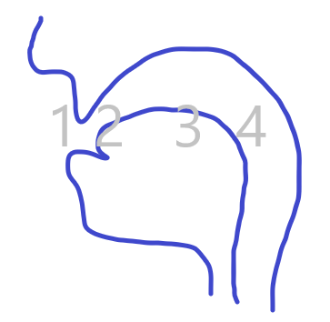
featural
M sound starts from the lips.
ㅁ (미음) for M looks like lips.
S sound starts from the teeth.
ㅅ (시옷) for S looks like teeth.
N sound starts from the back of upper teeth.
ㄴ(니은) for N looks like the tongue at the back of upper teeth.
ㄷ(디귿) for D has the same base of ㄴ because the sound starts from the same place of ㄴ.
ㅁㅅㄴ
Korean characters looks like the places that start at/from.

Slide 13

featural
[Korea] sign in KSL
It shows by the head which is the place the sign starts at.
WYSIWYG
Sign Writing does so.
It shows on the places that start at/from.
It is natural.

Slide 14
featural
Hangul
writing letter unit：강, 산 → syllabograph
consonant and vowel unit：ㄱ, ㅏ, ㅇ, ㅅ, ㅏ, ㄴ → letter
fetural unit：ㄷ(ㄴ, ㅡ)/ㅈ(ㅅ, ㅡ)/ㆆ(ㅇ, ㅡ) → basic form and added line

Slide 15
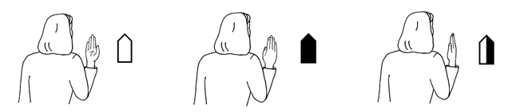
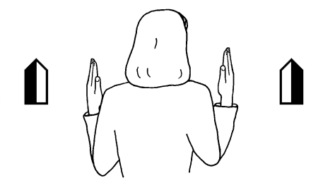
featural
SignWriting
Basic form
added characteristic

Slide 16

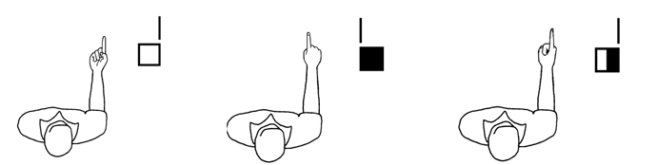
featural
SignWriting
Basic form
added characteristic

Slide 17
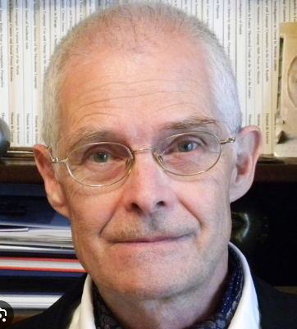
Korean-Hangul is analytically a featural system.
And it is systhetically a syllabic system.
-Florian Coulmas

Slide 18
SignWriting is a system of featural syllabographic characters

