Slide 1


Two Fingerspelling Keyboard Layouts for Myanmar Sign Language with
UT-YCC
OpU
Myanmar SignWriting
SignWriting Symposium 2018
Supervisor – Dr. Hnin Aye Thant
Co-supervisors – Dr. Ye Kyaw Thu,
Daw Swe Zin Moe
Presented by
Hlaing Myat Nwe
1

Slide 2
Group Memebers
Hlaing Myat Nwe
Ye Kyaw Thu
Hnin Wai Wai Hlaing
Swe Zin Moe
Khaing Hsu Wai
Hnin Aye Thant
Nandar Win Min
2

Slide 3
Outlines of Presentation
Introduction
Contributions
Objectives
Myanmar Sign Language
SignWriting
Fingerspelling Keyboard Layouts for MSW
Evaluations
Discussion
Conclusion
References
2

Slide 4
Introduction
Myanmar deaf people mainly use Myanmar Sign Language (MSL) as an essential communication language among them.
They have difficulties in relation to written languages with orally spoken words.
SignWriting is used for writing sign language in other countries for their deaf people.
There is no Myanmar language specific SignWriting text editor for Myanmar Deaf society yet.
2

Slide 5
Introduction (Cont‟d)
SignWriting will be useful for Deaf children education and documentation of sign language literature in Myanmar.
In the our paper, two fingerspelling keyboard layouts was proposed, one is based on pronunciation of Myanmar characters and another is based on the shapes of SignWriting symbols.
A user study with both hearing-impaired and hearing users was conducted and the comparisons are made between two keyboard layouts in terms of CPM and Likert scale feedbacks.
2

Slide 6
Contributions
This system is the first SignWriting text input interface for Myanmar fingerspelling characters with SignWriting
Building Myanmar SignWriting dictionary will be useful for future researchers who want to do researching about SignWriting and Myanmar Sign Language
6

Slide 7
Objectives
To develop Myanmar SignWriting Dictionary for Myanmar Sign Language
To implement Myanmar SignWriting Text Input Interface
To provide writing system for Myanmar Deaf people
To improve the quality of Deaf Education in Myanmar
7

Slide 8
Schools for the Deaf in Myanmar
Four Schools for the deaf in Myanmar:
  Mary Chapman School for the Deaf in Yangon (est. 1904)
  School for the Deaf, Mandalay (est. 1964)
  Immanuel School for the Deaf in Kalay (est. 2005)
  School for the Deaf, Tarmwe Yangon (est. 2014)
In Myanmar, sign languages used in each region are not the same.

Slide 9
Myanmar Sign Language (MSL)
MSL that Myanmar Deaf people use is also different with Myanmar
language in grammatical structure.
Example:
Myanmar Written Language:
ဘယ္
လ က
အပူ
ဆုံး လ လဲ ။
(“What is the hottest month ?” in English)
Myanmar Sign Lanugae:
ပူ
အရမ္း
လ
ဘာလဲ
။

Slide 10
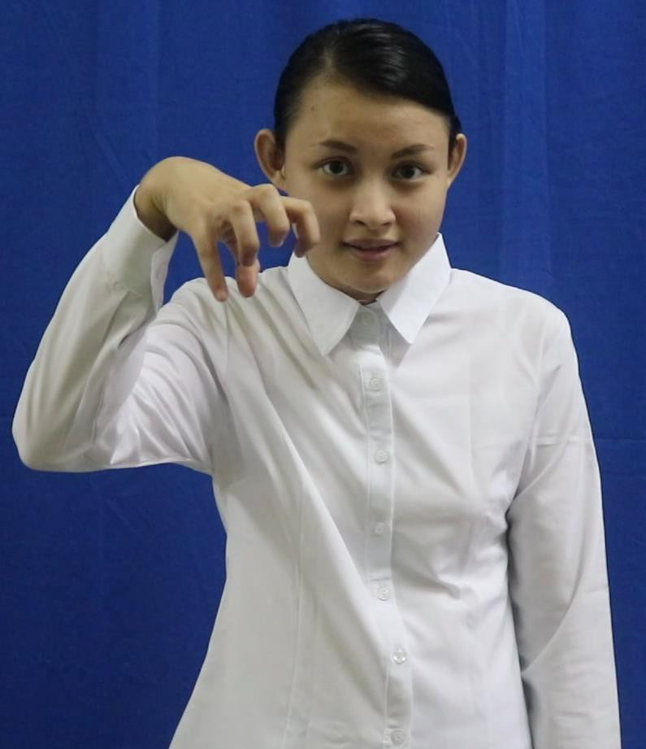
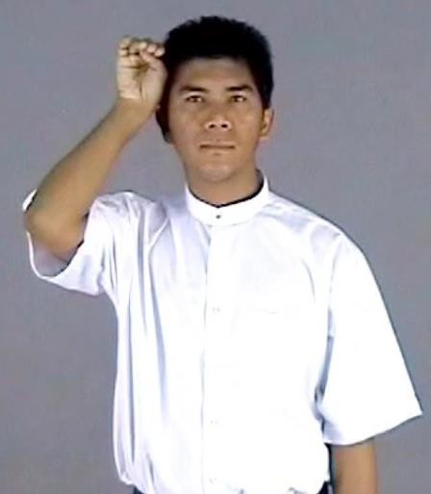
Myanmar Sign Language (Cont‟d)
Yangon Sign of
„Mathematics‟
Mandalay Sign of
„Mathematics‟
Figure 1. Example of MSL Difference between Yangon and Mandalay

Slide 11



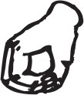

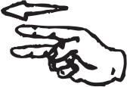
Myanmar Fingerspelling
It is the basic language of sign language for Myanmar deaf people.
It can be used to represent Myanmar consonant, vowel, and numbers with hands.
It is used for signing names, city names and words that are not existing in sign language.
Example:
ေ (e) န (na)
ေန (Nay)
တ (ta)
ိ (i)
တိုး (Toe)
ု (u)
း (visarga)

Slide 12








Myanmar Fingerspelling (Cont‟d)
Some of Myanmar fingerspelling characters can be seen as follows:
က (ka)
ခ (kha)
ဂ (ga)
ဃ (gha)
င (nga)
-ာ (aa)
-ါ (aa)
-ိ (i)
-ီ (ii)
-ု (u)
-ူ (uu)
စ (sa)
ဆ (sha)
ဇ (za)
စ် (zha)
ည (nnya)
ေ- (e)
-ဲ (ai)
-် (ya)
ျ- (ra) -ြ (wa)
-ွ (ha)
Figure 2. Some of MSL Fingerspelling for Myanmar Consonant and vowel
12

Slide 13
Myanmar Fingerspelling (Cont‟d)
There are two different fingerspelling character sets for Myanmar language.
  One is used in southern Myanmar
o e.g. used at “Mary Chapman School for the Deaf”, Yangon city
  The another is used in northern Myanmar
o e.g. used at “Mandalay School for the Deaf”, Mandalay city
They are similar in consonant but mainly different in vowel, medial and symbols.
In our paper, fingerspelling character set recognized as a standard in 2007 is used for designing two SignWriting keyboard layouts.

Slide 14
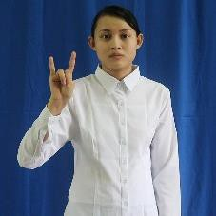

Myanmar Fingerspelling (Cont‟d)
Yangon Sign of
„ရ (Ya)‟
Mandalay Sign of
„ရ (Ya)‟
Figure 3. Example of Myanmar Fingerspelling Difference between Yangon and Mandalay

Slide 15
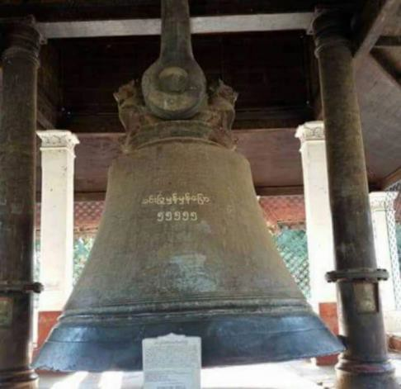



Classifier (CF)
One of Myanmar sign language that expresses sign according to the figures of objects
Example:
Min Guon
Inn Lay

Slide 16
SignWriting
In the 1974, Valerie Sutton invented for deaf people to write and read sign languages.
It is becoming the written form for sign language in over 40 countries.
There are
two view-points: the signer’s viewpoints and the
addressee’s viewpoints.
There are two main perspectives: front and top.
International SignWriting Alphabet (ISWA) includes all symbols used to write the handshapes, movements, facial expressions, and body movements.

Slide 17







7 Categories and 30 groups of SignWriting Symbols
Category3: Dynamics & Timing
Category5: Body
Category1: Hand
Category2: Movement
Category6: Detailed Location
Category4: Head & Face
Category7: Punctuation
17

Slide 18



SignWriting (Cont‟d)
Hand Orientation is also important
The Palm
The back of the hand
The side of the hand
18

Slide 19





SignWriting (Cont‟d)
Each basic symbol can have
  3 different fillings
  16 different spatial rotations
There are almost 35,023 symbols with various conditions
19

Slide 20
SignWriting (Cont‟d)
Each symbol is defined with corresponding Unicode value.
Sutton Unicode block is U+1D800 to U+1DAAF including Unicode value for
fill modifiers and rotation modifiers:
➢ = U1D800
➢ = U1D801
➢ = U1D802, and so on…..
20

Slide 21
Challenges
We are considering to propose a user-friendly Myanmar SignWriting text
input interface
The main challenge is how to organize or grouping many SignWriting symbols for Myanmar SignWriting
So as a first step, we only focus on typing Myanmar fingerspelling characters with SignWriting
22

Slide 22



















Fingerspelling Characters with SignWriting
Some of Myanmar fingerspelling characters with SignWriting symbols can be seen as follows:
Myanmar Characters | က | ခ | ဂ | ဃ | င | -ာ | -ါ | -ိ | -ီ | -ု | -ူ
Myanmar Fingerspelling
SignWriting
Table1. SignWriting for Some of MSL Fingerspelling Consonant and vowel
22

Slide 23
Two Fingerspelling Keyboard Layouts for MSW
In the proposed paper, two Myanmar fingerspelling keyboard layouts for
Myanmar SignWriting are implemented.
Typing SignWriting symbols are different with typing Myanmar characters.
To type a SignWriting symbol, at least two keys (i.e. symbol modifier and
fill modifier keys) are needed to press.
The typing order is symbol key, filling key and rotation key.

Slide 24



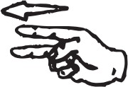













Two Fingerspelling Keyboard Layouts for MSW (Cont‟d)
Example of typing Myanmar word with SignWriting symbol is as follows:
Myanmar Words | ကေလးငယ္ | က | ေ | လ | း |  | င | ယ | ္
Myanmar Fingerspelling | -
Myanmar SignWriting | Symbol
 | Filling |  |  |  |  | -
 | Rotation | - | - | - |  |  |  | - | -
Table2. Example of typing Myanmar word ‘ကေလးငယ္’ (Children in English) with SignWriting

Slide 25
Two Fingerspelling Keyboard Layouts for MSW (Cont‟d)
These keyboard layouts were implemented for Linux or Unix like operating system computers using X Keyboard Extension (XKB).
The XKB is a part of the X Window System that extends the ability to control the keyboard and provides access to internal translation tables of keyboard codes.
In our paper, TrueType font of Sutton SignWriting built with the SignWriting 2010
Tools was used to display Myanmar fingerspelling characters with SignWriting.

Slide 26
Phonetic-based Keyboard Layout for Myanmar SignWriting
The mapping of Myanmar characters on English QWERTY keyboard based on their phonetic similarities with English characters such as
  Symbol of “က” (Ka) on k key
  Symbol of “ဂ” (Ga) on g key
  Symbol of “စ” (Ca) on s key
  Symbol of “ဆ” (Cha) on S (Shift + s) key and so on
The concept is same with the kKg (ကခဂ) Myanmar keyboard.

Slide 27


Phonetic-based Keyboard Layout for Myanmar SignWriting (Cont‟d)
Most of the SignWriting symbols for fingerspelling characters are same shapes
such as “ ” (Ga) and “ ” (Gha), “ ” (Nga) and “ ” (La) etc.
Every fingerspelling character are not needed to map on the keyboard.
Some Myanmar fingerspelling characters are mapped on English keys based on the
similar shape of characters
  Example: Myanmar consonant "င" (Nga) is mapping to English small c key

Slide 28
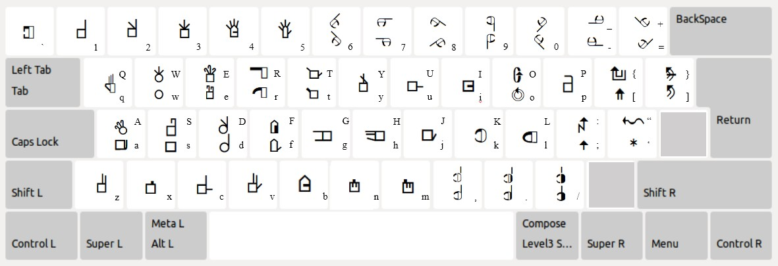
Phonetic-based Keyboard Layout for Myanmar SignWriting (Cont‟d)
The phonetic-based keyboard layout for MSW can be seen as follows:
28

Slide 29
Symbol-based Keyboard Layout for Myanmar SignWriting
The mapping is based on the shape similarities of SignWriting symbols.
MSW symbols are grouped by the shape of the symbols.
Example: the same shape and are mapped on s key and S (shift + s) key, and symbols are on d key and D (shift + d) key, respectively and so on.
Thumb group of SignWriting symbols such as “ ” (Le gaung), “ ” (Ca), “ ”
  are mapped on the bottom row keys of QWERTY keyboard layout.
This keyboard mapping concept might be difficult for the first-time users who are unfamiliar with Myanmar fingerspelling and SignWriting symbols.
29

Slide 30
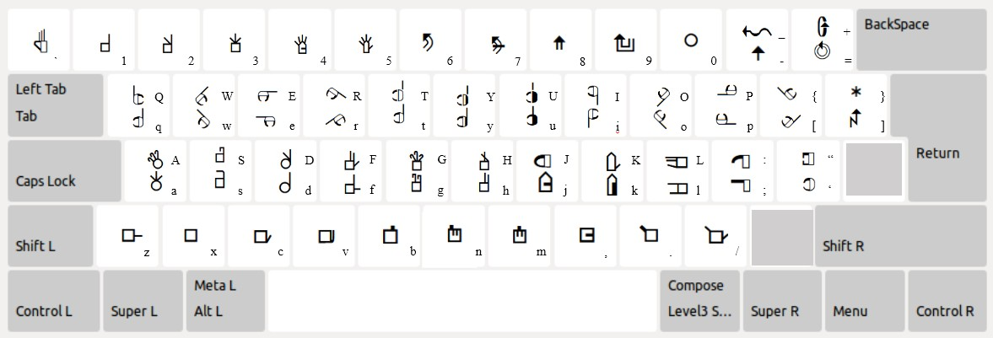
Symbol-based Keyboard Layout for Myanmar SignWriting (Cont‟d)
The symbol-based keyboard layout for MSW can be seen as follows:
30

Slide 31
Methodology
For User study,
  Participants → 19 volunteer participants (9 males and 10 female)
  Two types of users → Hearing-impaired users and
Hearing users
  Location → School for the Deaf, Mandalay
None of them had prior experience with SignWriting symbols for Myanmar
fingerspelling characters.

Slide 32
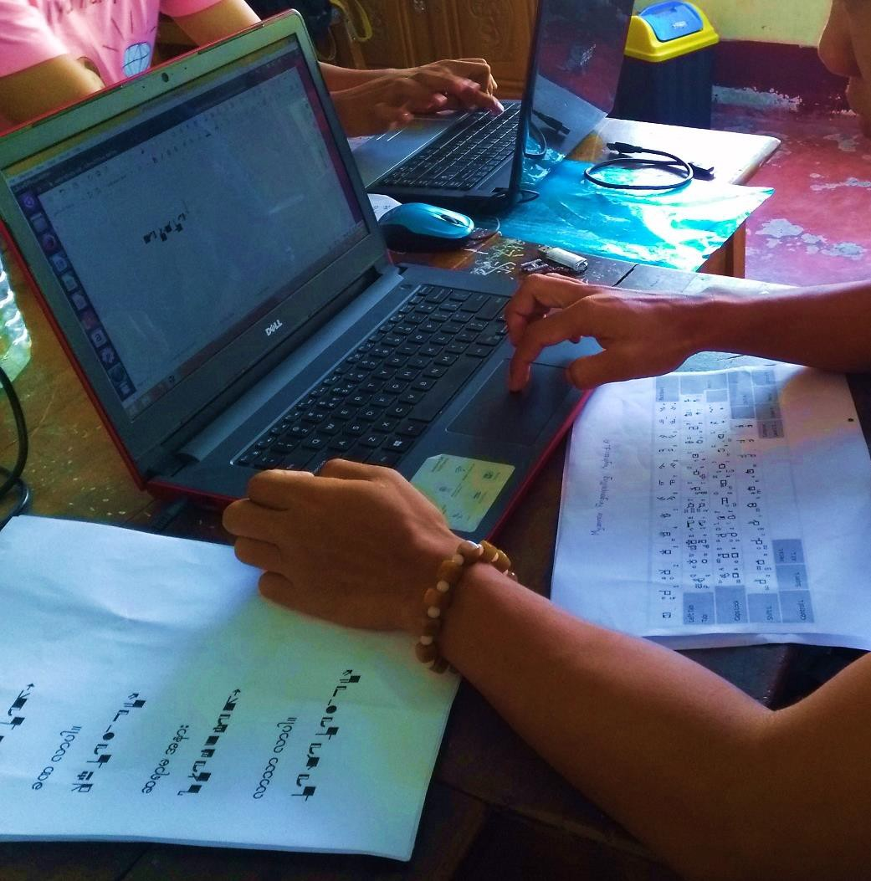
Methodology (Cont‟d)
The printouts of
the two keyboard
layouts and three SignWriting poems (parallel sentences with Myanmar language) was provided.
Figure 4. Experimental Environment with
hearing-impaired users

Slide 33




Methodology (Cont‟d)
Three poems from Myanmar language Primary School textbook were selected for
user study.
They cover most combination patterns of vowels and medials with a consonant.
One of three poems is as follows:
  စာရသလား
  ခဏလာပါ။
  ဆရာမအနား
  လာ သာ လာပါ။

Slide 34
Procedures of User Experiment
About SignWriting and two keyboard layout mapping concepts are introduced to
all participants.
How to type Myanmar SignWriting characters for all Myanmar consonants (characters Ka to A) are demonstrated.
All Myanmar consonants (characters Ka to A) are allowed to practice typing for two times to get some level of understanding on two keyboard layouts.
Typing speed of all participants for each poem for 10 times are recorded.
Participants are made discussion and their feedbacks, suggestions and comments are collected.

Slide 35
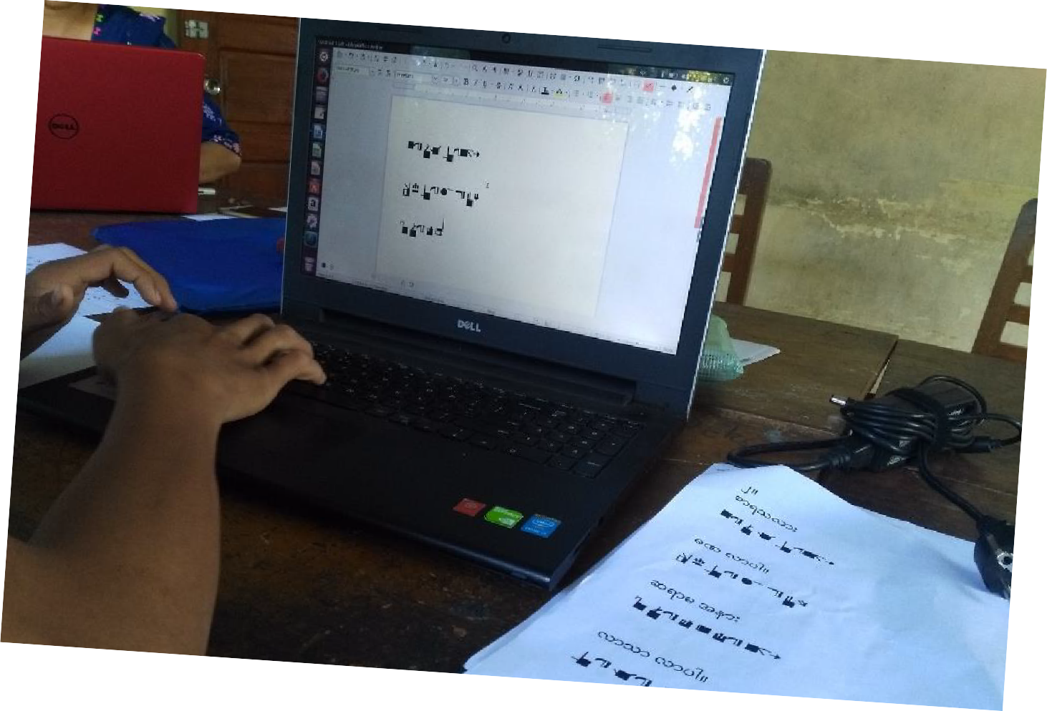
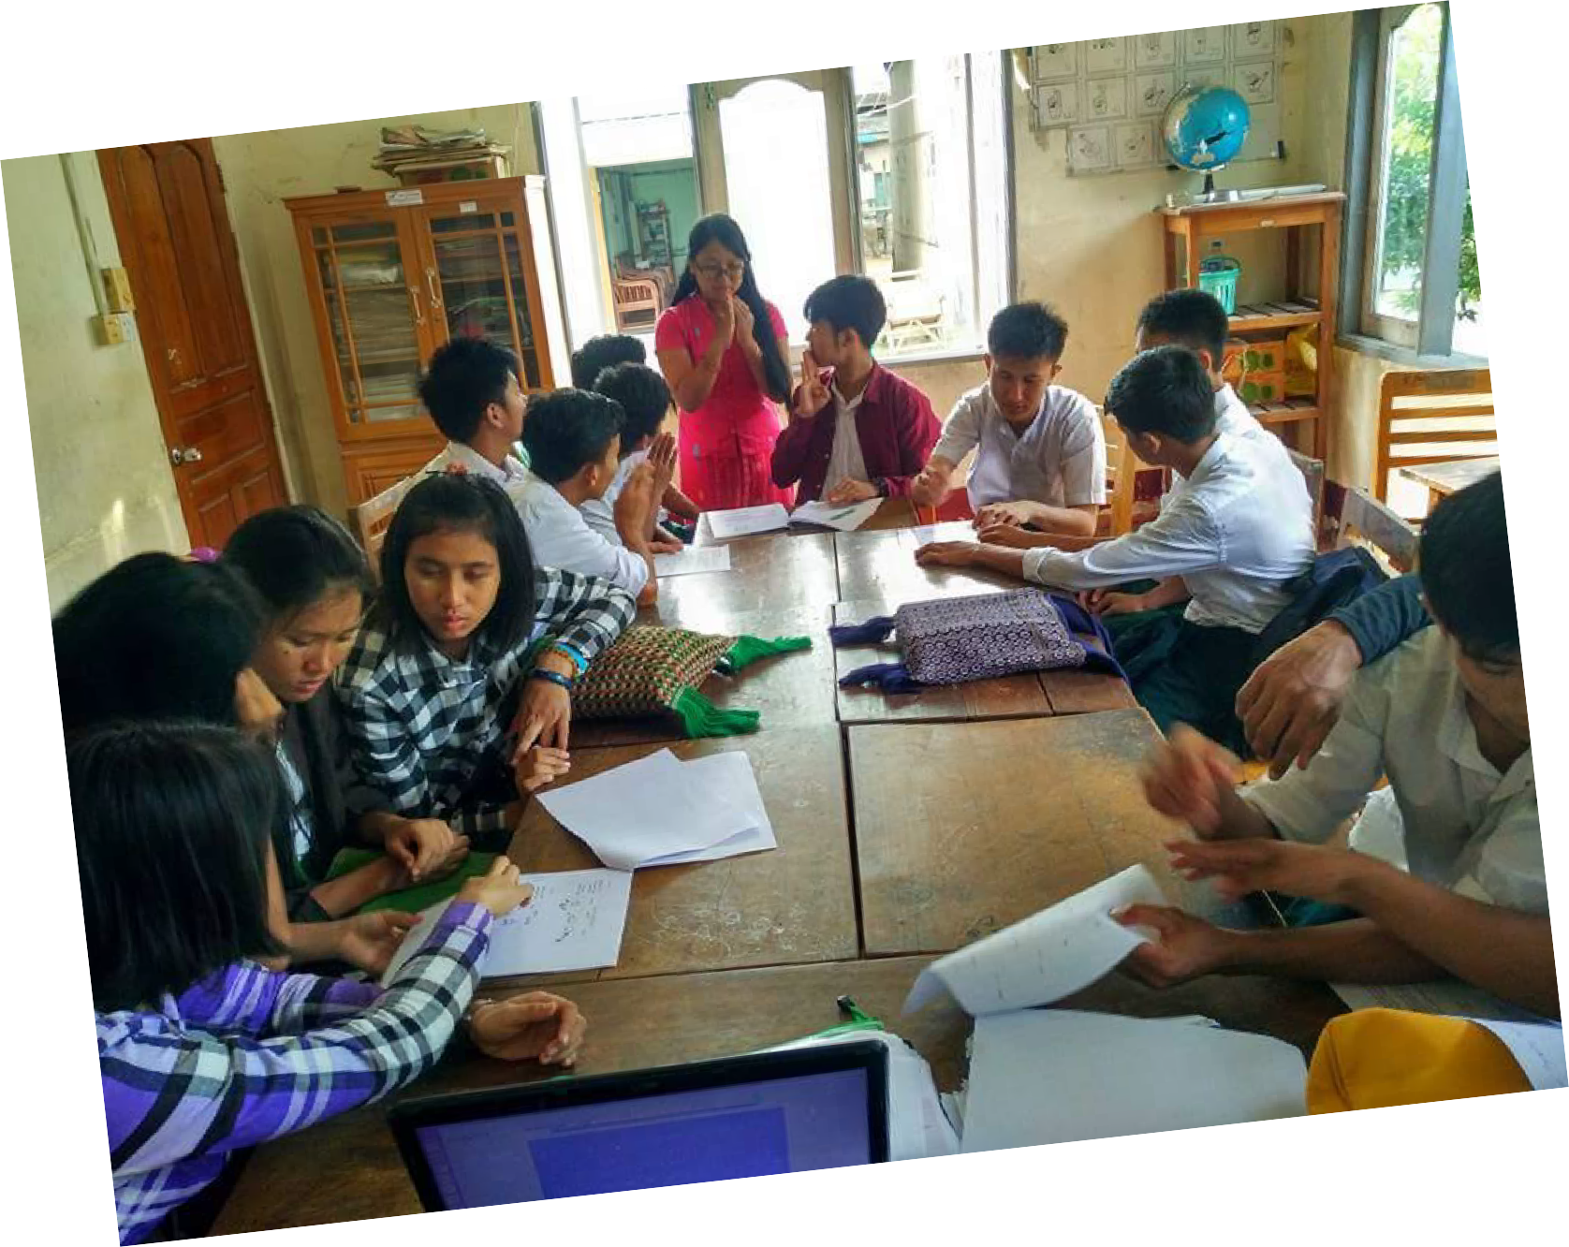
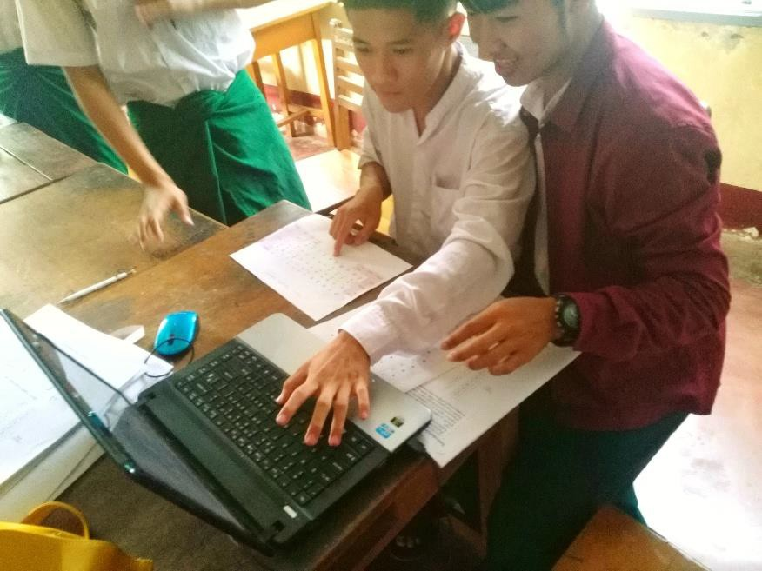
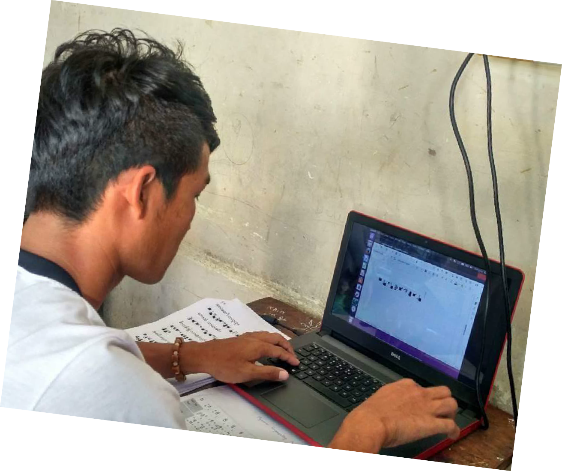
Procedures of User Experiment (Cont‟d)
Figure 5. Experimental Environment with hearing-impaired users
35

Slide 36
Typing Speed Evaluation
To measure the typing speed of participants, Character per Minute (CPM) is
used.
The formula of CPM is as follows:
𝐶𝑃𝑀 = ^{|T|−1} × 60
S
where,
|T| = length of string
T may contain SignWriting Symbols
S = seconds spent from the entry of the first character to the last

Slide 37
CPM Evaluation Results of Hearing-impaired Users
16.3
Character per minute
13.
12.6
11.5
10.9
10.7
9.8
8.3
9.1
6.5
3.3
0.
Poem1
Phonetic-based keyboard layout for MSW
Poem2 Poem3
Symbol-based keyboard layout for MSW
Figure 6. Average CPM of hearing-impaired participants‟ typing for
three poems with both two fingerspelling keyboard layouts for MSW

Slide 38
CPM Evaluation Results of Hearing Users
33.8
Character per minute
27.
26.5
24.1
23.5
21.5
20.3
18.9
16.9
13.5
6.8
0.
Poem1 Poem2 Poem3
Phonetic-based keyboard layout for MSW Symbol-based keyboard layout for MSW
Figure 7. Average CPM of hearing participants‟ typing for three poems
with both two fingerspelling keyboard layouts for MSW

Slide 39
Comparison of CPM Values of Two Users
25.
Character per minute
20.6
20.
18.5
18.5
16.9
15.
14.5
13.6
10.
5.
0.
Poem1 Poem2 Poem3 Phonetic-based keyboard layout for MSW Symbol-based keyboard layout
Figure 8. Average CPM typing speed of two types of participants: hearing-impaired and hearing participants for three poems with both two fingerspelling keyboard layouts

Slide 40
Likert Scale Evaluation
Questionnaires were taken to the participants in order to get their comments and
suggestions on that keyboard layout.
The questions are:
  Do you have any experience of using personal computer?
  Are you familiar with one of the existing Myanmar PC keyboard layout?
  Can be skillfully used QWERTY keyboard layout?
  Which keyboard layout is the best suitable to use in real time?
  Do you have any comments or suggestions?

Slide 41
Likert Scale Evaluation (Cont‟d)
Four Likert scales (1 to 5) are made to rate the user-friendliness of two fingerspelling keyboard layouts for Myanmar Sign Writing.
The scales are:
  Difficult-easy
  Slow-fast
  Dislike-like
  Impossible-possible
Likert scales value 1 is the most negative, 3 is neutral and 5 is the most positive.

Slide 42
Likert Scale Evaluations Results
The average or arithmetic mean results of Likert scale questions to hearing- impaired users and hearing users can be seen as follows:
Likert scales | Phonetic-based keyboard layout for MSW | Symbol-based keyboard layout for MSW
Difficult-Easy | 4.3 | 4.1
Slow-Fast | 4.3 | 3.9
Dislike-Like | 4.5 | 4.3
Impossible- Possible | 4.4 | 4
Likert scales | Phonetic-based keyboard layout for MSW | Symbol-based keyboard layout for MSW
Difficult-Easy | 4.5 | 3.7
Slow-Fast | 4.1 | 4.1
Dislike-Like | 4.4 | 4.5
Impossible- Possible | 4.8 | 4.6
Table 3. Evaluation by hearing-impaired users
Table 4. Evaluation by hearing users
42

Slide 43
Comparison of Likert scale Evaluation Results
4.6
4.5
4.4
4.3
4.2
4.1
4
3.9
4.5
Likert scale value
4.4
 |  |  |  |  |  | 4.2
 |  | 4.1
Hearing-impaired users
Hearing users
Phonetic-based keyboard layout for MSW Symbol-based keyboard layout for MSW
Figure 9. Comparison of Likert scale evaluation results for both two fingerspelling keyboard layouts for MSW
43

Slide 44
Discussion
Experiment was made with 8 hearing-impaired users and 11 hearing users.
Hearing users achieved maximum typing speed 26.5 CPM with phonetic-based keyboard and 23.5 CPM with symbol-based keyboard.
Hearing-impaired users achieved 12.6 CPM with phonetic-based keyboard and 11.5 CPM with symbol-based keyboard.
The results of two users are very different because of hearing-impaired users are not familiar with computer keyboard but the results of two keyboard layouts are not significantly different.

Slide 45
Discussion (Cont‟d)
From the evaluations in terms of both CPM and Likert scale, both of the keyboard layouts are applicable for typing Myanmar fingerspelling SignWriting.
Based on users‟ comments, suggestions and Likert scale values, phonetic-based keyboard layout is more flexible to use for both users.
.

Slide 46
Conclusion
This research introduced the first study of Myanmar SignWriting and the Myanmar SignWriting text input interface system of Myanmar sign language for Myanmar deaf society.
Reading and writing Myanmar sign languages with SignWriting are effective in Deaf Education and communicating with each other.
In our paper, two fingerspelling keyboard layouts for Myanmar SignWriting:
phonetic-based and symbol-based keyboard layouts have been proposed.

Slide 47
Conclusion (Cont‟d)
Among two fingerspelling keyboard layouts, the phonetic-based keyboard layout is more flexible to use for both hearing-impaired users and hearing users based on the results of experiments.
Two-fingerspelling keyboard layouts were shared with the public via GitHub, and can be downloaded and used on your Ubuntu desktop computer. (https://github.com/ye-kyawthu/MyanmarSignWriting-Fingerspelling-Keyboards)
The future work is the implementation of SignWriting Text Input Interface for Myanmar Deaf people to write Myanmar sign language.

Slide 48
Reference
“Myanmar Sign Language Dictionary (Vol:1)”, Mandalay School for the Deaf, 2007
“Text book of Speaking and Myanmar Sign Communication”, Mary Chapman School for the Deaf, 1988
“Text book of Primary Myanmar”, Mandalay School for the Deaf
MacKenzie, I. S. and Aleks Oniszczak, “A Comparison of Two Input Methods for Keypads on
Mobile Devices”
Valerie Sutton and Adam Frost: Manual book about SignWriting Hand Symbols in the International SignWriting Alphabet 2010
Ye Kyaw Thu†, Sai Aung Win Maung‡ and Yoshiyori Urano†: Direct Keyboard Mapping (DKM) Layout
for Myanmar Fingerspelling Text Input
Sutton SignWriting, Unicode Standard, 10.0
https://en.wikipedia.org/wiki/SignWriting
https://en.wikipedia.org/wiki/SignLanguage
https://github.com/ye-kyaw-thu/kKg-Myanmar-keyboard/

Slide 49
List of Publications
Swe Zin Moe, Hlaing Myat Nwe, Hnin Wai Wai Hlaing, Ye Kyaw Thu, Hnin Aye Thant, Nandar Win Min, “Myanmar Sign
Language (MSL) Corpus for Emergency Domain”, PACLING2017 conference, Yangon, Myanmar. (Demo and Poster)
Swe Zin Moe, Ye Kyaw Thu, Hlaing Myat Nwe, Hnin Wai Wai Hlaing, Ni Htwe Aung, Hnin Aye Thant, Nandar Win Min, “Corpus Building for Machine Translation between Myanmar Sign Language and Myanmar Written Text”, World Deaf Day 2017, 14th Sept. 2017, Mandalay Community Center, Chan Aye Tharzan Township, Mandalay, Myanmar. (Poster)
Swe Zin Moe, Hnin Wai Wai Hlaing, Ye Kyaw Thu, Hlaing Myat Nwe, Ni Htwe Aung, Hnin Aye Thant, Nandar Win Min, “ျမန္မာ လက္သေကၤတျပဘာသာစကားမွ ျမန္မာစကားေျပာစာေၾကာင္းသို႕ ကြန္ပ်ဴတာသံုး ဘာသာျပန္ သုေတသန”, International Day of Persons with Disabilities 2017, 3rd Dec. 2017, Wilson Hotel, No.31(E), Yangon-Mandalay Main Road, Maha Aung Myay Township, Mandalay, Myanmar. (Demo and Poster)
Hlaing Myat Nwe, Ye Kyaw Thu, Hnin Wai Wai Hlaing, Swe Zin Moe, Ni Htwe Aung, Hnin Aye Thant, Nandar Win Min, "Two Fingerspelling Keyboard layouts for Myanmar SignWriting", International Day of Persons with Disabilities 2017, 3rd Dec. 2017, Wilson Hotel, No.31(E), Yangon-Mandalay Main Road, Maha Aung Myay Township, Mandalay, Myanmar. (Demo and Poster)

Slide 50
List of Publications
Hlaing Myat Nwe, Ye Kyaw Thu, Hnin Wai Wai Hlaing, Swe Zin Moe, Ni Htwe Aung, Hnin Aye Thant, Nanda Win Min,
"Two Fingerspelling Keyboard Layouts for Myanmar SignWriting", In Proceedings of ICCA2018, February 22-23, 2018,
Yangon, Myanmar, pp. 290-298. (Paper)
Swe Zin Moe, Ye Kyaw Thu, Hnin Wai Wai Hlaing, Hlaing Myat Nwe, Ni Htwe Aung, Hnin Aye Thant, Nandar Win Min, "Statistical Machine Translation between Myanmar Sign Language and Myanmar Written Text", In Proceedings of ICCA2018, February 22-23, 2018, Yangon, Myanmar, pp. 217-227. (Paper)
Hnin Wai Wai Hlaing, Ye Kyaw Thu, Swe Zin Moe, Hlaing Myat Nwe, Ni Htwe Aung, Nandar Win Min, Hnin Aye Thant, “Statistical Machine Translation between Myanmar Sign Language and Myanmar SignWriting”, at the First International Symposium on Artificial Intelligence for ASEAN Development, ASEAN-AI2018, Phuket, Thailand, 26th March 2018. (Paper)

Slide 51
Contact
Hlaing Myat Nwe
  University of Technology (Yatanarpon Cyber City), Pyin Oo Lwin, Myanmar
  hlaingmyatnwe.nwe@gmail.com
Ye Kyaw Thu
  Language and Speech Science Research Lab., Waseda University, Japan
  wasedakuma@gmail.com

