Slide 1
SignWriting in
an ASCII World!
XX
XXX
XXX
XXX
XXX
XXX
XXX
XXX
XXX
XX XXX
XXX XXX
XXX XXX
XXX XXXXX
XXX XXXXXXX
XXX XXXXXXXXX
XXX XXXXXXXXXXX
XXX XXXXXXXXXXXXX
XXX XXX XXXXXXXXXX
XXX XXX XXXXXXXXXX
XXX XXX XXXXXXXXXX
XXX XXX XXXXXXXXX
XXXXX XXX XXXXXXX
XXXXXXX XXX XXXXX
XXXXXXXXX XXX XXX
XXXXXXXXXXX XXX XXX
XXXXXXXXXXXXX XXX XXX
XXXXXXXXXX XXX XXX XXX
XXXXXXXXXX XXX XXXXXX
XXXXXXXXXX XXX XXXX
XXXXXXXXX XXX XX
XXXXXXX XXX
XXXXX XXX
XXX XXX
XXX XXX
XXX XXX
XXX XXX
XXXXXX XXXXX
XXXX XXXXXXX
XX X XXXXX
XX XXXXX
X XXXX
XX XXXX
XX
XX XXXXXXXXXXX
XXXX XX XXXXXXXXX
XXXXXX XX XXXXXXX
XXXX XX XX XXXXX
XXX XX XX XXX
XXXX XX XX X
XXX XX XXXXXXXXXXX
XXX X XX XXXXXXXXX
XXX XXX XX XXXXXXX
XXX XX XX XX XXXXX
XXX XX XX XX XXX
XXX XX XX XX X
XXX XXXXXXXXXXX X
XXX X XX XXXX
XXX XXX X XXXX
XXX XX XX XX XXXX
XXX XX XX XXXXXX
XXX XX XX XXXX
XXX XXXXXXXXXXX
XXX
XXX XX
XXXX XX
XXX XX
XXXX XX
XXXXXX
XXXX
XXXXXXXXXXXXXXXXXXXXXX
XXXXXXXXXXXXXXXXXXXXXXX
XX XXX
XX XXX
XX XXX
XX XXX
XX XXX
XX XXX
XX XXX
XX XXX
XXXXXXXXXXXXXXXXXXXXXXX
XXXXXXXXXXXXXXXXXXXXXX
XXXXX
XXXXXXX
XXX XXX
XXX XX
XX XXXXXXXXXXXXXXX
XX XXXXXXXXXXXXXXX
XXX XXXXXXXXXXXXXXXX
XXX XXXXXXXXXXXXXXXXX
XXXXXXXXXXXXXXXXXXXXXX
XXXXX XXXXXXXXXXXXXXX
XXXXXXXXXXXXXXX
XXXXXXXXXXXXXXX
XX XX XXXXXXXXXXXXXXX
XX XX XXXXXXXXXXXXXXX
XX XX XXXXXXXXXXXXXXX
XX XX XXXXXXXXXXXXXXX
XX XX XXXXXXXXXXXXXXX
XX XX XXXXXXXXXXXXXXX
XX XX XXXXXXXXXXXXXXX
XX XX
XX XX
XX XX
XX XXX
XX XXXXXXXXXXXXXX
XX XXXXXXXXXXXXXX
XX XXX
XXX XXX
XXX XX
XXXXXXXXXXXXXX XX
XXXXXXXXXXXXXX XX
XXX XX
XX XX
XX XX
XX XX
XX XX
XX XX
XX XX
XX XX
XX XX
XXXXXXXXXXXXXXXX
XXXXXXXXXXXXXX
XXXXXXXXXXXX
XXXXXXXXXX
XXXXXXXX
XXXXXX
XXXX
XX
,,,,,,
o#'9MMHb':'-,o,
.oH":HH$' "' ' -*R&o,
dMMM*""'`' .oM"HM?.
,MMM' "HLbd< ?&H\
.:MH ."\ ` MM MM&b
. "*H - &MMMMMMMMMH:
. dboo MMMMMMMMMMMM.
. dMMMMMMb *MMMMMMMMMP.
. MMMMMMMP *MMMMMP .
`#MMMMM MM6P ,
' `MMMP" HM*`,
' :MM .- ,
'. `#?.. . ..'
-. . .-
''-.oo,oo.-''
by Stephen E Slevinski Jr

Slide 2
It’s an ASCII World!
Starting Point
  ASCII
  Regular Expressions
  Token Patterns
  Hexadecimal
Definition
  Symbol Keys
  Numbers
  Formal SignWriting
  Query Strings

Slide 3
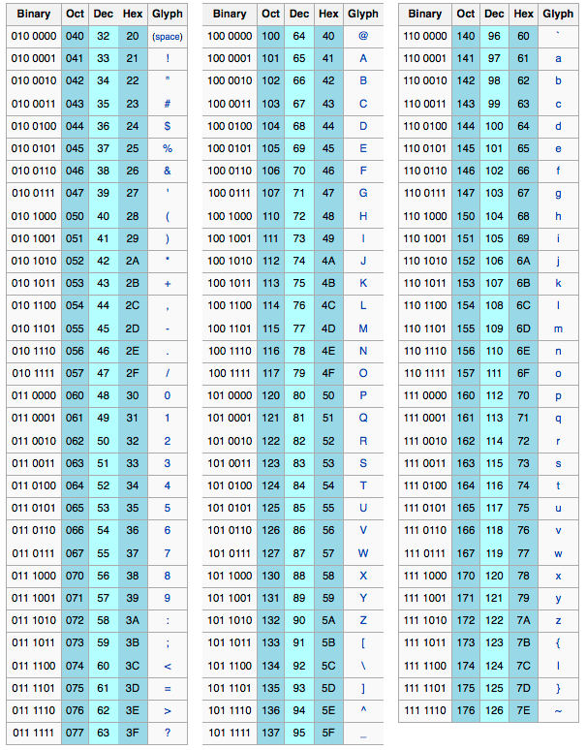
Starting Point
ASCII
American Standard Code for Information Interchange.
ASCII is the basis for text processing and standard definition.
Unicode is ASCII plus
additional characters.
ASCII is UTF-8,
character for character.
ASCII will outlive Unicode.
https://en.wikipedia.org/wiki/ASCII/

Slide 4
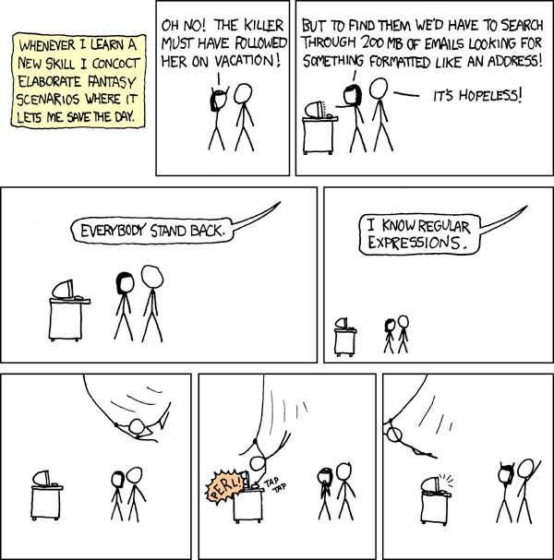
Starting Point
Regex
A regular expression is used to examine text and identify strings that match a stated pattern.
It is faster to recognize a string with regular expressions then to analyze a string with a routine.
https://xkcd.com/208/
https://xkcd.com/208/

Slide 5
Starting Point
Regex
Character
Description
Example
*
Match a character
0 or more times
ABC* matches
AB, ABC, ABCC, ...
+
Match a character
1 or more times
ABC+ matches
ABC, ABCC, ABCCC, …
?
Match a character
0 or 1 times
ABC? matches
AB or ABC
{#}
Match a character
explicit number times
AB{2} matches
ABB
Test Regex Online
https://regex101.com/

Slide 6
Starting Point
Regex
Character
Description
Example
[ ]
Match any character
from a list
[ABC] matches
A, B, or C
[ - ]
Match any character
in a range
[A-C] matches
A, B, or C
( )
Create a group
for matching
A(BC)+ matches
ABC, ABCBC, ABCBCBC, …
( | )
Match one of
several alternatives
(AB|BC|CD) matches
AB, BC, or CD
Test Regex Online
https://regex101.com/

Slide 7
Starting Point
Regex
Find a number between 122 and 455
Regex
Matches
Step 1) 10's don't match and the min 1's are not zero ( last number to 9)
12[2-9]
122 to 129
Step 2) Bring up the 10's if hundreds are different
1[3-9][0-9]
130 to 199
Step 3) Bring up the 100's if different
[2-3][0-9][0-9]
200 to 399
Step 4) Bring up the 10's
4[0-4][0-9]
400 to 449
Step 5) Bring up the 1's
45[0-5]
450 to 455
Final Regex
(12[1-9]|1[3-9][0-9]|[2-3][0-9][0-9]|4[0-4][0-9]|45[0-5])
Test Regex Online
https://regex101.com/

Slide 8
Starting Point
Token Patterns
A
B
L
M
R
Structural Markers
w
s
P
Symbol Bases
i
o
Symbol Modifiers
n
Numbers

Slide 9
Starting Point
Token Patterns
A
Sequence Marker
Writing Symbol
B
SignBox Marker
L
Left Lane Marker
w
i
o
M
Middle Lane Marker
R
Right Lane Marker
w
Writing Base Symbol
s
Sequence Base Symbol
P
Punctuation Base Symbol
Cartesian
Coordinate
i
Fill Modifier
o
Rotation Modifier
n
n
n
Number

Slide 10
Starting Point
Hexadecimal
Character
Value
String
Value
x0
x1
x2
x3
x4
x5
x6
x7
x8
x9
xA
xB
xC
xD
xE
xF
0
1
2
3
4
5
6
7
8
9
10
11
12
13
14
15
Decimal Value
x00
x10
x20
x30
x40
x50
x60
x70
x80
x90
xA0
xB0
xC0
xD0
xE0
xFF
0
16
32
48
64
80
96
112
128
144
160
176
192
208
244
255
Standard numbers that we use are base 10, using only the 0 thru 9.
Hexadecimal
Prefixed with an ‘x’,
hexadecimal characters and strings are base 16, using 0 thru 9 and A thru F.

Slide 11
Definition
Symbol Key
Symbol keys are used to identify each of the 37,811 symbols of the ISWA 2010.
Writing symbol
w
i
o
Sequence symbol
Symbols keys are built using three tokens.
s
i
o
Symbol Base of “w”, “s”, or “P”
Fill Modifier of “i”
Rotation Modifier of “o”
Punctuation symbol
P
i
o
https://tools.ietf.org/html/draft-slevinski-signwriting-text-05#section-2.1

Slide 12
Definition
Symbol Key
Symbol keys are 6 characters long.
S1005f
S
100
5
f
Symbol Starter
Base
Fill Modifier
Rotation Modifier
Regex
S[123][0-9a-f]{2}[0-5][0-9a-f]
http://signbank.org/SignWriting_Character_Viewer.html#?set=key

Slide 13
Definition
Numbers
The number characters encode the ruler principle for 2-dimensions.
Cartesian Coordinate
n
n
Numbers range from 250 to 749, with 500 being the center.
250x749
Cartesian Coordinates
are built using two tokens.
250
749
X Coordinate
Y Coordinate
Number of “n”
Number of “n”
(250,749)
Top-Left Coordinate of symbol
https://tools.ietf.org/html/draft-slevinski-signwriting-text-05#section-2.2

Slide 14
Definition
Numbers
Description
Example
Regex
Numbers are 3 characters long.
500
[0-9]{3}
Coordinates are 7 characters long.
500x500
[0-9]{3}x[0-9]{3}
X Coordinate
Y Coordinate
Regex for explicit number between 250 and 749
(2[5-9][0-9]|[3-6][0-9]{2}|7[0-4][0-9])

Slide 15

Definition
Formal SignWriting
According to Wikipedia, "In mathematics, computer science, and linguistics, a formal language is a set of strings of symbols that may be constrained by rules that are specific to it."
Sign as Word
Mathematical ASCII name
Optional time for sorting
Mandatory space for visual
https://tools.ietf.org/html/draft-slevinski-signwriting-text-05#section-2

Slide 16
Definition
Formal SignWriting
Spatial symbol
Used in the
Spatial Signbox
Identifies a specific symbol with coordinate information.
w
i
o
n
n
Spatial symbols are built using five tokens.
Symbol Base of “w”
Fill Modifier of “i”
Rotation Modifier of “o”
Number of “n”
Number of “n”
Regex
S[123][0-9a-f]{2}[0-5][0-9a-f][0-9]{3}x[0-9]{3}
https://tools.ietf.org/html/draft-slevinski-signwriting-text-05#section-2.3

Slide 17
Definition
Formal SignWriting
Spatial SignBox
B
L
M
R
A cluster of symbols used in 2-dimensions
w
i
o
Regex for Token Description
[BLMR]nn(wionn)*
n
Regex for Formal SignWriting
[BLMR]([0-9]{3}x[0-9]{3})(S[123][0-9a-f]{2}[0-5][0-9a-f][0-9]{3}x[0-9]{3})*

Slide 18
Definition
Formal SignWriting
Temporal Prefix
A
An optional ordered list of symbols used for sorting.
w
s
i
o
Regex for Token Description
(A([ws]io)+)?
Regex for Formal SignWriting
(A(S[123][0-9a-f]{2}[0-5][0-9a-f])+)?

Slide 19


Definition
Formal SignWriting
AS18711S20500M514x517S18711490x483S20500486x506
Time
Space
AS18711S20500
M514x517S18711490x483S20500486x506
A
S18711
S20500
M514x517
S18711490x483
S20500486x506
M
514x517
S18711
490x483
S20500
486x506
Sequence
Marker
(514,517)
(490,483)
(486,506)
Symbol
Middle Lane
SignBox
Max
Coord
Spatial
Symbol

Slide 20
Definition
Query String
The query string is a lite ASCII markup similar to Formal SignWriting.
Query String for all signs
Q
Query strings are used to search Formal SignWriting.
Formal SignWriting can be converted into several different query string, depending on the search parameters.
Query String for
sortable signs
QT
https://tools.ietf.org/html/draft-slevinski-signwriting-text-05#section-3

Slide 21
Definition
Query String
Q
Query Strings
15 to 50 times expansion
(A(S[123][0-9a-f]{2}[0-5][0-9a-f])+)?[BLMR]([0-9]{3}x[0-9]{3})(S[123][0-9a-f]{2}[0-5][0-9a-f][0-9]{3}x[0-9]{3})*
Regular Expressions
process million of characters per second
Formal SignWriting
search results

Slide 22
Definition
Query String
The query string is a concise representation for a much larger and detailed set of regular expressions.
When a query string returns more than one regular expression, a filter and repeat step is required.
QS10000S20500
(A(S[123][0-9a-f]{2}[0-5][0-9a-f])+)?[BLMR]([0-9]{3}x[0-9]{3})(S[123][0-9a-f]{2}[0-5][0-9a-f][0-9]{3}x[0-9]{3})*S10000[0-9]{3}x[0-9]{3}(S[123][0-9a-f]{2}[0-5][0-9a-f][0-9]{3}x[0-9]{3})*
(A(S[123][0-9a-f]{2}[0-5][0-9a-f])+)?[BLMR]([0-9]{3}x[0-9]{3})(S[123][0-9a-f]{2}[0-5][0-9a-f][0-9]{3}x[0-9]{3})*S20500[0-9]{3}x[0-9]{3}(S[123][0-9a-f]{2}[0-5][0-9a-f][0-9]{3}x[0-9]{3})*

Slide 23
Definition
Query String
Two main sections of a query string
Temporal Sequence
Searching
Spatial SignBox
Searching
1-Dimensional order
2-Dimensional order
Both sections use the same definition for a symbol or a range.
Search Symbol
S[123][0-9a-f]{2}[0-5u][0-9a-fu]
Search Range
R[123][0-9a-f]{2}t[123][0-9a-f]{2}

Slide 24
Definition
Query String
Temporal Sequence Searching
}
}
It is possible to specify the start order of the temporal sequence by identifying a series of symbols and/or ranges.
Q((A(S[123][0-9a-f]{2}[0-5u][0-9a-fu]|R[123][0-9a-f]{2}t[123][0-9a-f]{2})+)?T)?
Symbol Search
Range
Search
Fill and Rotation values of ‘u’ represent unknown and allow all possible values.
Finds all symbols between two specified symbol bases
w
i
o
s
i
o
w
w
w
s
s
s

Slide 25
Definition
Query String
Spatial SignBox Searching
Allowable distance from
specified coordinates
It is possible to specify one or more symbols (or ranges of symbols) that must be included in the spatial SignBox with optional coordinates for each symbol or range.
Optional
Variance
}
}
}
}
}
Q(S[123][0-9a-f]{2}[0-5u][0-9a-fu]([0-9]{3}x[0-9]{3})?|R[123][0-9a-f]{2}t[123][0-9a-f]{2}([0-9]{3}x[0-9]{3})?)*(V[0-9]+)?
Symbol Search
Range
Search
n
n
n
n
Fill and Rotation values of ‘u’ represent unknown and allow all possible values.
Finds all symbols between two specified symbol bases
Optional
Coordinates
Optional
Coordinates
w
i
o
Specified coordinates will limit the search results for the previous symbol.
w
w
Specified coordinates will limit the search results for the previous range.

Slide 26


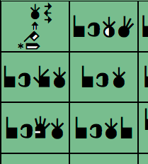
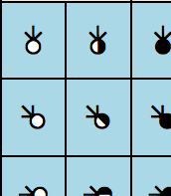
Examples
Query String
SVG and PNG
Query
Description
Results
QS18711
Finds signs that use an exact symbol in the SignBox
QS187uu
Finds signs that use a general base symbol in the SignBox with any fill or rotation.

Slide 27

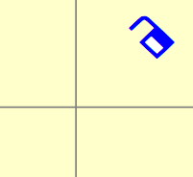
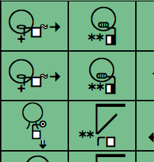
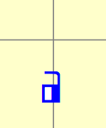
Examples
Query String
SVG and PNG
Query
Description
Results
QS10a11532x445
Finds signs that use an exact symbol near a specific coordinate in the sign box
QS10auu491x526
Finds signs that use a general base symbol near a specific coordinate in the SignBox with any fill or rotation.

Slide 28


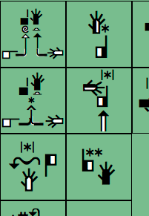
Examples
Query String
SVG and PNG
Query
Description
Results
QAS14c12S10018T
Finds signs with a temporal sequence that starts with specified symbols
QAS14cuuS100uuT
Finds signs with a temporal sequence that starts with the ordered base symbols and any fills or rotations

Slide 29
Examples
Query String
For mixed searching, the Temporal Sequence searching is defined first.
QAS100uuS100uuTS20500470x470
Temporal Sequence
Searching
Spatial SignBox
Searching
Temporal Sequence starts with any two index hand shapes
Contact star is used near coordinate (470,470)

