Slide 1
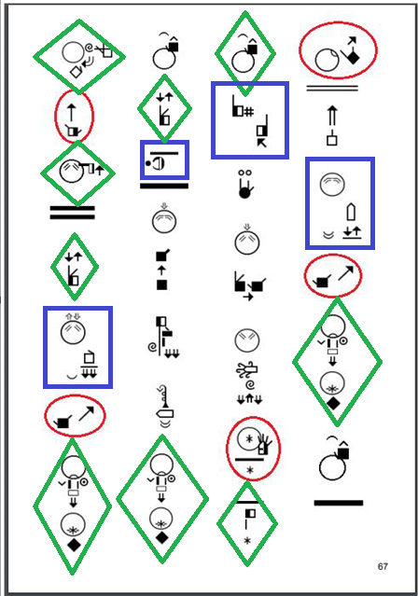
Linguistic Studies on Brazilian Sign Language (Libras) SignWriting: analysis based on the book “oral health”
Prof. Débora Campos Wanderley, PhD

Slide 2
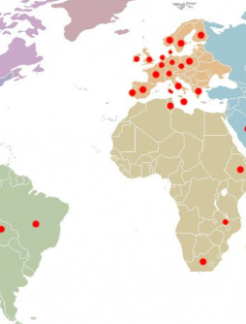
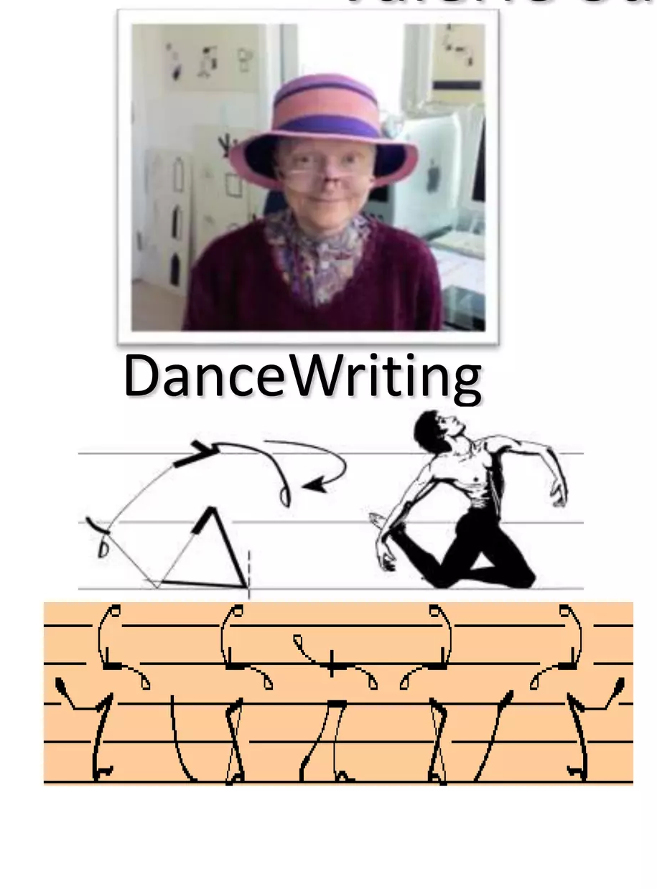
Valerie Sutton
1975
Brazil – 1996
Linguistic and Education - 2005
Grammar in SignWriting - 2017

Slide 3
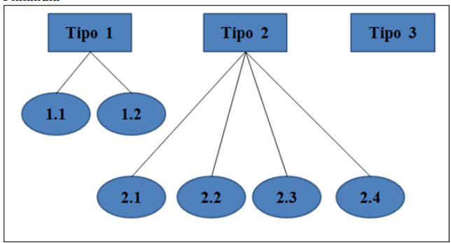
Haapanen e Wainio (2010, p.86)
Morphology in Sign Languages (Padden 1990)
Type 2 verbs - subcategories:
Type 2.1 one-handed
Type 2.2 twohanded
Type 2.3 reverse
Type 2.4 Hand orientation.

Slide 4
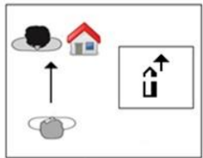
Why research in SignWriting?
Verb - Grammar
Type 2.1: one-handed *modified verbs

Slide 5
Why research in SignWriting?
Verb - Grammar
Type 2.1: one-handed *modified verbs

Slide 6
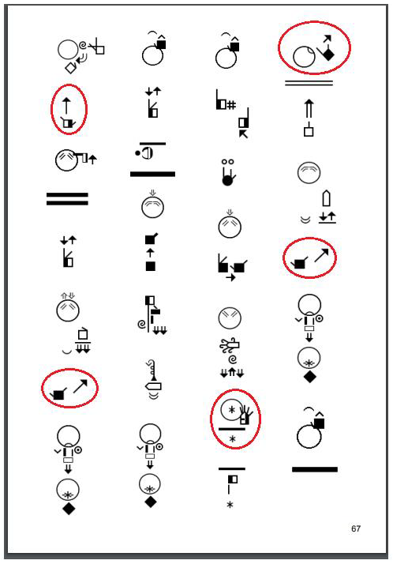
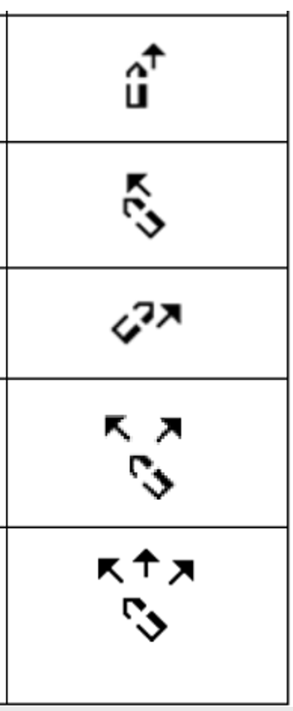


Slide 7
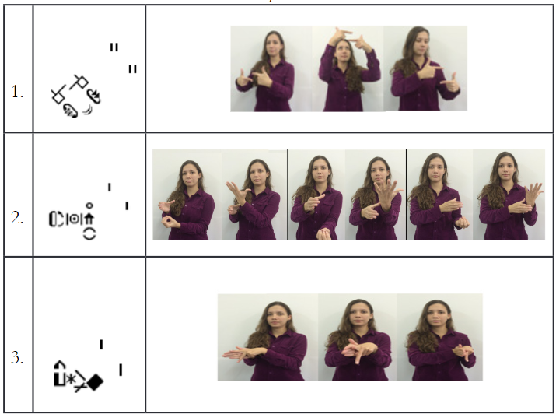
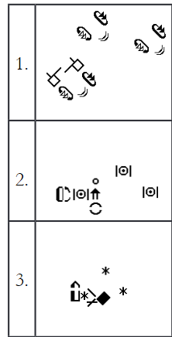
PLURAL MARKING morphemic
BATTISON (1978)
Libras
AFTER
BEFORE
English
Portuguese
boy – boys
day – days
menino – meninos
dia– dias

Slide 8
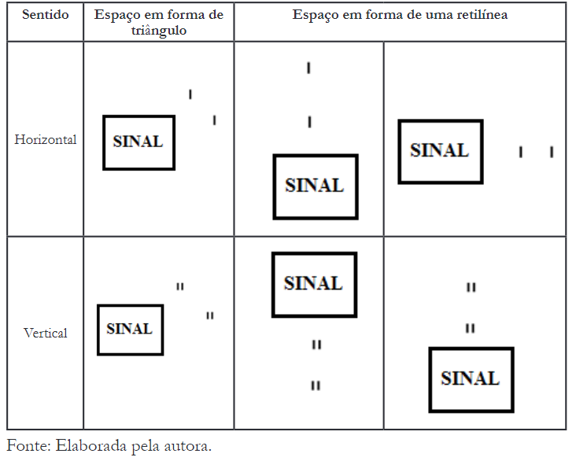



Slide 9
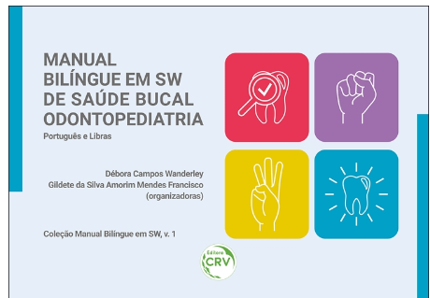
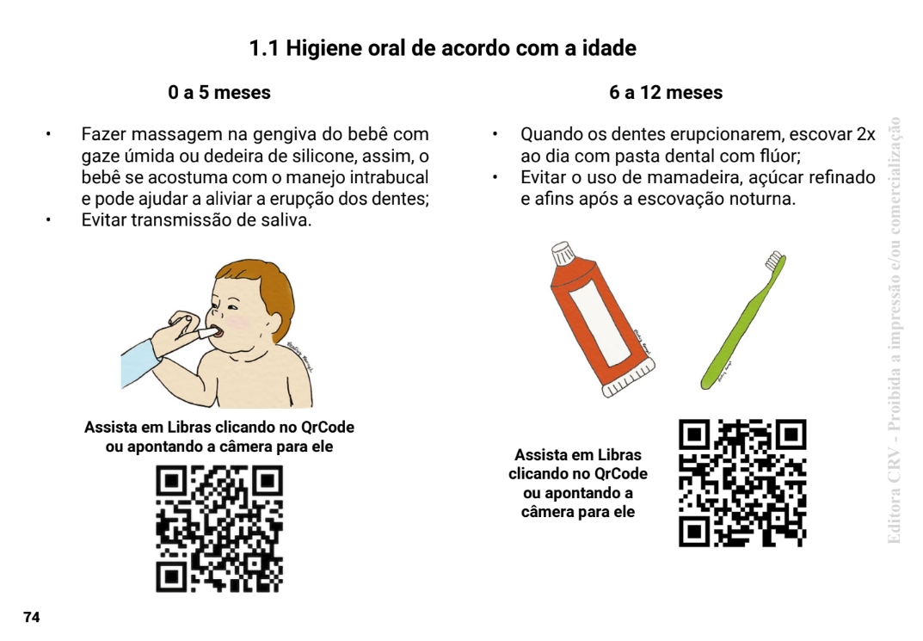
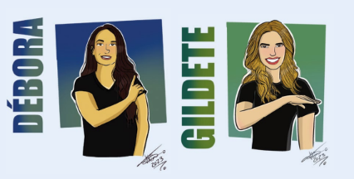
Book “oral health”
https://www.editoracrv.com.br/produtos/detalhes/38109-crv
https://www.editoracrv.com.br/produtos/detalhes/38109-crv
Link:
https://www.editoracrv.com.br/produtos/detalhes/38109-crv

Slide 10


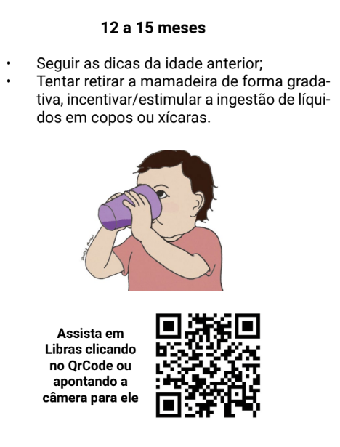
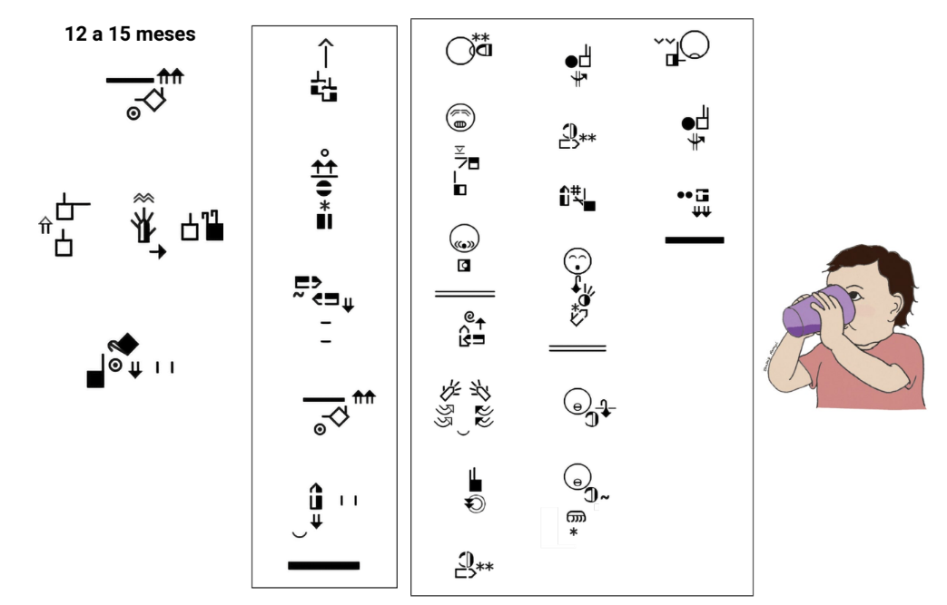


Slide 11
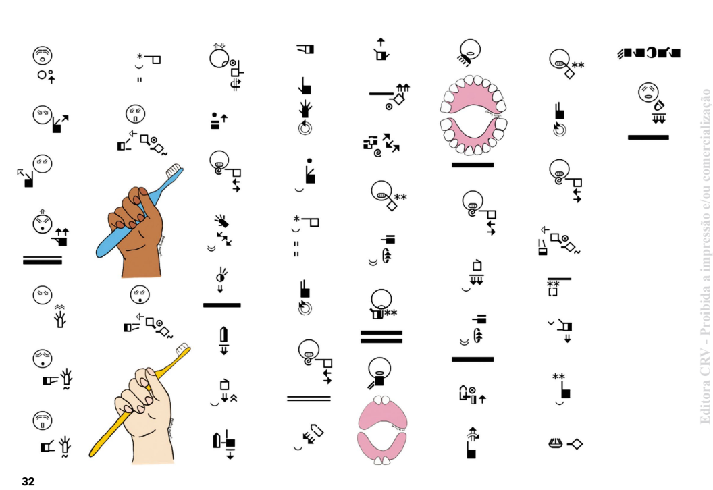
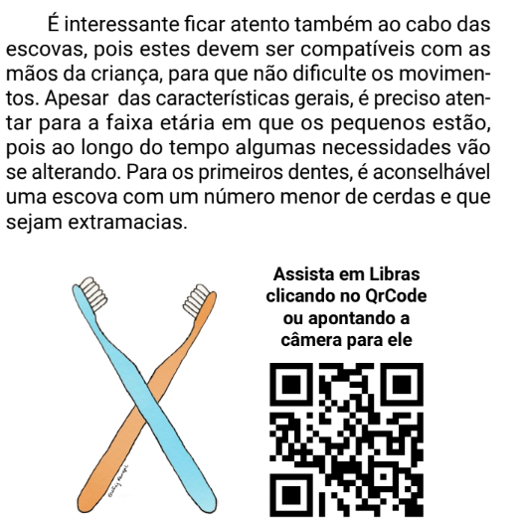

Slide 12
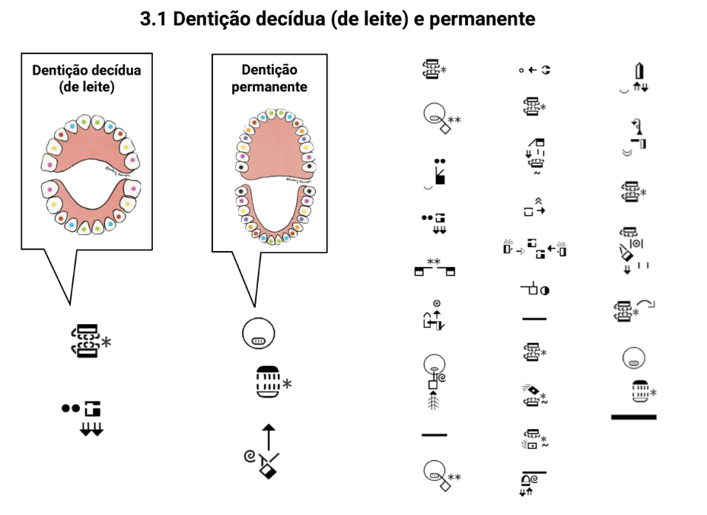
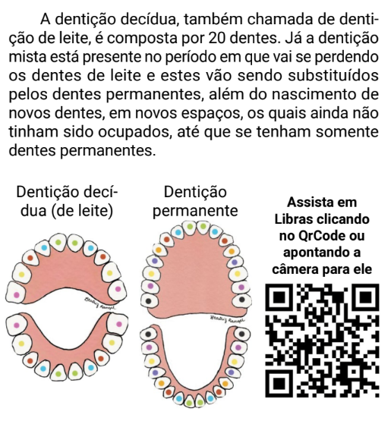

Slide 13
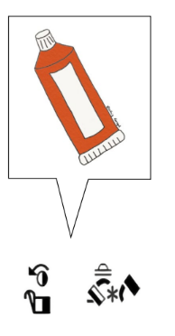
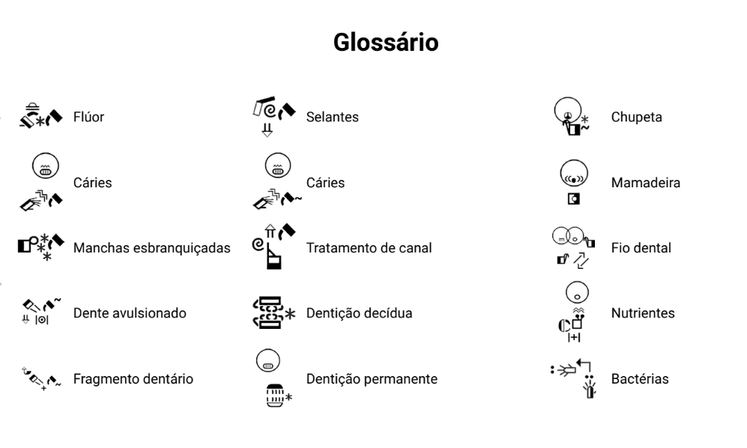
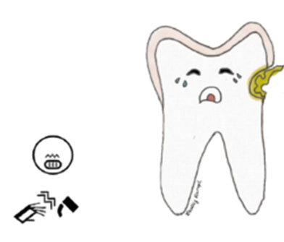
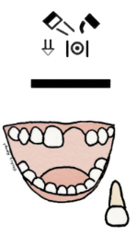
GLOSSARY

Slide 14
CONCLUSION
The results of the analysis of the signwriting corpus, equal to modified verbs – subcategories (Type 2.1 one-handed ;Type 2.2 twohanded; Type 2.3 reverse and Type 2.4 Hand orientation) in Sign Language - Haapanen e Wainio (2010)
Marking the plural in sign writing becomes valid and clear for morphosyntactic studies, with greater theoretical detail and needs to be analyzed further to improve grammar in books and activities after publication. (WANDERLEY and STUMPF, 2017)
The application of linguistic knowledge can result in more effective pedagogical methods, improving writing and education.

Slide 15
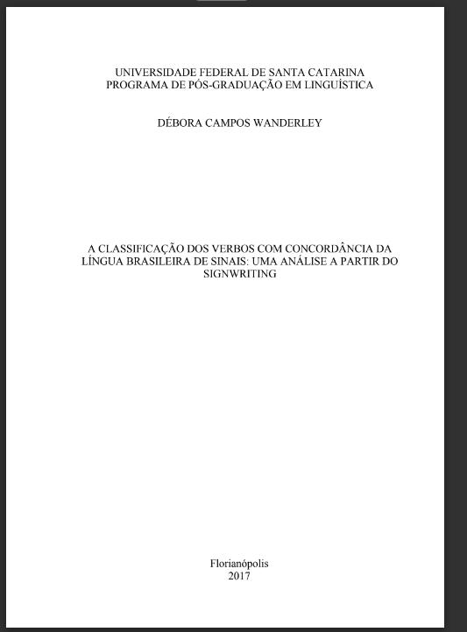
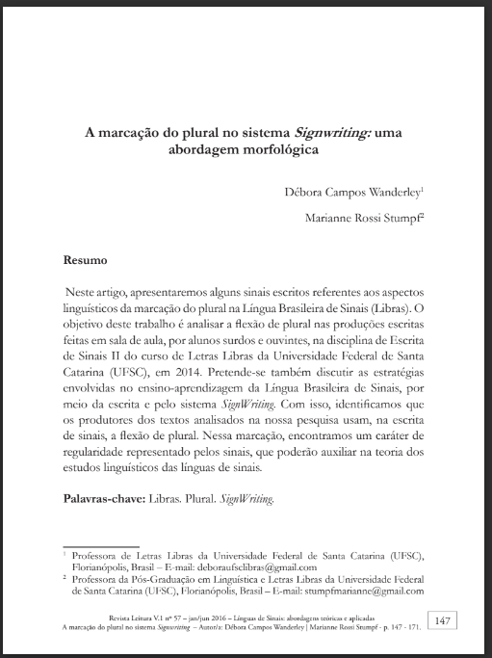

THANKS

