Slide 1
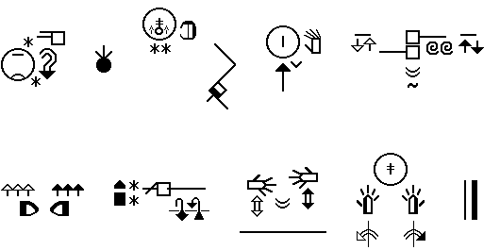
“What three little pigs and a hungry wolf can teach us about sign language grammar.”
By James Shepard-Kegl, Nicaraguan Sign Language Projects, Inc. (2015)

Slide 2
Are signed languages even languages?
Sure, linguists say as much, but ---
Most people don’t really believe that!
Many educators don’t really believe that!
Teachers of Deaf only half believe it: “Sign language is an inferior language – limited lexicon, no real grammatical structure, not especially sophisticated.”
Deaf signers only half believe it, too.

Slide 3
“Anybody from Missouri?”
If you can’t show me why signed languages are at a par with speech driven languages, then maybe you don’t really believe it, either.
Hearing school children are taught metalinguistic skills in elementary school.
Deaf children, interpreters, teachers of Deaf are almost never taught such skills.

Slide 4
Metalinguistic skills
My definition: a highfalutin way of saying someone is aware of how language is constructed
For our purposes: being able to discuss grammatical rules using labels
Hearing fourth graders learn labels for speech driven languages: nouns, verbs, adjectives, adverbs, prepositions, subjects, predicates, objects, tense, conjugations, etc.

Slide 5
Life in the ivory tower
Sign language linguists discuss grammar labels that apply to signed languages: classifiers, clitics, spatial verbs, locative objects
Outside the ivory tower, few people are familiar with these labels.
How come Deaf 4th graders aren’t taught this stuff?

Slide 6
Real languages can be written.
My favorite reason why signed language are not real languages: inherently unwritable.
But, this presentation is not about using SignWriting as an orthographic system.
This presentation is about integrating SignWriting in a course to teach schoolchildren the grammar of their signed language.

Slide 7
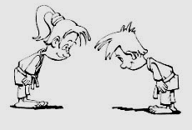

It’s all about RESPECT!
Or, more accurately, self-respect!
The Deaf child/adult has to be convinced that sign languages are bona fide members of the human language club.
Self-respect is empowering.
Empowered individuals demand respect from others.

Slide 8
Research Methodology (1)
Years of videotaping Deaf Nicaraguans with first language ISN fluency.
Presenting drawings and non-verbal cartoons to elicit sentences and narratives.
Simply asking informants to describe personal experiences or to use a particular sign in a sentence.
Transcribing results using SignWriting.

Slide 9

Research Methodology (2)
Analyzing recordings and transcriptions to look for grammatical patterns.
Comparing input from multiple sources to confirm consistent patterns.
Special thanks to Sayda Parrales Rocha from Managua for months of participation as an informant. Sayda is natively fluent in ISN, and had minimal exposure to ASL users.

Slide 10
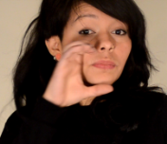
Research Methodology (3)
Special thanks also to Yuri Shepard-Kegl, our narrator for the Three Little Pigs.
Yuri is from Bluefields and ISN is her first language. However, Yuri has lived in the USA for 9 years, and therefore has to code switch between ISN and ASL. For our purposes today, this does not matter.

Slide 11
ISN and ASL
ISN: Idioma de Señas de Nicaragua. This is the preferred acronym chosen by ANSNIC, the Nicaraguan Deaf Association.
Following the end of the Contra War and with the advent of radically improved communications technology, we have noted increased borrowing of ASL lexicon in ISN.
Languages are dynamic. Languages that do not borrow invariably perish.

Slide 12
Are all signed languages similar?
Yes – all human languages are similar, and Deaf signers happen to be human.
Also, signed languages are visually based. Signers are able to exploit signing space and various grammatical strategies to express spatial relationships in a way that speech driven languages cannot.
For example, ISN and ASL use a different set of classifiers. But, a “classifier” is a “classifier” in any signed language.

Slide 13


Iconicity
Is ISN iconic?
We argue: absolutely not, except in rare instances.
The sign for “5” is iconic:
The sign for “tree” does not look like a tree at all. However, the sign certainly presents features that abstractly resemble prominent features associated with a tree.

Slide 14


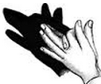
Iconicity or Resemblance?
Does this look like a wolf to you?
How about this?
This does, maybe:

Slide 15
Resemblance: Signs often in some way look like a prominent feature or features associated with the concept they represent. The feature may be obvious or abstract.
Resemblance vs. iconicity? Sounds like just semantics.
If ISN signs were truly iconic, then ISN would be, more or less, a sequence of pictures – and while that would be a valid mode of communication, it is not what most of us would define as a language.

Slide 16

Initialization
Like ASL, Nicaraguan Sign Language’s lexicon includes initialized signs based upon the Spanish gloss.
Example: adulto
I suspect this sign was borrowed from ASL.
In Yuri’s six minute rendition of The Three Little Pigs, this was the only initialized sign she used.

Slide 17


Mama or Mama
Once in awhile, we see a shift from a non-initialized sign to one formed with an alphabet-hand shape.
Mama from Yuri’s narrative:
Mama by Sayda:

Slide 18

To initialize or not to initialize?
Initialization certainly presents an advantage for Spanish speakers who are trying to memorize signs.
Does initialization help Deaf students recognize the Spanish word for the sign in question?
Unless your Deaf baby is reading Spanish, initialization is of no particular benefit in first language acquisition.

Slide 19
Is it just gesturing or is it signing?
Good storytellers in spoken languages enhance their narratives with gestures – an emotional facial expression, a shrug of the shoulders.
Good storytellers in signed languages use gestures for the same purpose.
Yet, many signs have their origins in common gestures.
So, what is the difference?

Slide 20
Think FUNCTION
A sign is composed of many elements, each meaningless by itself, but together representing a concept.
Components of signs (or grammar): hand shape, hand shape orientation, hand motion, eye gazing, facial expression.
Signs can be supplemented with gestures.

Slide 21
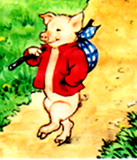
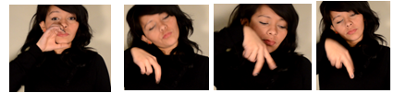


Gestures make communication more vivid but are not integral to the signs.
The pig saunters.
Thanks to Golden Book Publishing Co. for use of The Three Little Pigs, adapted by Alan Benjamin with illustrations by Lilian Obligado (New York, 1988)

Slide 22

SignWriting affords us a closer look.
saunter

Slide 23
Under our microscope….
The downward eye gaze, the person-by-legs classifier hand shape and the ambling movement of the hand shape are all components of the sign for the verb “saunter”.
Yuri gestures by raising and lowering her two shoulders, one after the other, to supplement her signing.

Slide 24
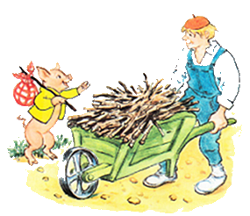




Is it pantomime or is it signing?
Pantomime: an act without words but with gestures and bodily movements only.
….

Slide 25

ISN is a PRODUCTIVE language.
This sign is made with a handling classifier – a technique that Yuri employs frequently when she needs to produce a sign on the spot.

Slide 26
ISN grammar rule: In a verb of motion or location, the eyes follow (or gaze at) the classifier serving as the theme.

Slide 27
Classifiers
Classifier hand shapes, incorporated into verbs, are used to show appearance, location and/or movement.
After a signer indicates some particular thing, a classifier can be used to show where the thing is located, what it looks like and where and how it moves.
In the case of a physical object, the classifier may resemble its surface feature, depth or general shape.

Slide 28
Classifiers are people, too.
Classifiers represent living things, too, especially people.
There are two rules to guide you in producing and using classifiers when constructing a sentence: 1) The classifier relates back to an already specified person or thing. 2) The classifier becomes part of the verb that shows where and how the person or thing moves.

Slide 29
This handling classifier relates back to the identified person.
antecedent noun: man
verb phrase produced with handling classifier: pushing cart

Slide 30

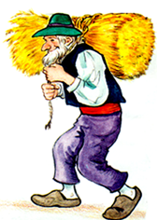
The old man carries a heavy bale of straw on his back.
More productive signs using handling classifiers:
ISN dictionaries list only a 1000 or so signs.
With handling & shape classifiers, signers are able to produce signs as needed.
With productive signing, the number of potential signs is enormous.

Slide 31
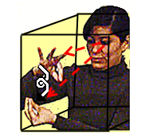
speech driven vs. signed languages
The signer takes advantage of three dimensional signing space to convey direction and movement.

Slide 32
object of the preposition vs. locative object
In ISN, action and spatial relationship (“from”, “to”, “on”, “at”, and so forth) are merged within the spatial verb.
The grammatical term “object of the preposition”, common in languages that use prepositions to describe spatial relationships, is not applicable.
But, the object of this kind of sentence is not a direct object, either. Linguists prefer the label “locative object” to describe the sign that specifies a location.

Slide 33
Spatial verbs that show direction and movement are called directional verbs.
Directional verbs show source location (example: “to depart”), goal location (example: “to touch”), or both.
Alternative terminology: A spatial verb is a type of applicative verb. The object within the applicative verb is called an applied object.
The applied object is constructed with a classifier clitic.

Slide 34
spatial verb grammatical labels and rules
Within a spatial verb, grounded object must precede moving figure.
Hence, the word order tends to be object-subject-verb.
When signing a spatial verb with a source location or a goal location or both, your eyes must follow the moving figure. This eye gazing is called smooth pursuit.

Slide 35
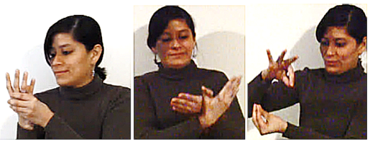
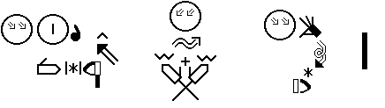
directional spatial verb parts
Grounded object
Moving figure
Source location
Goal location
Classifier clitic
Smooth pursuit

Slide 36
clitics
Our minds see two different signs separated by a very weak boundary.
The grounded object classifier is a clitic.
Classifier clitic: simply means that while the classifier carries its own meaning, it cannot function as a separate sign. Instead, the classifier must be linked with the verb.

Slide 37



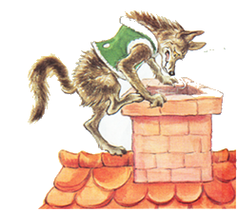



Yuri: The wolf looks up, has an idea, climbs the house, climbs onto the roof….
….

Slide 38
Focusing on the spatial verb:
Word order: subject-object-verb.
This is a compound sentence involving a topicalized subject, plain verb construction and spatial verb construction.
…

Slide 39

Components of the directional spatial verb: grounded object.
1. CLASSIFIER CLITIC (in red): Flat surface classifier. This is the grounded object within the spatial verb.

Slide 40
Components of the directional spatial verb: moving figure – the theme.
2. CLASSIFIER: Person-by-arms & legs (in green). This is the moving figure classifier that relates back to the noun “wolf” – the subject of the sentence. This classifier also serves as the subject or theme within the spatial verb.

Slide 41
Components of the directional spatial verb: movement from source and/or to goal locations.
3. The movement and contact symbols (in blue) depict the action – the verb within the spatial verb.
Remember to use your eyes to follow the moving figure in smooth pursuit.

Slide 42
And we’ve barely scratched the surface --
locative verbs
Inflecting verbs
Serial verbs (common in ISN)
Negation
Distributive aspect
Tense marking
Topicalization
Relative clauses

Slide 43
Can the grammar of a sign language be taught in a workshop?
From our experience, positively NOT
A series of workshops would be required.
“Series of workshops” – another expression for a school course

Slide 44
Does SW have a function in teaching grammar?
A picture is worth a thousand words
But, not practical with chalk and blackboard
Not practical for taking notes
Do we rely on tape recorders to teach English grammar?

Slide 45
WHY?
RESPECT
Teach grammar to teach respect for the signer
Learn to write the signed language to teach respect for the signer
Empower the signer with self-respect

Slide 46
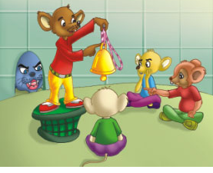
“So where can I get ahold of one of these sign language grammar books for my signed language?”

