Slide 1
SignWriting interface for
Open Journal Systems
SignWriting Symposium 2015
Ronnie Fagundes de Brito
Milton Shintaku
Sandra Patrícia Nascimento
Messias Ramos Costa

Slide 2
Background
Development of Artifacts that Support Accessibility of Deaf to Audiovisual Contents

Slide 3
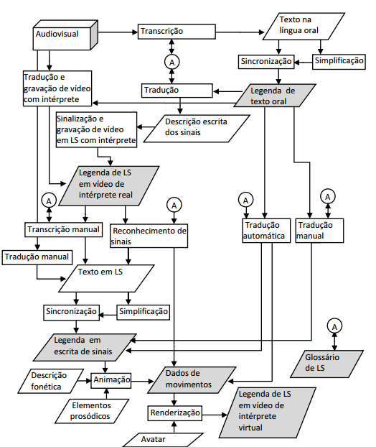

Slide 4
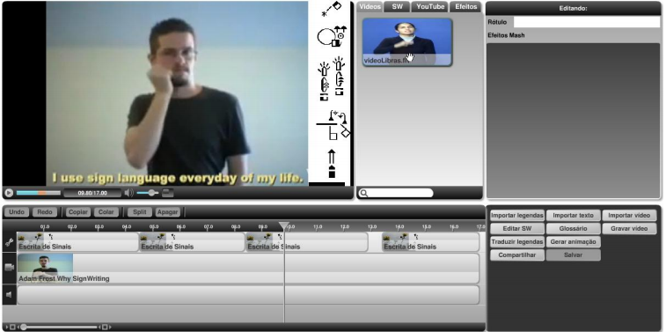
SW on TV subtitles

Slide 5
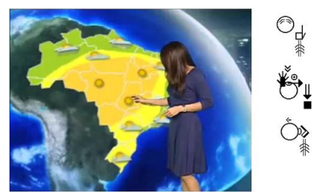
SW on TV subtitles
https://www.youtube.com/watch?v=gvtdzaOVj-I

Slide 6
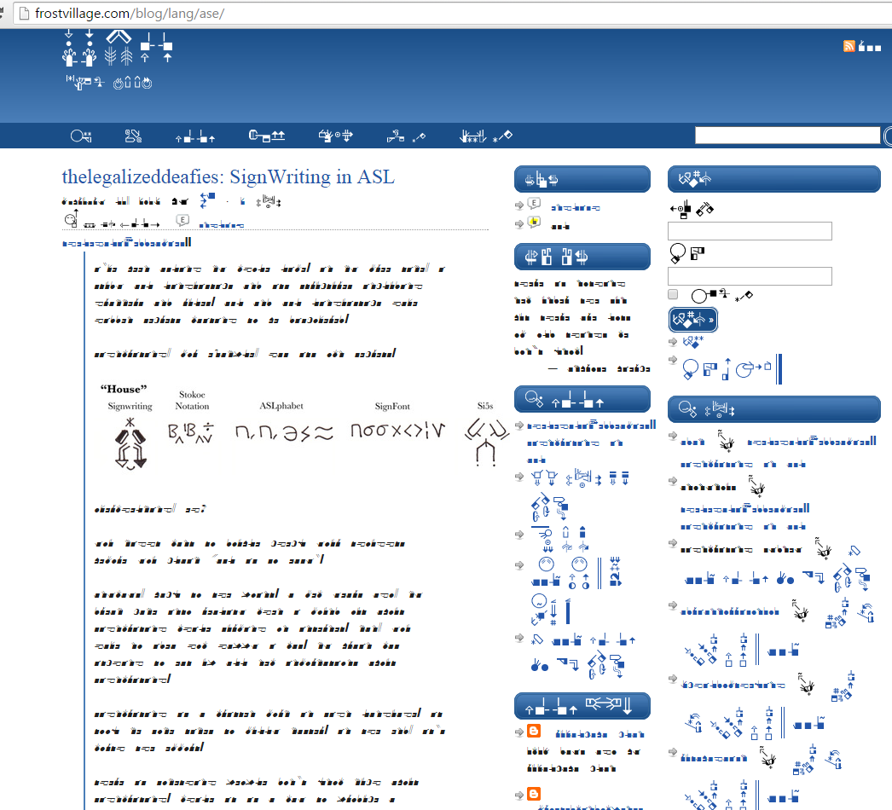
SignWriting

Slide 8
Current Work
IBICT
Instituto Brasileiro de Informação em Ciência e Tecnologia
COAT
Coordenação de Articulação, Geração e Aplicação de Tecnologia;
Systems that support scientific communication:
Institutional Repositories;
Library and monograph systems;
Terminologies;
Identifiers;
Journal and Conference Systems;

Slide 9
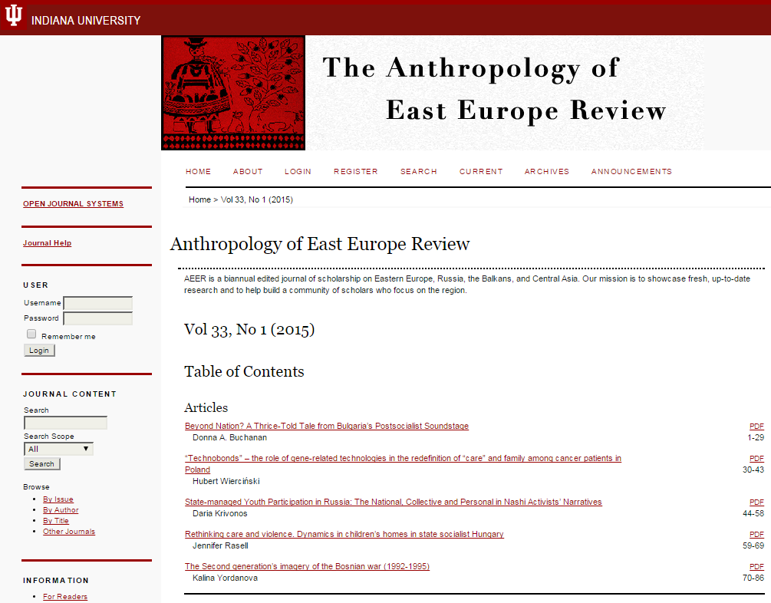
Open Journal Systems

Slide 10
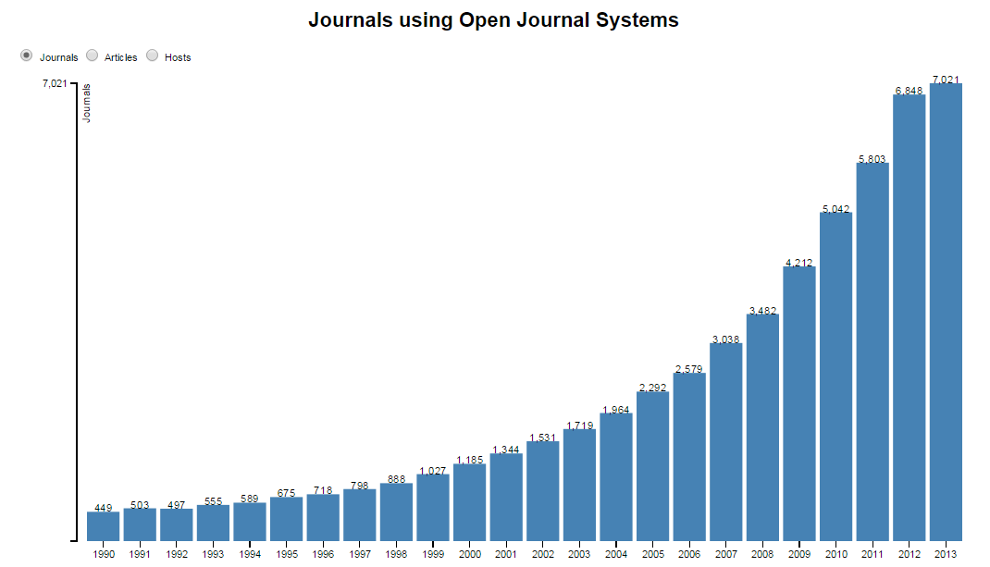
Open Journal Systems

Slide 11
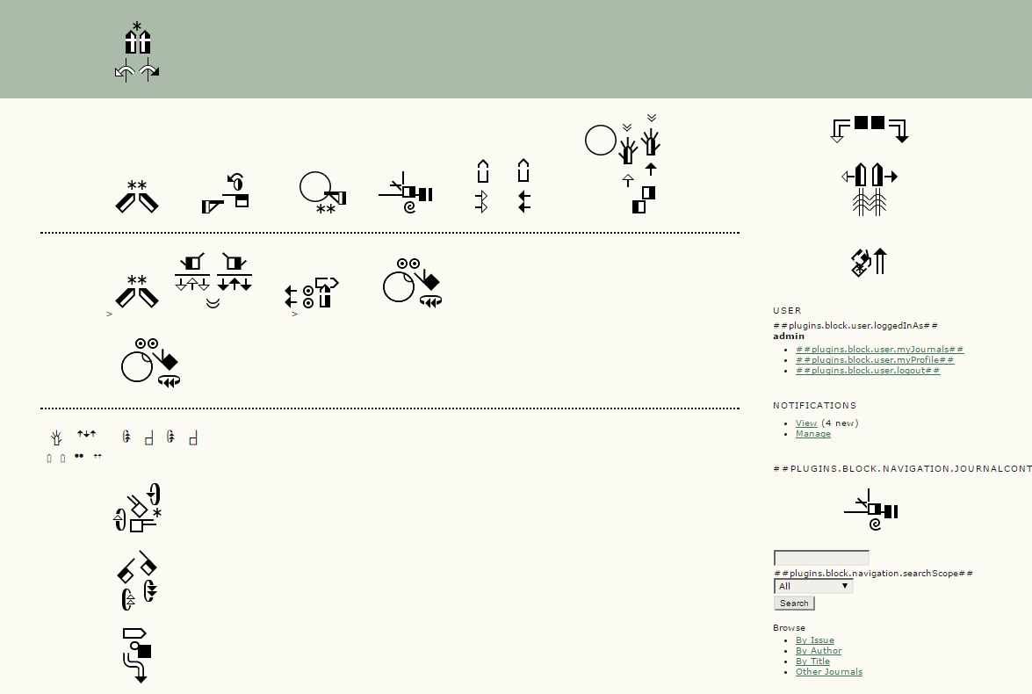
SignWriting & Open Journal System

Slide 12
SignWriting
Advantages:
Ease of edition;
Scalability;
Emerging technologies;
Drawbacks:
Not widely adopted;
Lack of fluent writers/readers;
Terminology.

Slide 13
Methods
Use of OJS internationalization resources;
Translation to Libras;
Corpus/lexus definition;
Transcription to SW;
Register in SignPudlle / SignBank;
Retrieve SW codification (FSW);
Incorporate codes into sgn-BR files;
Deploy JS codes;
Layout;
Test with users;

Slide 14
Horizons
Funding;
Applied study on SignWriting;
Refine methods;
Translate OJS interface;
Apply in other systems;
Resources to support scientific publications in Sign Language;
http://revistabrasileiravrlibras.paginas.ufsc.br/

Slide 15
ronniebrito@ibict.br

Slide 16
Suggestions
?

