Slide 1
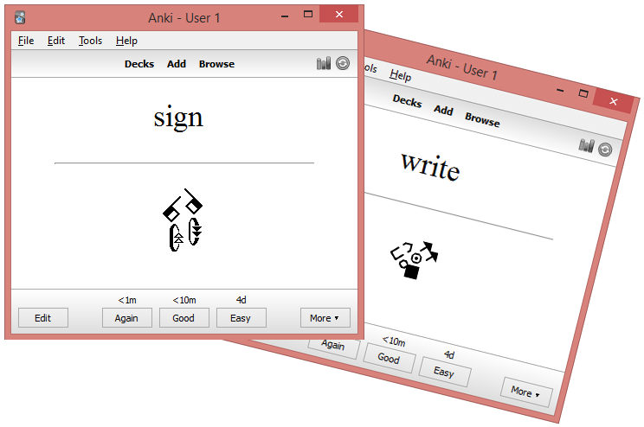

Electronic flashcards for sign languages with SignWriting
By
André Lemyre
Canada, Quebec 2015

Slide 2
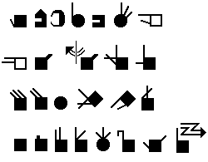
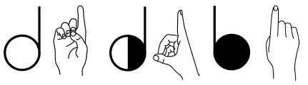



SignWriting
SignWriting was invented in 1974 by Valerie Sutton.
  http://www.signwriting.org/
We will use the American sign Language ASL as an example
Simple configurations
(A-Z, 0-10):
The hand is square when closed and round when the thumb forms a circle.
The hand color indicates if the signer sees the palm (white) or the back of the hand (black).
The symbol is cut at the fingers if the hand is horizontal.
Floor Her-him
(Simultaneously)

Slide 3






A vertical movement has a double stem arrow. A horizontal movement has a single stem arrow. The black arrowhead is for the right hand and the white arrowhead is for the left hand. The empty arrowhead represents both hands.
Family Important Sign Zoo Go forward Stairs

Slide 4






Movement symbols: < fast, rub, * touch, + grasp, brush, # strike
Fast Rub
Deaf Hit
Slide Friend

Slide 5






Head and finger movements
The face, the shoulders and the hips are written if necessary.
A line represents the forearm or a wrist movement.
No Spelling
Man Belt
Play Yes

Slide 6
SpeechWriting
Stefan Wöhrmann ´s SpeechWriting system
Writing what is seen, when lip reading, not sounds.
Wöhrmann, Stefan (2014) Wöhrmann´s SpeechWriting, in SignWriting Documents, Teaches Deaf Students Spoken Language.
http://www.signwriting.org/symposium/presentation0002.html
http://www.gebaerdenschrift.de/
http://www.gebaerdenschrift.de/read/Mundbilder/uebersicht_mundbilder.htm

Slide 7
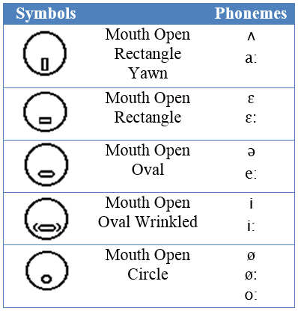
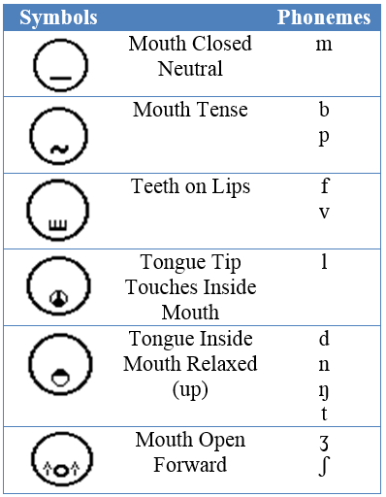
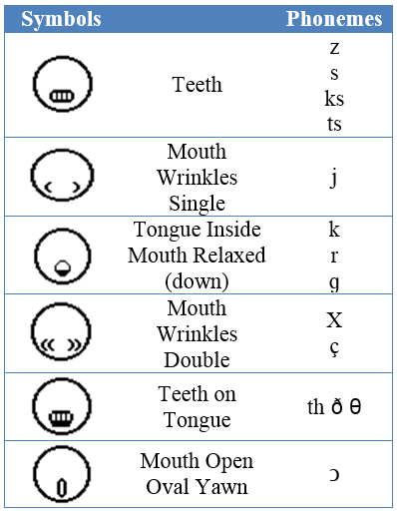

Slide 8
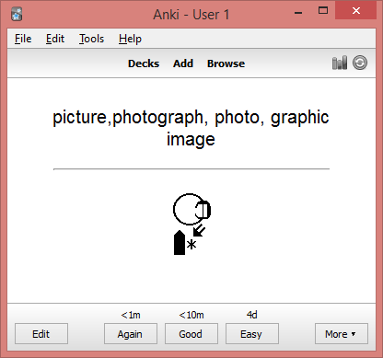
Anki and AnkiDroid
Anki wascreated by Damien Elmes.
  http://ankisrs.net/
The software is based on active revisions. Decks of flashcards on several topics are available. Each electronic flashcard presents a word or a question and the corresponding sign. You have to try remembering the sign. This effort helps memorization.
After, verify the answer. The words you forgot or for which you made a mistake will be displayed more often than those you got right.

Slide 9
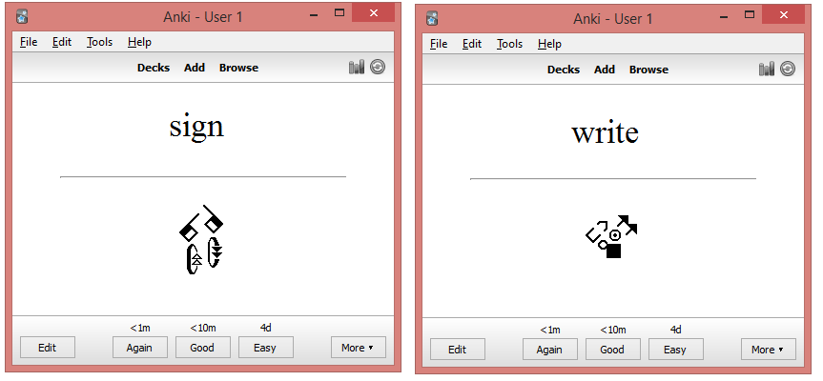
Learn a Sign Language with Anki Software
The flashcards can be studied on a Windows PC, an Android phone, a Mac, an iPhone, an iPad or an iPod Touch.
The signs are exported from de SignPuddle Online dictionairies. Signs are imported in the sign editor SignWriter StudioTM and exported to Anki for flashcards creation.

Slide 10
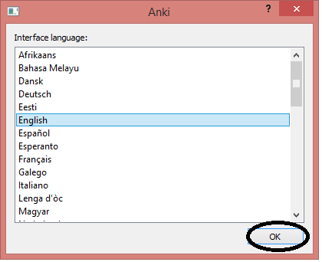
Installing AnkiDroid on an Android Cell Phone
There are several videos on YouTube explaining how to use Anki.
Visit google play web site. Install the English application on your Android phone:
  https://play.google.com/store/apps/details?id=com.ichi2.anki&hl=fr
The French version:
  https://play.google.com/store/apps/details?id=com.ichi2.anki&hl=fr
The Spanish version:
  https://play.google.com/store/apps/details?id=com.ichi2.anki&hl=es
The Deutsch version:
  https://play.google.com/store/apps/details?id=com.ichi2.anki&hl=de
The Italian version:
  https://play.google.com/store/apps/details?id=com.ichi2.anki&hl=it

Slide 11
Anki for iPad and iPhone
The iPhone/iPad/iPod Touch version is available for a low cost :
  https://itunes.apple.com/us/app/ankimobile-flashcards/id373493387?mt=8&ign-mpt=uo%3D4

Slide 12


Anki on Computer
The software for Windows, MAC, Android and Linux in English are free (several languages are available during the installation):
  http://ankisrs.net/

Slide 13
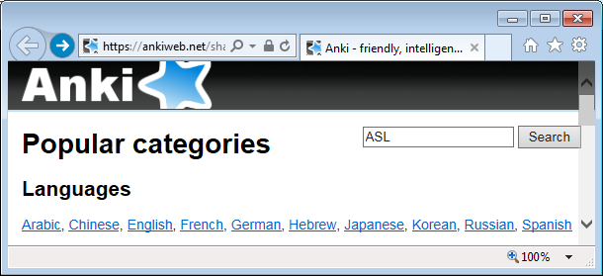
Installing an Existing Deck
Launch Anki and click « Get Shared » at the bottom of the window.
A web page is displayed.
  https://ankiweb.net/shared/decks/
In the « Search » field type a category, : the name of a sign language (example ASL), Deaf, SignWriting, sign, Sutton …

Slide 14
Sign Language Flashcards
  https://ankiweb.net/shared/decks/
Sign Languages | Signs
FSL Filipino sign language Lexicon in SignWriting 2014 | 826
LSQ Langue des signes Québécoise SignEcriture 2015 | 314
ISN Idioma de Señas de Nicaragua SignoEscritura 2015 | 1539
LSM Maltese Sign Language dictionary in SignWriting 2014 | 455
LSF dictionnaire Langue signes française 2014 SignEcriture | 951
BSL British sign language dictionary in SignWriting 2014 | 646
LSPY Lengua de Señas Paraguaya Signo Escritura 2015 | 1618
ASL American sign language dictionary in SignWriting 2014 | 9594
Libras Língua Brasileira Sinais LibrasEscrita 2015 | 4680
LSE Lengua de Signos Española SignoEscritura 2015 | 7836
LSA Lengua de Señas Argentina SignoEscritura 2015 | 1568
LSBF LSFB Dictionnaire Langue des signes de Belgique francophone | 1873

Slide 15
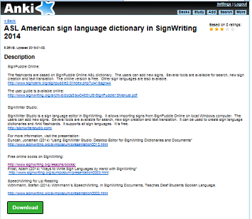
When you have found a deck, click « Info » to see details.
Click « Download ».

Slide 16
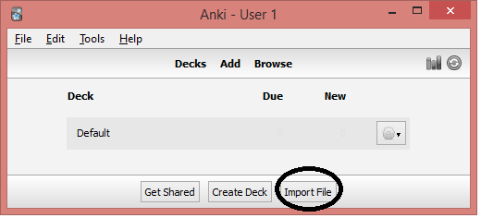
When the file is saved, double-click on it to trigger the download by Anki or click the « Import File» button.

Slide 17
Introduction to SignWriting
http://www.signwriting.org/lessons/books/
http://www.signwriting.org/archive/docs2/sw0116-Lessons-SignWriting.pdf
http://www.SignWriting.org/lessons/iswa
http://www.signwriting.org/archive/docs5/sw0493-SWLessonsBook-Parkhurst-EngLSE.pdf
http://www.signwriting.org/symposium/presentation0003.html
Introduction on SpeechWriting:
Wöhrmann, Stefan (2014) Wöhrmann´s SpeechWriting, in SignWriting Documents, Teaches Deaf Students Spoken Language.
http://www.signwriting.org/symposium/presentation0002.html
http://www.gebaerdenschrift.de/
http://www.gebaerdenschrift.de/read/Mundbilder/uebersicht_mundbilder.htm.
SpeechAnimating (including an analysis on how to extend SpeechWriting to several languages and to several languages in cued speech):
http://www.signwriting.org/symposium/presentation0020.html

Slide 18
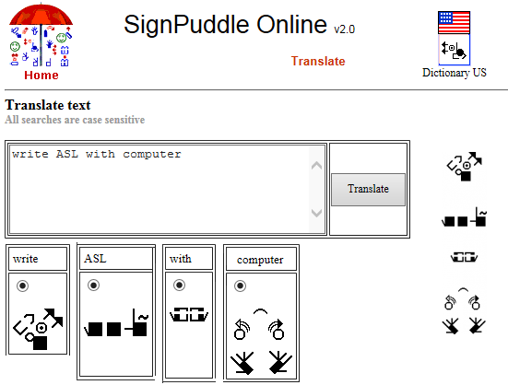
SignPuddle Online
SignPuddle Online contains centralized dictionaries for LSQ, ASL… The users can add new signs. Several tools are available for search, new sign creation and text translation. The online version is free. There exists a version that can be installed on a private computer, it is not expensive.
  http://www.signbank.org/signpuddle/

Slide 19
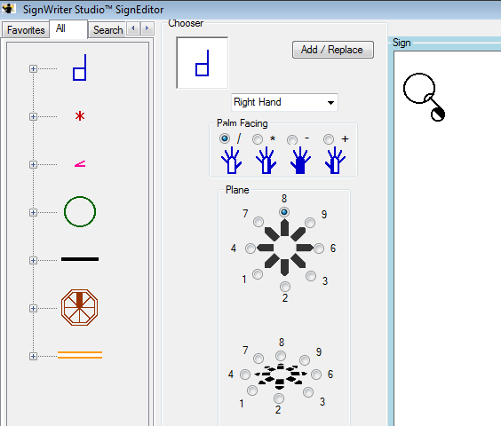
SignWriter StudioTM
SignWriter Studio™ is a sign language editor in SignWriting. It allows importing signs from SignPuddle Online on local Windows computer. The users can add new signs. Several tools are available for search, new sign creation and text translation. It can be used to create sign language dictionaries and Anki electronic flashcards for computers or cell phones. It supports all sign languages. It is free.
  http://signwriterstudio.com/
For more information, visit the presentation:
  Duncan, Jonathan (2014) “Using SignWriter Studio: Desktop Editor for SignWriting Dictionaries and Documents”
  http://www.signwriting.org/symposium/presentation0013.html

