Slide 1

The SignPuddle Standard for SignWriting Text
presented by Stephen E Slevinski Jr
in association with the Center for Sutton Movement Writing
discussing draft-slevinski-signwriting-text-03

Slide 2
How do we encode the SignWriting Script?
Mathematical Model
Complication
Practical Application

Slide 3
Outline
Background of SignWriting Text
Benefits of SignWriting Text
Elements of SignWriting Text
Extending the standard

Slide 4
1. Background
My background
Historical foundation
SignPuddle Beginnings
Naming the signs

Slide 5
My Background
Math major
Love of literacy
Raised children with sign language
Deaf friends in Pittsburgh, PA
10 year collaboration with Valerie Sutton

Slide 6
Historical Foundation
SignWriting invented in 1974
Computerization began in 1984
SignWriter Dos created by Richard Gleaves
Standardized symbol sets in 1999, 2002, and 2004

Slide 7
SignPuddle Beginnings
Screen captures of sign images
Gloss file names
Drag & drop construction

Slide 8
Naming the signs
Build string
SWML
Binary SignWriting
Character SignWriting
Kartesian SignWriting
Unicode PUA
Formal SignWriting

Slide 9
2. Benefits of the standard
Universal for all sign languages
Beautiful images
Real sign language text
Efficient sorting
Powerful searching
Growing body of work

Slide 10
SignWriting is Universal
American Sign Language, Arabian Sign Languages, Australian Sign Language, Bolivian Sign Language, Brazilian Sign Language, British Sign Language, Catalan Sign Language, Colombian Sign Language, Czech Sign Language, Danish Sign Language, Dutch Sign Language, Ethiopian Sign Language, Finnish Sign Language, Flemish Sign Language, French-Belgian Sign Language, French Sign Language, German Sign Language, Greek Sign Language, Irish Sign Language, Italian Sign Language, Japanese Sign Language, Malawi Sign Language, Malaysian Sign Language, Maltese Sign Language, Mexican Sign Language, Nepalese Sign Language, New Zealand Sign Language, Nicaraguan Sign Language, Norwegian Sign Language, Peruvian Sign Language, Philippines Sign Language, Polish Sign Language, Portuguese Sign Language, Quebec Sign Language, South African Sign Language, Spanish Sign Language, Swedish Sign Language, Swiss Sign Language, Taiwanese Sign Language, Tunisian Sign Language, and more…
http://www.signwriting.org/about/who/

Slide 11
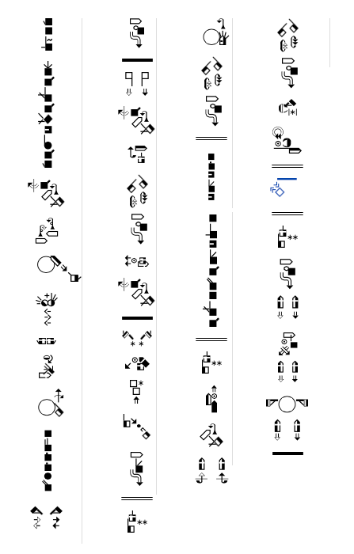
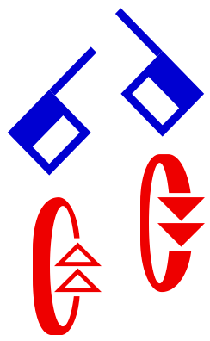
Beautiful Images
Scalar Vector Graphics

Slide 12
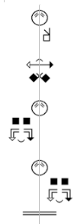
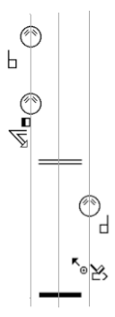
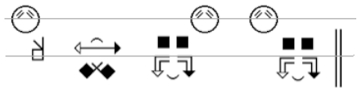
Real sign language text
grammatically correct

Slide 13
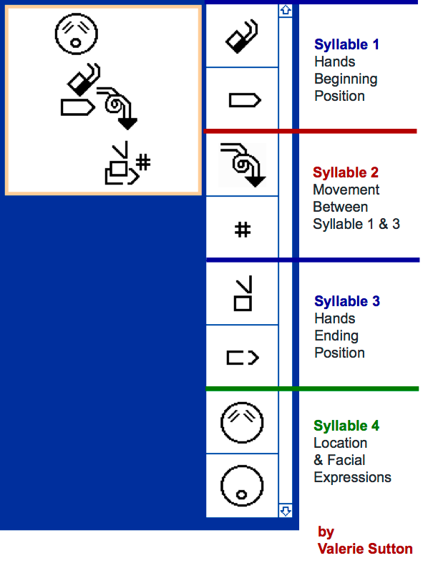
Efficient Sorting
Supports multiple theories

Slide 14
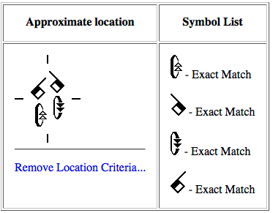
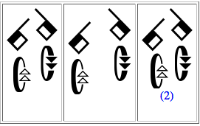
Powerful Searching
Find exact symbols
Find general symbols
Find symbol ranges
Ignore location
Use approximate location

Slide 15
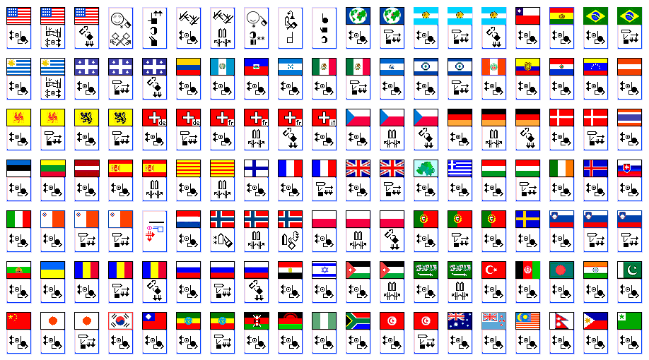
Growing body of work
http://www.signbank.org/signpuddle

Slide 16
3. Elements of the Standard
International SignWriting Alphabet 2010
Writer control and flexibility
Visual Image
Mathematical Name
Regular Expressions
2 Years of Stability

Slide 17
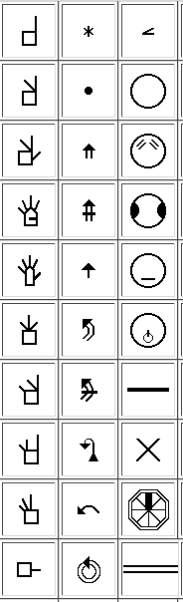
International SignWriting Alphabet
ISWA 2010
Grapheme
Symbol
Hierarchy
Encoding

Slide 18
Writer Control and Flexibility
Symbol selection, placement, and order
No limitations
No gatekeepers
No waiting

Slide 19
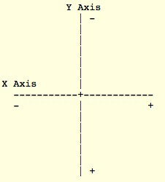
Visual Image
2-Dimensional Order
PNG
SVG
TrueType

Slide 20
Mathematical Name
Plain text string of characters
Structured with tokens
2-dimensional space
Optional 1-dimensional order

Slide 21
Regular Expressions
Pattern matching
Efficient processing
Automatic conversion

Slide 22
2 Years of Stability
January 12th, 2012
ASCII based
Unicode - Private Use Area

Slide 23
4. Extending the Standard
Embrace the standard
Maintain compatibility
Experiment and try something new

Slide 24
Embrace the Standard
SignTyp
SignWriter Studio
DELEGS Online
Wikimedia Incubator
TrueType Font development

Slide 25
Maintain Compatibility
SWIFT
Alternate ISWA 2010 fonts

Slide 26
Experiment and Try Something New
Other symbol sets
Other coordinate system
Other internal structure
Other character sets
Other input methods

