Slide 1
MemoSign Game: A learning Game for Deaf Learners
Research Laboratory of Technologies of Information
and Communication & Electrical Engineering
(LaTICE)
Mohamed Ali Khenissi, Yosra Bouzid,
Mohamed Jemni
The second SignWriting Symposium, LaJolla, USA, 21-14 July, 2015

Slide 2
Content
Introduction
Related Works
Learning version of Memory Match
Game for deaf learners
Experimentation
Conclusion

Slide 3
Introduction
Sign language is an integral part and an identifying feature of membership in the Deaf Culture
According to WFD, there are about 70 million deaf people who use sign language as their first language or mother tongue.
For deaf and hard hearing people, learning any spoken language is not a natural or automatic process, it is rather a long and intensive task.
Around 80% of deaf people worldwide lack education or are undereducated, are illiterate or semi-literate

Slide 4
Introduction
Having a means to represent their own language would bring to these signers the same advantage that writing systems for spoken languages bring to speakers.
The main benefit of having a SL written form is that Deaf signers could :
Express, share, and record their ideas and thoughts on paper without translating it all the time.
Learn new things and skills outside of oral communication.
Improve their ability to comprehend and acquire the written versions of oral language.
……

Slide 5
Introduction
SignWriting is one of the best known writing systems for SL.
It uses a set of highly iconic symbols that can be combined to describe any sign
It is conceived to be used in writing sign languages for the same purposes hearing people commonly use written oral languages.
It is now used in more than ten countries to aid literacy.
A training to learn to interpret the SignWriting notations is needed for novice users who are accustomed to the use of their sign language in a visual-gestural modality

Slide 6
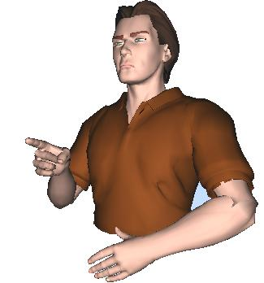
Contribution
The use of ICT, especially 3D signing avatars, has been identified as a successful practice that can support the teaching of literacy to students who are deaf or hard of hearing.
The use of computer games is another interesting alternative to reinforce learning experience of deaf learners since they can consume the attention of learners and increase their motivation and engagement which can then lead to stimulate learning.
In this context, we propose a new learning game which federates the avatar technology, computer game and the SL writing form SignWriting to motivate deaf signers to read and write in their mother tongue.

Slide 7
Content
Introduction
Related Works
Learning version of Memory Match
Game for deaf learners
Experimentation
Conclusion
7

Slide 8
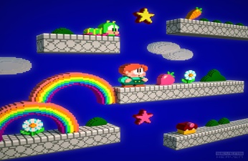
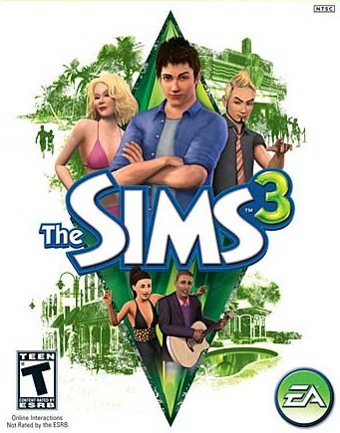
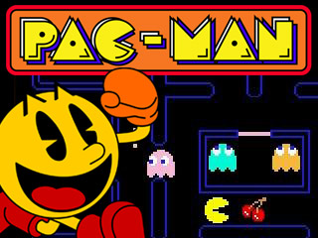
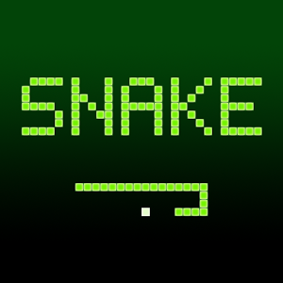
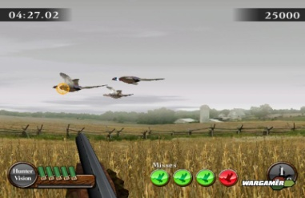
Related Works
+
Teaching English language
+
Teaching English language
+
Responding to questions about the programming languages
+
Determining the precedence relationship between activities
+
Teaching introduction to programming language
8

Slide 9
Content
Introduction
Related Works
Learning version of Memory Match
Game for deaf learners
Experimentation
Conclusion
9

Slide 10
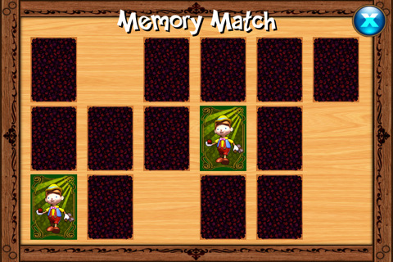
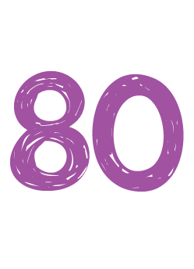
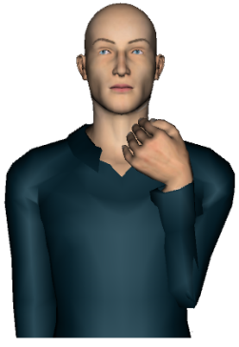
Learning version of Memory Match Game For Deaf Learners
Memory Match Game
Is a card game in which all of the cards are laid face down on a surface. The objective of the game is to turn over pairs of matching cards with the least possible trials.
Learning version of Memory Match Game for Deaf Learners
1)
2)
3)
10

Slide 11
Learning version of Memory Match Game For Deaf Learners
The avatar-based system tuniSigner
The virtual avatar is driven by an animation software called tuniSigner. tuniSigner was conceived to automatically interpret the exact gestures represented within SignWriting notations.
SignWriting notation
Parsing and processing the SW notation
Identifying
the explicit linguistic representation
of the sign
Scripting and generating
animations using
XML Sign Modeling
Language, SML
11

Slide 12
Content
Introduction
Related Works
Learning version of Memory Match
Game for deaf learners
Experimentation
Conclusion
12

Slide 13
Content
Introduction
Related Works
Learning version of Memory Match
Game for deaf learners
Experimentation
Conclusion
13

Slide 14
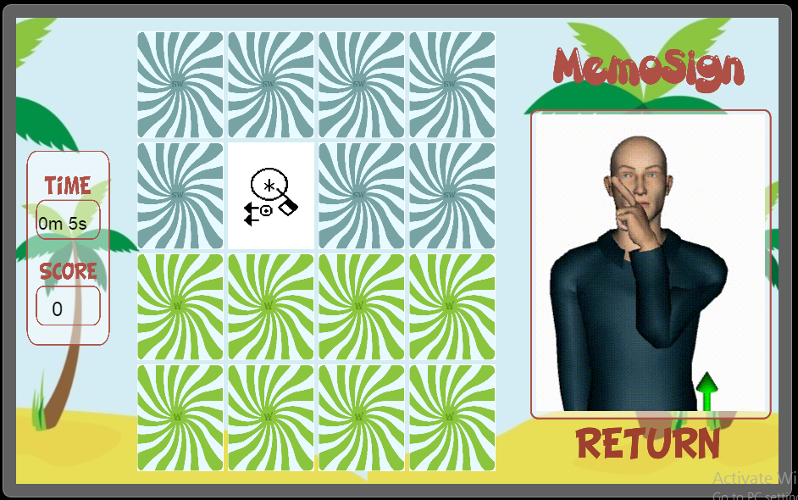
Conclusion
A new educational game for deaf learners,
To foster vocabulary acquisition for DL in both spoken and sign languages.
To render the learning experience with more fun.
To engage DL and to keep them motivated.
Futures works will study the impact of this learning game on level of knowledge.
14

Slide 15
Thank You for your Attention !

