Slide 1
SignWriting Vision 2030
for the future of Sutton SignWriting
by Steve Slevinski
https://SteveSlevinski.me

Slide 2
SignWriting Vision 2030
across the globe, a common script for all sign languages,
a developmental powerhouse, connecting sign language disciplines with text

Slide 3
This presentation will discuss…
Who are Val and Steve?
What is the Center for Sutton Movement Writing?
What is SignWriting Vision 2030?
What are the three pillars?
What are the eight objectives?
What are the programs?

Slide 4
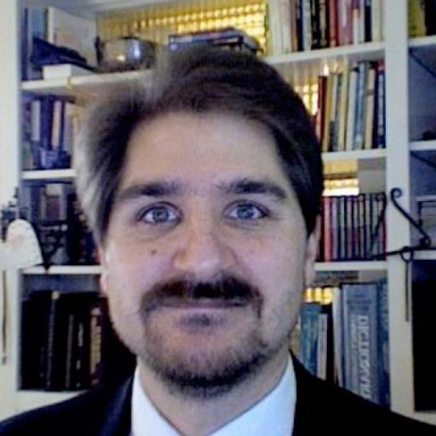
Hi, I’m Steve!
sign language user
friend of the deaf
SignWriting Evangelist
14 years ago, I started a collaboration with
Valerie Sutton, the inventor of SignWriting.
Together, we created the Sutton SignWriting Standards of 2010, 2012, and 2017. These standards will be useful far into the future.

Slide 5
I am the encoder of Sutton SignWriting
https://SteveSlevinski.me
2010, 2012, 2017
A hundred years from now, properly encoded Sutton SignWriting text will still be legible.
ase-US-Sgnw

Slide 6
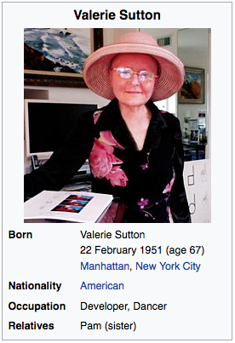
My Friend Val
1966 | Valerie Sutton invents DanceWriting
1974 | Valerie Sutton invents SignWriting
From the beginning, Valerie Sutton has encouraged writers of every sign language.
http://valeriesutton.com/
https://en.wikipedia.org/wiki/Valerie_Sutton

Slide 7
The Center for Sutton Movement Writing
a 501c3 educational non-profit
95-3068257
1974 | The Center for Sutton Movement Writing is founded
1976 | The CSMW becomes California Tax-Exempt
1978 | The CSMW becomes US Federal Tax-Exempt
2004 | Steve Slevinski hired as consultant
Val and Steve have worked together through the non-profit, along with many others, to develop and promote the use of SignWriting for all sign languages.

Slide 8
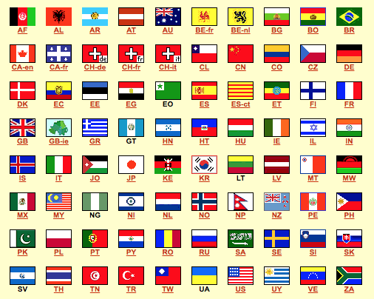
Around the world, over 140 sign languages have been identified
Brazil | ISO 3166-1 | Two letter country codes | BR
Brazilian Sign Language | ISO 639-3 | Three letter language codes | bzs

Slide 9
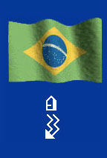
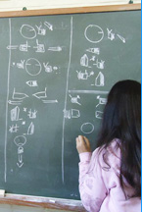
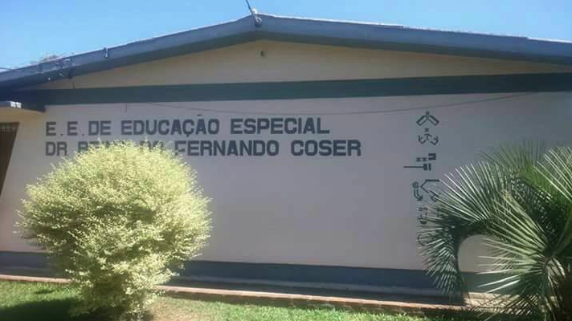
SignWriting in Brazil
http://signwriting.org/brazil
SignWriting is used in 18 Federal Universities and 12 public schools.
The History of SignWriting in Brazil on TV INES.
http://tvines.ines.gov.br/?p=16704

Slide 10
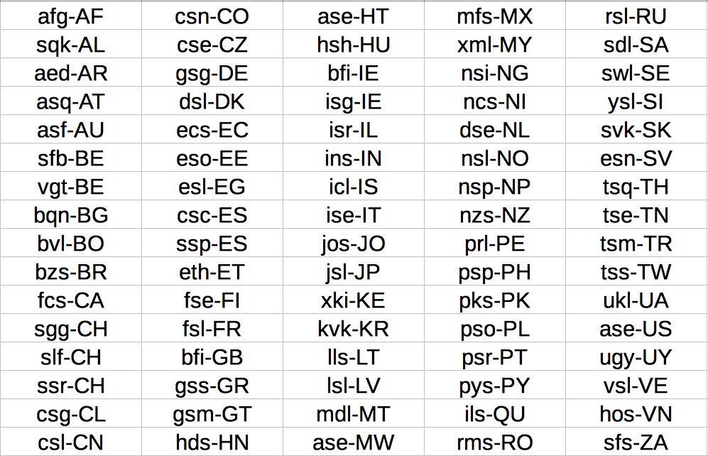
80 sign languages are written with SignWriting
Sutton SignWriting | ISO 15924 | Four letter script code | Sgnw

Slide 11
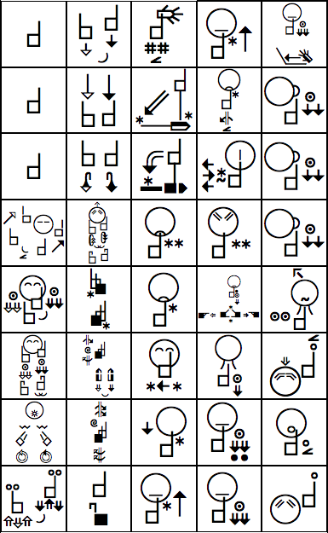
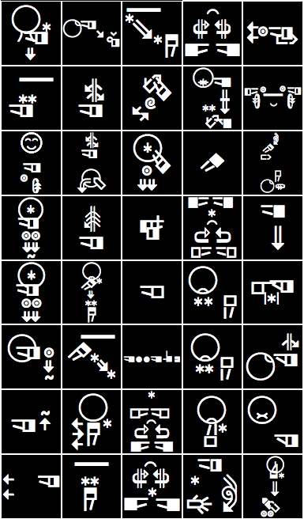
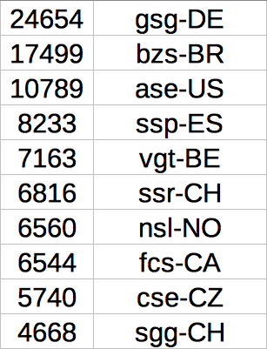
The 10 largest dictionaries have over 4,600 signs each
https://www.ethnologue.com/browse/codes

Slide 12
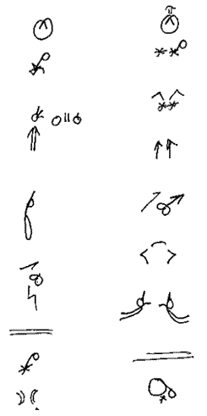
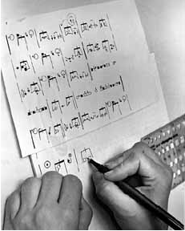
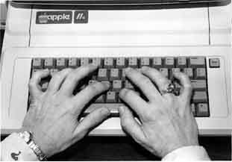
Before I was Involved
1974 - 1986 | SignWriting is written exclusively by hand
1981 - 1984 | Publishing efforts with stencils and wax transfers
1986 - 1995 | Computer encoding with keyboarding
2002 | Advanced sorting with printed dictionaries

Slide 13
My History with SignWriting
2004 | Drag-and-drop user interface
2006 | ISO 15924 Script Code Sgnw
2010 | International SignWriting Alphabet 2010 (ISWA 2010)
2012 | Formal SignWriting in ASCII (FSW)
2015 | Sutton SignWriting Block added to Unicode Standard
2017 | SignWriting in Unicode (SWU)

Slide 14
Project of note
The American Sign Language Wikipedia
A long term project that will benefit every sign language
The ASL Wikipedia has
over 50 articles.
https://incubator.wikimedia.org/wiki/Wp/ase
http://www.signwriting.org/encyclopedia/

Slide 15
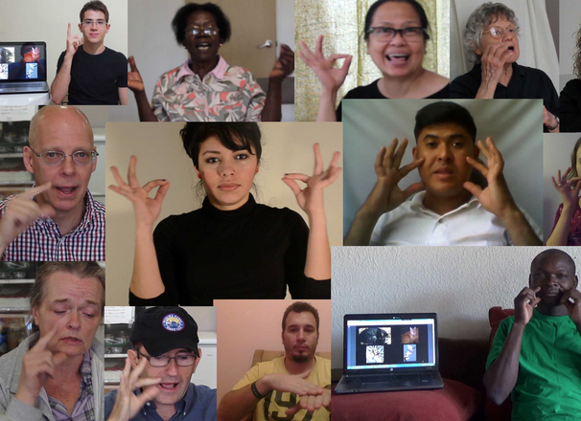
Project of note
The SignTyp project and linguistic coding system
20,000 videos from 25 countries.
Organized sets for analysis.
SignWriting conversion to SignTyp
linguistic coding system.
So far, 8,000 full transcriptions with SignWriting.
http://signtyp.uconn.edu/

Slide 16
SignWriting Free
$0 a month
Everyone is free to use SignWriting.
We support free culture and
the creation of free culture works.
If you are financially able, become part of the team to fund continuing developments.
https://www.patreon.com/signwriting

Slide 17
What is SignWriting Vision 2030?
This is our vision of the future that is ambitious yet achievable. It expresses our long-term goals and expectations. It reflects our strengths and capabilities.

Slide 18
Our Strengths
a common script for all sign languages
a developmental powerhouse
connecting sign language disciplines with text
The Pillars of
SignWriting Vision 2030
Vibrant Communities
Sustainable Economics
Ambitious Groups

Slide 19
Pillar 1: Vibrant Communities
Strong
Roots
Focusing our efforts on multiple generations of writers and teachers.
Fulfilling
Lives
Promoting culture and entertainment. Stimulating thought and communication.
Strong
Foundations
Caring for our children and students. Empowering deaf communities.

Slide 20
Pillar 2: Sustainable Economics
Free
Writing
Encouraging people to write by hand or computer with free tools and resources.
Non-Profit
Support
Boosting the financial support of the non-profit so we can expand our efforts.
Long-Term
Success
Realizing long-term success requires continuity and sustained development.

Slide 21
Pillar 3: Ambitious Groups
Committing to literacy in primary languages for mental development.
Effective
Creating meaning and value in our lives while sharing with others and society.
Generous

Slide 22
Our Programs
Community Building
We will continue to support all writers of sign language with the SignWriting script.
Economic Vitality
We will expand our fundraising efforts so that
we can sustain our mission into the future.
Group Empowerment
We will provide resources to groups and encourage connections between them for the benefit of all.

Slide 23
SignWriting Team
$1 a month or more
SignWriting is a proven success for education, literature, and research.
SignWriting is not an economic success because we give everything away for free.
We need your support, and the support of people you know, for 2019 and beyond.
https://www.patreon.com/signwriting

Slide 24
Donating to the non-profit
The Center for Sutton Movement Writing is
tax-exempt for California and for US Federal
http://movementwriting.org/csmw/
Donations will help with the work of the non-profit:
Book donations
Educational material
Teaching and instruction
Resources and websites
Non-profit administration
Legal documents and taxes
http://signwriting.org/donate/

Slide 25
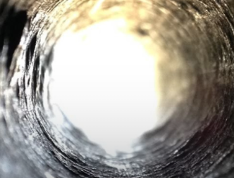
SignWriting
Vision 2030
Steve Slevinski
slevinski@signwriting.org
November 2018
For the Future of
Sutton SignWriting
https://SteveSlevinski.me

Slide 26
SignWriting Vision 2030
Inspired by the Saudi Vision 2030
http://vision2030.gov.sa/en
Building communities and bridges
https://deafunity.org/2018/07/deaf-perspectives-on-the-saudi-arabia-vision-2030

