Slide 1
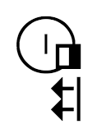
Sutton SignWriting
Standard of 2017
by Stephen E Slevinski Jr
the Center for Sutton Movement Writing
http://www.signwriting.org/symposium/presentation0066.html

Slide 2
The Big Umbrella of the Center for Sutton Movement Writing
a 501c3 educational non-profit
All sign languages supported right now.
Various hand writing styles.
7+ years of stable and free standards.
International cooperation.
1974 Founded | 1976 California Tax-Exempt | 1978 US Federal Tax-Exempt

Slide 3
SignWriting, a brief history
1966 | Valerie Sutton invents DanceWriting
1974 | Valerie Sutton invents SignWriting
1974 - 1986 | SignWriting is written exclusively by hand
1981 - 1984 | Publishing efforts with stencils and wax transfers
1986 - 1995 | Computer encoding with keyboarding
2004 | Drag-and-drop user interface
2006 | ISO 15924 Script Code Sgnw
2010 | International SignWriting Alphabet 2010 (ISWA 2010)
2012 | Formal SignWriting in ASCII (FSW)
2015 | Sutton SignWriting Block added to Unicode Standard
2017 | SignWriting in Unicode (SWU)
https://tools.ietf.org/html/draft-slevinski-signwriting-text-01#section-1.2

Slide 4
Characters and Fonts
Characters are used to name signs
Fonts are used to view signs

Slide 5
Design Principles of
Sutton SignWriting
Complete
Support the structures inherent to the script.
Universal
Support all sign languages without
additional characters or updated fonts.
Empowering
Enable the writers to decide on the spelling
of their own sign languages.
Possible
Work with existing font technologies.

Slide 6
2012 Standard
Formal SignWriting in ASCII
FSW
AS18711S20500M514x517S18711490x483S20500486x506
Mathematical names
ASCII characters only
ABLMRS0123456789xabcdef
Signs are written as unified words
https://datatracker.ietf.org/doc/draft-slevinski-formal-signwriting/

Slide 7
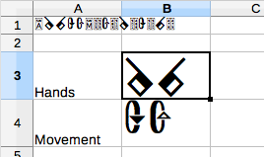
2017 Standard
SignWriting in Unicode
SWU
Endorsed by the Center for Sutton Movement Writing
Submitted to the Unicode Technical Committee July 2017
http://www.unicode.org/L2/L2017/17220-signwriting-design-opt.pdf

Slide 8
SWU is equivalent to FSW
Time
Space
(514,517)
(490,483)
(486,506)
Sequence
Marker
Sorting
List
Middle Lane
Signbox
Spatial
Symbol
Spatial
Symbol
Max
Coord
A
S18711
S20500
M 514x517
S18711 490x483
S20500 486x506
AS18711S20500M514x517S18711490x483S20500486x506

Slide 9
The Unicode Standard
“a worldwide character standard”
“addresses only the encoding and semantics of text.”
“used for representation of text for computer processing.”
Principles of the Unicode Standard
Universal repertoire
Logical order
Efficiency
Unification
Characters, not glyphs
Dynamic composition
Semantics
Stability
Plain Text
Convertibility
“The Unicode Standard groups characters together by scripts in blocks.
A script is any system of related characters.”
http://unicode.org/standard/principles.html

Slide 10
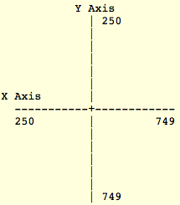
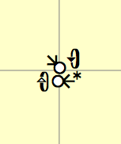
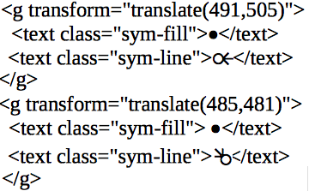
Scalar Vector Graphics (SVG)
SVG is a widely supported image standard
that is available in most environments with a variety of options. 2-Dimensional placement is supported with cartesian coordinates.

Slide 11
Sutton SignWriting Fonts
2017 Edition
The Sutton SignWriting fonts are available for download and installation.
Installing the fonts is not required, but it will improve the user experience and allow the fonts to be used throughout the user’s computer.
https://slevinski.github.io/SuttonSignWriting/components/fonts.html

Slide 12
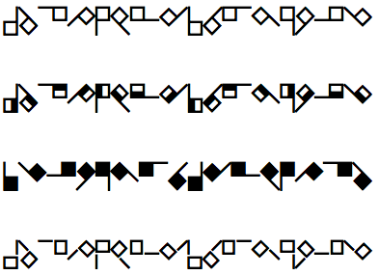
Sutton SignWriting Line
Two Fonts for SVG
Scalar Vector Graphics used with FSW or SWU
Sutton SignWriting Fill
positive space for
the symbol image
negative space for
overlapping symbols

Slide 13
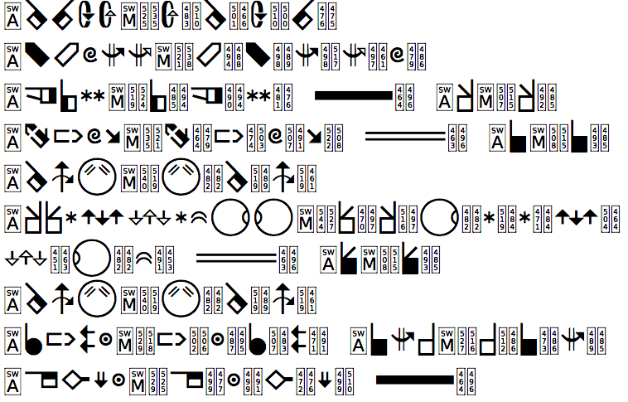
Sutton SignWriting One-D
Two Fonts for SWU
SignWriting in Unicode only, SVG not required
Sutton SignWriting Two-D
Available now
Development planned for 2018

Slide 14
Characters for naming
Characters are units of information
Characters are put together to form a string
Each character is associated with a number

Slide 15
Naming a symbol
With FSW, the name of a symbol is a string of 6 characters.
String
"S 2 6 b 0 2"
Unicode
UTF-8
"U+53 U+32 U+36 U+62 U+30 U+32"
UTF-16
"U+0053 U+0032 U+0036 U+0062 U+0030 U+0032"
UTF-32
"U+00000053 U+00000032 U+00000036 U+00000062 U+00000030 U+00000032"

Slide 16
Naming a symbol
With SWU, the name of a symbol is a single character.
Character
Unicode
UTF-32
“U+00048823”
UTF-16
“U+D8E2 + U+DC23”
UTF-8
“U+F1 U+88 U+ A0 U+A3”

Slide 17
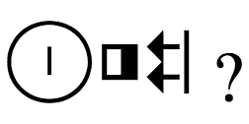
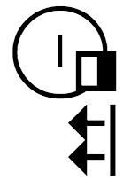
How do you spell a sign?

Slide 18
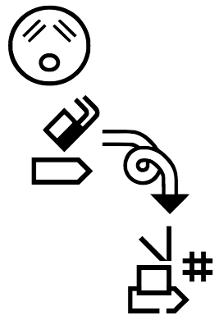
What about something more complex?
M571x617S30a00482x483S34400482x483S11817497x522S15a06492x549S2970b523x537S15a36534x605S10e30538x579S20b00558x590

Slide 19
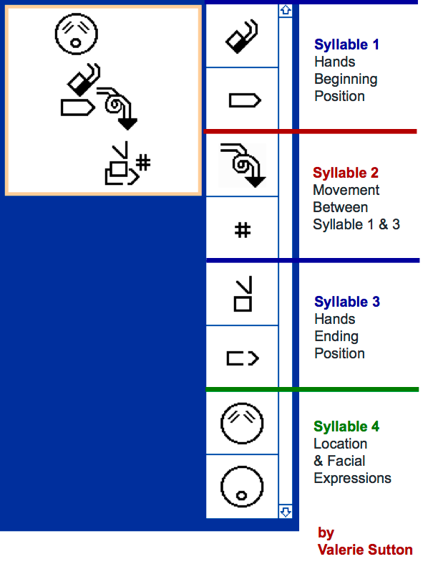
The SignSpelling
Sequence
First syllable starts with
beginning hand positions.
Second syllable contains
the movements and dynamics.
Additional syllables alternate
between hand positions
and movements.
The Last syllable contains
faces and locations.
Used for sorting and
rendered in dictionary
Syllable Types
Hand Positions
Movements
Between
Faces &
Locations

Slide 20
Two perspectives for Syllables
Front Perspective
Top Perspective
a straight on view
of the signer
a top-down view
of the signer

Slide 21
The Importance of palm facings
Front Perspective
Top Perspective
Line breaks for
top perspective.
White palm faces up.
White palm faces the signer.
Half palm faces to the side.

Slide 22
Arrow heads and tails
Black arrow head for right hand
Front Perspective
Top Perspective
Double line tail
Movement
up then down
Single line tail
Movement
away then back

Slide 23
Reading the sign
Starting position
Front perspective
Left palm facing signer
Right palm facing to side
Movement between
Front perspective
Right hand moves to the
right, loops and down.
Hash mark for strike!
Ending position
Top perspective
Both palms facing up

Slide 24
How does
?
become

Slide 25
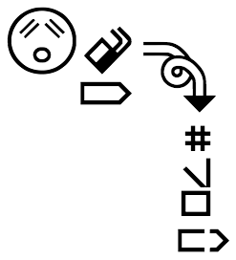
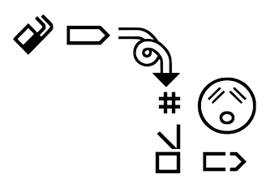
Why isn’t
equal to something else?

Slide 26
is fundamentally
!
different than
is equal to something else.

Slide 27
Layered writing in
2-Dimensions with
Cartesian Coordinates

Slide 28
Two-Dimensional Space with (X,Y) values
(-3,-3)
(3,-3)
-3
-2
-1
1
2
3
X
-3
-2
-1
1
2
3
(-3,3)
(3,3)
Y

Slide 29
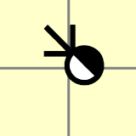
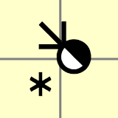
Writing in Two-Dimensional Space
=
(514,517)
(490,483)
(486,506)
Middle Lane
Signbox
Max
Coord
Spatial
Symbol
Spatial
Symbol
Signbox
Space
Both X and Y range
from 250 to 749.
Center is (500,500)

Slide 30
Formal SignWriting
A two part word of time and space.
First syllable
Starting hand shapes
Layered writing in
2-Dimensions
Second syllable
Movements and Dynamics
Third syllable
Faces and Locations
Temporal Prefix
Spatial Signbox

Slide 31
Formal SignWriting
Temporal Prefix
Sequential list of symbols
Written by an author
Ordered by a particular theory
Neither formatting nor style
Meaning not found in the Spatial Signbox

Slide 32
Formal SignWriting
Spatial Signbox
2-dimensional cluster of symbols
Written by an author
Symbols are positioned with Cartesian Coordinates
Neither formatting nor style
Meaning beyond the Temporal Prefix

Slide 33
Formal SignWriting
Spatial Signbox Equivalents
The order of spatial symbols only matters for overlap.
A correct order must write the hand after the head.

Slide 34
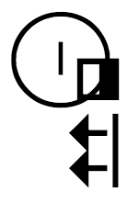
Formal SignWriting
Spatial Signbox Dissimilars
Some sequences of spatial symbols will overlap incorrectly.
An incorrect order will write the hand before the head.

Slide 35
How does
?
become

Slide 36
SignWriting Today
Scan and process
Regular Expressions are used to identify signs written in SignWriting.
Signs are rewritten with fonts inside of SVG, retaining the source string as text which can be copied.

Slide 37
SignWriting Tomorrow
The Universal Shaping Engine (USE) is a widely supported rendering system for complex scripts.
With the Universal Shaping Engine,
SignWriting text can be correctly rendered by the operating system.
A 2-Dimensional font is being developed for the Sutton SignWriting script which leverages the Universal Shaping Engine.

Slide 38
Sutton SignWriting
Standard of 2017
Characters for
naming signs
Fonts for
viewing signs
Stable platform for growth

Slide 39
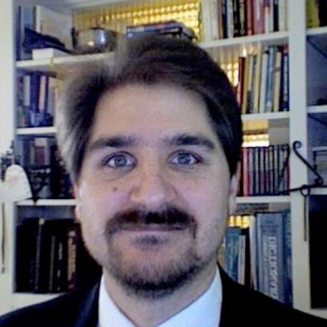
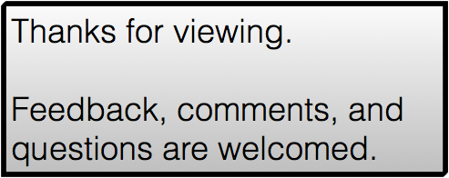
Sutton SignWriting
Standard of 2017
by Stephen E Slevinski Jr
slevinski@signwriting.org
https://slevinski.github.io/SuttonSignWriting/

