Slide 1
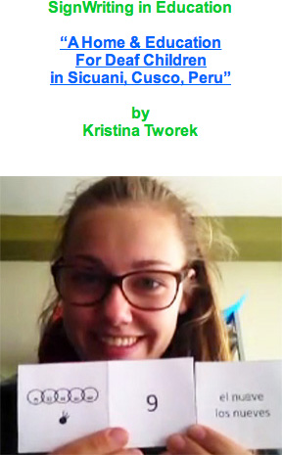
Monday, July 18 Watch Session 1 Presentation 53 Presentation Time: GMT: 15:00 - 16:00 Presentation 53 Web Page: “A Home & Education For Deaf Children in Sicuani, Cusco, Peru”
SignWriting Symposium
2016!
Broadcast LIVE on YouTube July 18, 19, 20, 21
GMT: 15:00 - 19:00

