Slide 1
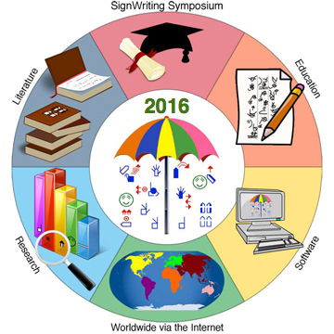
SignWriting Symposium 2016
Presentation 53 “A Home & Education For Deaf Children in Sicuani, Cusco, Peru” by
Kristina Tworek
Monday, July 18 GMT 15:00-16:00
Click below to watch LIVE on YouTube!
http://www.signwriting.org/symposium/2016/Live_Streaming.html#Day1Session1
Presentation 53 Web Page:
http://www.signwriting.org/symposium/presentation0053.html

