Slide 1


THE SPREAD OF SIGNWRITING IN MARANHÃO STATE: A CURRICULAR PROPOSAL IN A BILINGUAL SCHOOL IN THE CITY OF IMPERATRIZ
Flávia de ALMEIDA
José Ribeiro da SILVA JÚNIOR
SignWriting in Education
Presentation 059 – Live online
July 20, 2016

Slide 2
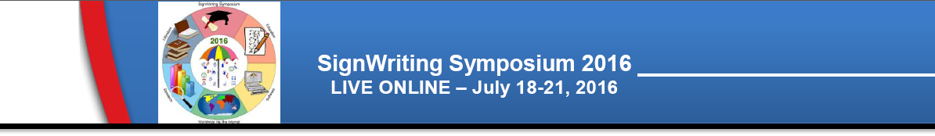
INTRODUCTION
The SignWriting (SW) in the state of Maranhão is not yet widespread and practiced comprehensively, considering that only a few individuals of the local deaf community have this knowledge, through contact with the system in southern Brazil.
01

Slide 3
JUSTIFICATIVE
It is known that the teaching centers in Maranhão have no adaptations for deaf individuals, such as interpreters and qualified professionals to meet and cooperate with reality. This occurs in different ways in the city of Imperatriz, given that the local deaf community has an acceptable organizational aspect.
02

Slide 4
JUSTIFICATIVE
Through this reality, we highlight the importance of promoting the practice of SW, as a resource for social inclusion and appreciation of deaf culture, facilitating, in fact, in the process of literacy and language development of deaf children, because the contrast in interpretation of how deaf people think, towards the writing in Portuguese reality, limits the applicability of their worldview, so fitting, the need to establish the principle of written LIBRAS.
03

Slide 5
GOALS
General
The aim of this study is to: highlight the need for SW practice of popularization in the state of Maranhão.
04

Slide 6
GOALS
Specific
Promote the application of the system through activities and methodologies in a bilingual school in the city of Imperatriz;
Create actions as benchmarks for initiatives in the medium and long term, there will be put into force the above-mentioned state;
Emphasize favorable actions for the release of the SW in Maranhão, through the creation of a Municipal Law, to set the mandatory SW practice in the bilingual school.
05

Slide 7
METHODOLOGY
Application project in bilingual school (in loco), from the inductive method (particular to the general);
Social actions in partnership with public and private institutions for the implementation of workshops, lectures and training courses with specialized professionals.
06

Slide 8
THEORETICAL APPROACH
Characterization of Imperatriz city
Founded on July 16, 1852, by Frei Manuel Procópio do Coração de Leão, being classified as a village on August 27, 1856 (Law number 398), and later recognized as a city on April 1, 1924 (Law number 1.179);
Second most populous city, with 253,123 inhabitants and an area of 1367.901 square kilometers, of which 15,480 km² are in urban area (IBGE, 2012);
The education of the deaf in the Imperatriz city began in 1986, with the efforts of Teacher Maria Ivanilde Oliveira.
07

Slide 9
THEORETICAL APPROACH
Characterization of Bilingual School in the Imperatriz city
The Escola Municipal Professor Telasco Pereira Fialho (Bilíngue), was inaugurated in 2012 by the Ordinary Law number 1453/2012 (IMPERATRIZ, 2012);
Serves approximately 100 children between deaf and hearing;
In the school work the methodology with learnin in LIBRAS and Portuguese (L2).
08

Slide 10
THEORETICAL APPROACH
Proposals and Perspectives
Creation of a Municipal Law Project;
Elaboration of a SignWriting Congress in Maranhão;
Lectures and training on SignWriting;
Creation of the "SignWriting Day", an annual event on SW (to be held on the first Sunday of the month of “October”);
Educational project on SW to run in Bilingual School of Imperatriz;
Creation an App that will foster and facilitate learning SW;
Translation and production of specialized literature for dissemination of knowledge.
09

Slide 11
FINAL CONSIDERATIONS
Therefore, it is salutary that pioneering actions like this are established in the state of Maranhão, as a tool to promote accessibility and development through the inclusion of write signals, assuming that promoting the importance of sign language turns a place into a different one, with appropriate enhancement and applicability of the written aspect.
10

Slide 12
REFERENCES
IBGE. Estimativas populacionais para os municípios brasileiros em 01.07.2012. Available in: <http://www.ibge.gov.br/home/estatistica/po pulacao/estimativa2012/>. Access in: Jun. 30, 2016.
IMPERATRIZ. Lei Ordinária nº 1.453/2012. Imperatriz: SEMED, 2012.

