Slide 1
Beyond
SignWriting Plain Text
Version 2
by Stephen E Slevinski Jr
in association with the Center for Sutton Movement Writing

Slide 2
Styled SignWriting Text
Size and color within a sign.
Settings for all symbols
Settings for specific symbols
Styling String
-D_blue_
Styling String
--D03_blue_

Slide 3
Defining Colors
CSS color names or hex values
CSS Color Names
red
green
blue
Hex Values (3 or 6 long)
FF0
FF0000

Slide 4
SignWriting Styling String
using color and size within a sign
- Adjusting all symbols
C - Colorize
P - Padding
G - Background
D - Detail colors
Z - Zoom level
-- Adjusting specific symbols
D - Detail colors
Z - Zoom level

Slide 5
Colorize - All Symbols
Styling String
-C

Slide 6
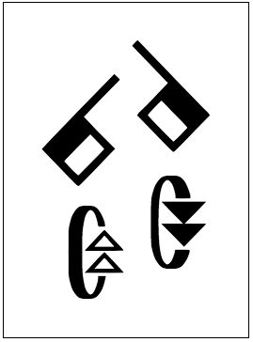
Padding - All Symbols
Signs default with a tight bounding-box.
Styling String
-P10
Padding value must be a 2 digit string, from 01 to 99.

Slide 7
Background - All Symbols
Signs default with a transparent background
Styling String
-G_lightblue_

Slide 8
Detail Colors - All Symbols
Signs default with a
black line and white fill
Styling String
-D_red_

Slide 9
Detail Colors - All Symbols
Signs default with a
black line and white fill
Styling String
-D_red,yellow_

Slide 10
Zoom Level - All Symbols
Signs default with a
size of 1
Styling String
-Z6.4
Zoom level can be any integer or decimal value.

Slide 11
Combinations - All Symbols
Styling String
-P10G_lightblue_D_red,yellow_Z4
Styling String
-CP10G_lightblue_Z4
The order of the styling options is important.

Slide 12
Detail Colors - Specific Symbols
Styling String
--D01_red,yellow_
Styling String
--D02_red,transparent_
Styling String
--D03_red_
Specific symbols are identified using a 2 digit string, from 01 to 99.

Slide 13
Zoom Level - Specific Symbols
Styling String
--Z01,2
Styling String
--Z02,2,480x490
Styling String
--Z03,2,510x500
The zoom level for specific symbols allows for an optional adjustment coordinate, with 500x500 meaning no adjustment.

Slide 14
Complex Styling
Styling String
-P10G_lightblue_Z2-D01_red_D02_blue_D06_red_D07_blue_Z05,2
The order of the styling options is important.

Slide 15
Beyond SignWriting Plain Text
Version 2
by Stephen E Slevinski Jr
slevinski@signwriting.org
http://slevinski.github.io
http://www.slideshare.net/StephenSlevinski/presentations

Slide 16
Styling String
Character Changes and Additions
 | v1 | v2
Color Start Marker | Left Parenthesis ( | Underscore _
Color End Marker | Right Parenthesis ) | Underscore _
Symbol Specific Section Marker | Plus Sign + | Minus Sign -
Size Unrestricted Value |  | Small X Zx is valid

