Slide 1
SignWriting in
Unicode Next
Prepared for UTC # 148 (August 3-5, 2016)
a Unicode Technical Committee meeting in Redmond, WA
by Stephen E Slevinski Jr
in association with the Center for Sutton Movement Writing

Slide 2
The Big Umbrella of the Center for Sutton Movement Writing
All sign languages supported right now.
Various hand writing styles.
Formal SignWriting Standard.
4+ years of stable and free standards.
Many implementations from separate groups.

Slide 3
Formal SignWriting
FSW is a formal language and a script encoding
AS18711S20500M514x517S18711490x483S20500486x506
Time
Space
AS18711S20500
M514x517S18711490x483S20500486x506
A
S18711
S20500
M514x517
S18711490x483
S20500486x506
M
514x517
S18711
490x483
S20500
486x506
Sequence
Marker
(514,517)
(490,483)
(486,506)
Symbol
Middle Lane
SignBox
Max
Coord
Spatial
Symbol

Slide 4
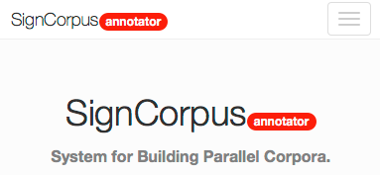
2016 Highlight - SignCorpus
Formal SignWriting
Web Interface
Generates flat file data
https://bitbucket.org/unipampa/signcorpus
A Web Tool for Building Parallel Corpora
of Spoken and Sign Languages.
http://www.signwriting.org/symposium/presentation0057.html

Slide 5
Real World Impact
Moving forward with sign language projects under Wikimedia.
WikiConference USA
October 2016 in San Diego
https://meta.wikimedia.org/wiki/WikiConference_USA
Formal SignWriting
Adoption
Unicode
Considerations
SignWriting Encyclopedia Projects: Wikipedias in
American Sign Language and Tunisian Sign Language
http://www.signwriting.org/symposium/presentation0064.html

Slide 6
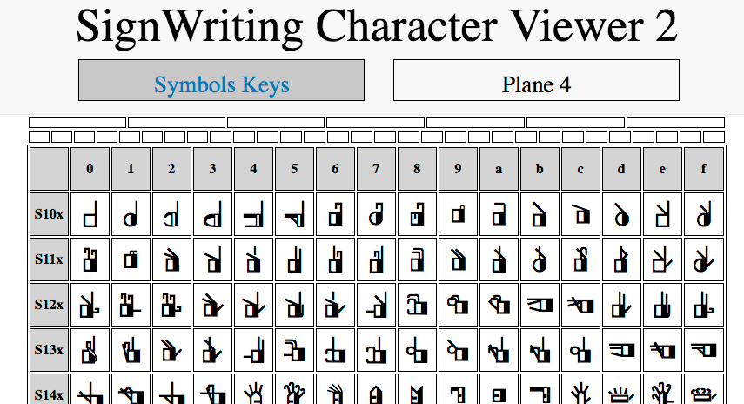
CSMW Proposal for Unicode 10
and 2016 Font Development
Symbol Encoding Model
Plane 4 (37,811 characters)
No Private Use Area
No Ligatures
Temporary Characters
used with 2 TrueType Fonts
16-bit glyphs set
created by Valerie Sutton
652 Palettes of 6 by 16 Grid
SVG and CSS
for presentation
Dynamic Pages: single file 114 KB
http://signbank.org/SignWriting_Character_Viewer_2.html

Slide 7
CSMW Proposal for Unicode 10
with Vertical Layout and Lanes
HTML and CSS Hardcoded
http://codepen.io/Slevinski/pen/zqGNqz
JavaScript and CSS Dynamic
http://codepen.io/Slevinski/pen/MywOej
Visit either link, then change page size or zoom.
The signs will reflow into different columns.

Slide 8
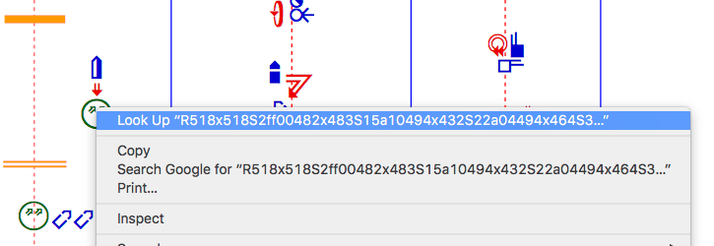
CSMW Proposal for Unicode 10
Individual Sign Copy and Paste
Double-Click or Triple-Click an individual signs to select.
Use the Alternate-Click on the same sign for a menu to copy.
An individual sign may or may not appear selected.

Slide 9
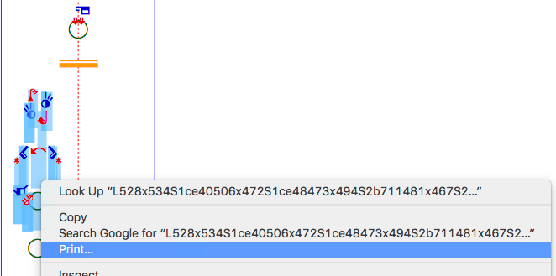
CSMW Proposal for Unicode 10
Multiple Sign Copy and Paste
Using the mouse, click and drag to select several signs.
The FSW will be selected, possibly with plane 4 or 16 characters.

Slide 10
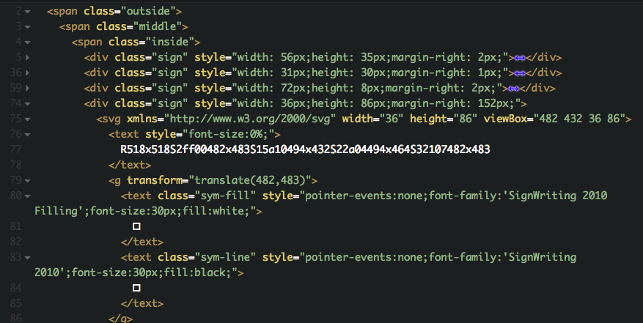
CSMW Proposal for Unicode 10
with Vertical Layout and Lanes
HTML
FSW
source
coordinates
Unicode
Plane 4 or 16
for S2ff00
http://codepen.io/Slevinski/pen/zqGNqz

Slide 11
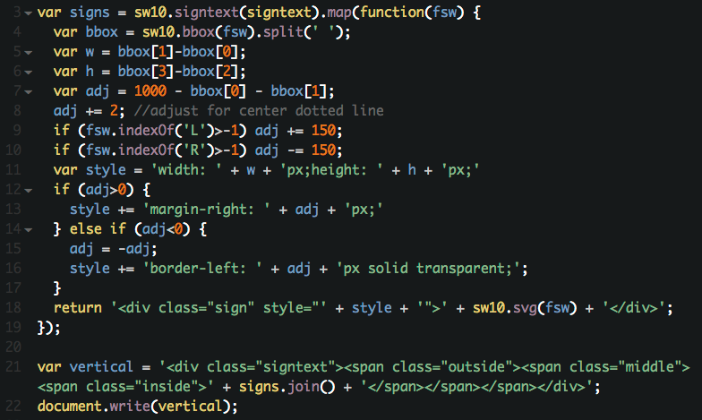
CSMW Proposal for Unicode 10
with Vertical Layout and Lanes
JavaScript
FSW
source
coordinates
Unicode
Plane 4
for S2ff00
http://codepen.io/Slevinski/pen/MywOej

Slide 12
Formal SignWriting and Fonts
Render FSW with css, zoom, and reflow
https://slevinski.github.io/SignWriting_Character_Viewer/
Version 1: Private Use Area Plane 16
SignWriting 2010 Fonts
Version 2: Proposed Unicode 10 Plane 4
Sutton SignWriting Fonts
Sutton SignWriting rendered from Formal SignWriting
with 2 KB each of HTML, CSS and JS
http://codepen.io/Slevinski/full/XKRPzm/

Slide 13
SignWriting in Unicode Next
Discuss accomplishments
Share insights
Create action items
SignWriting Design, With Three
Examples and Their Representation
http://www.unicode.org/L2/L2015/15219-signwriting-design.pdf

Slide 14
SignWriting Design, With Three
Examples and Their Representation
M536x518S2ff00482x483S10000521x457

Slide 15
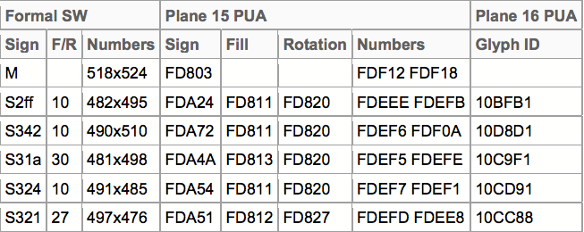
SignWriting Design, With Three
Examples and Their Representation
M518x524S2ff10482x495S34210490x510S31a30489x498S32410491x485S32127497x476

Slide 16
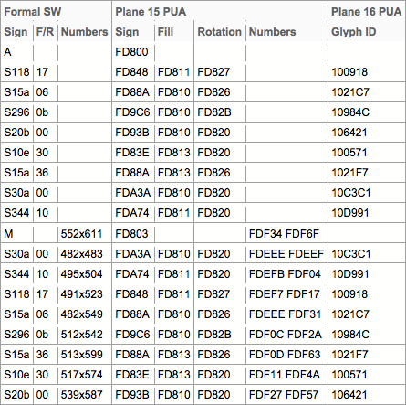
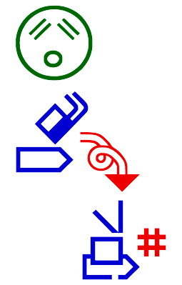
SignWriting Design, With Three
Examples and Their Representation
AS11817S15a06S2960bS20b00S10e30S15a36S30a00S34410M552x611S30a00482x483S34410495x504S11817491x523S15a06482x549S2960b512x542S15a36513x599S10e30517x574S20b00539x587

Slide 17
Discussion Ideas
Script Encoding Model
PUA Plane 15 (1,179 characters)
2-Dimensional Layout with Graphite and Cartesian coordinates
SignWriting has a prototype font that uses Cartesian coordinates to control the 2-dimensional layout with Graphite and PUA Plane 15 characters. If you have any experience with 2-dimensional layout using Cartesian coordinates, let’s discuss the possibilities.
Symbol Encoding Model
PUA Plane 16 (37,811 characters)
Entire Plane for the International SignWriting Alphabet 2010
The ISWA 2010 uses 37,811 glyphs. Each glyph has a unique code point on Private Use Area Plane 16. These code points are used in the 16-bit font files. Rather than use plane 16, it would be nice to use Plane 4.
both designs are productive and plane 16 is used with fonts

Slide 18
CSMW Proposal Workflow
Unicode 10
TTF
16-bit
Server Side
single character per symbol
CSS
SVG
SVG Shapes
style text
15 times expansion
paths without Unicode text and fonts
ASCII Lite Markup
10% to 50% reduction
Formal SignWriting
Query Strings
JS
search results
6 KB zipped
15 to 50 times expansion
Regular Expressions
process million of characters per second

Slide 19
Discussion Ideas
2-Color Fonts
SignWriting relies on a 2-color font. Currently, SignWriting mimics a 2-color font by using 2 TrueType Fonts: one for the line and another for the filling. If you have any experience with 2-color fonts, let’s discuss the possibilities.
Glyphs with 2 Types of Space
SignWriting creates signs as 2-dimensional arrangements of symbols. The glyphs for the SignWriting symbols have 2 types of space: a positive space and a negative space. The positive space is visible and reveals the line or shape of the glyph. The negative space is set to a background color or made transparent. When 2 symbols overlap, the symbols are placed in order on a 2-dimensional canvas. The negative space of the top symbol will overwrite the positive space of the symbol underneath. Current software uses a background color for the negative space. MicroSoft has a solution for making the negative space transparent and still overwriting the positive space of the symbol underneath.

Slide 20
What about SW in Unicode 8?
Character encoding design history
Please deprecate
PUA Plane 15 design (1,179 characters)
The symbol only design removed 2-D layout by dropping 5 structural markers and 500 number characters
N4015 Preliminary Unicode (674 characters)
A new inherent design removes 2 characters (F1 and R1) and breaks collation as stated in proposal
N4090 Revised Unicode (672 characters)
A new facial diacritic design is proposed that is unsupported and untested
N4342 Unicode Proposal (672 characters)

Slide 21
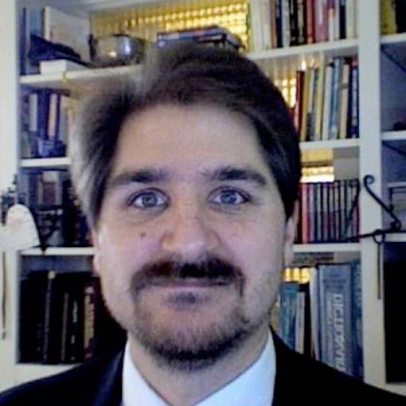
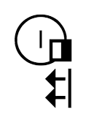
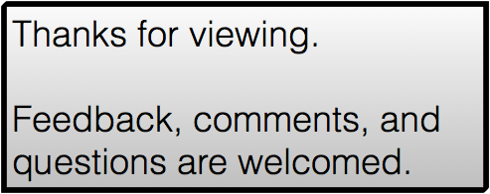
SignWriting in
Unicode Next
by Stephen E Slevinski Jr
slevinski@signwriting.org
http://slevinski.github.io
http://www.slideshare.net/StephenSlevinski/presentations

