Slide 1
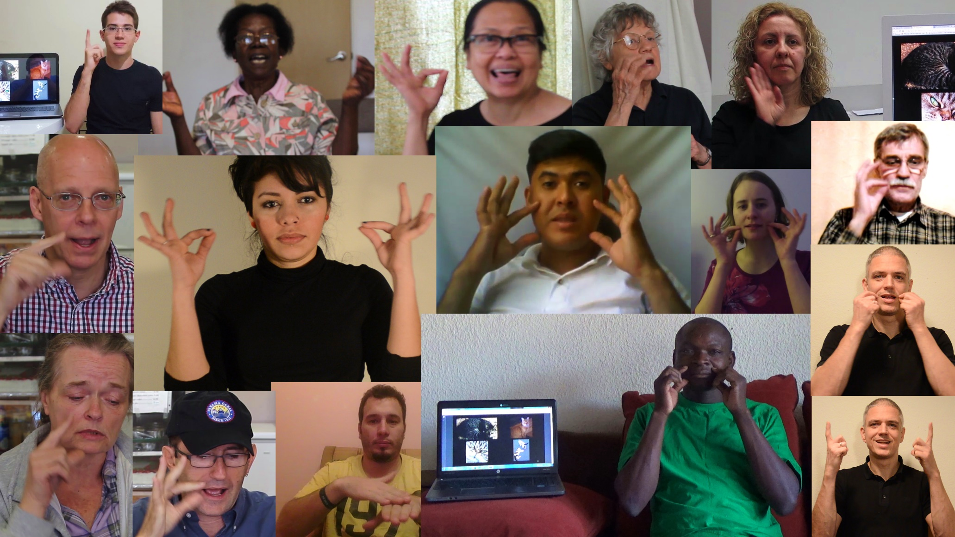
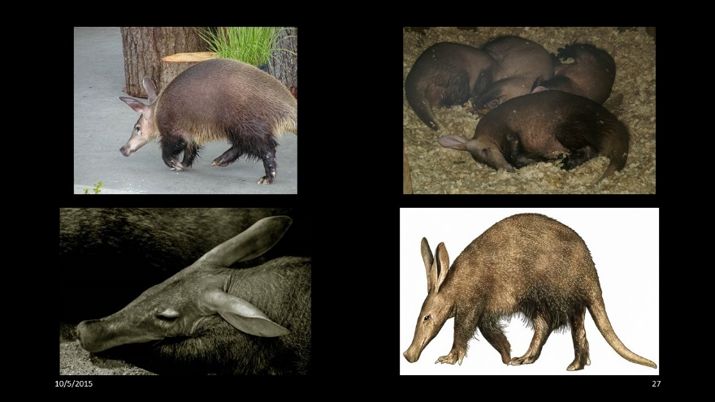
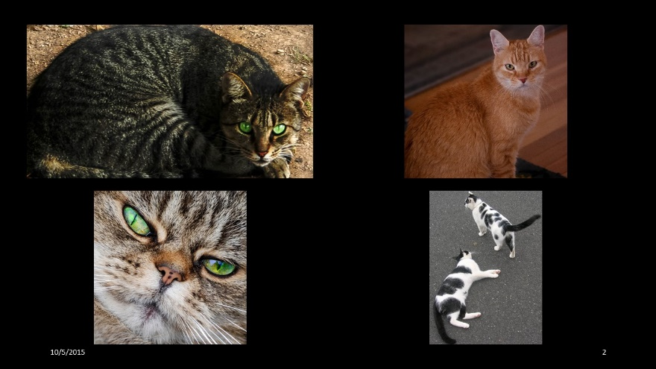
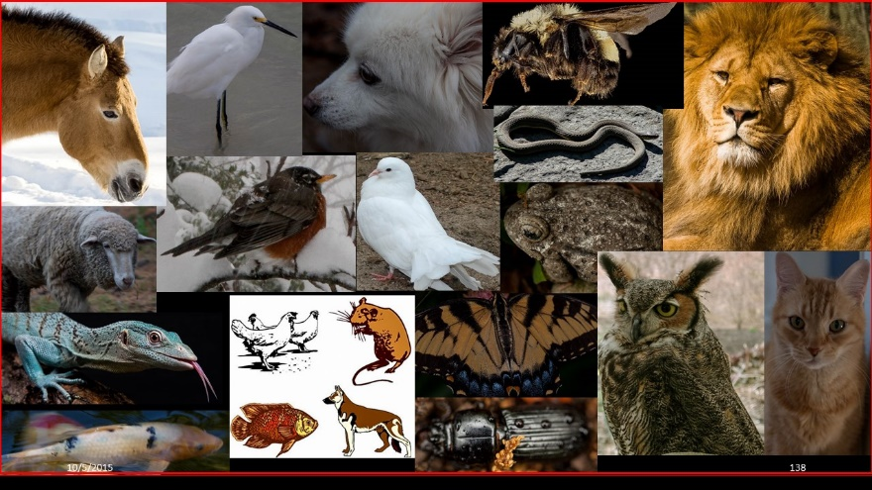
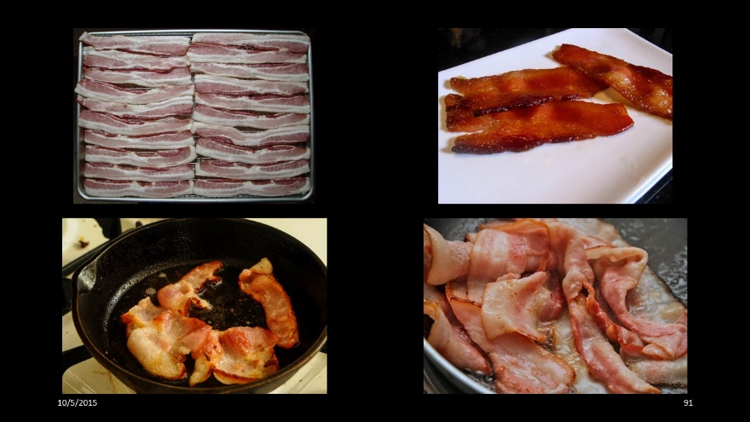
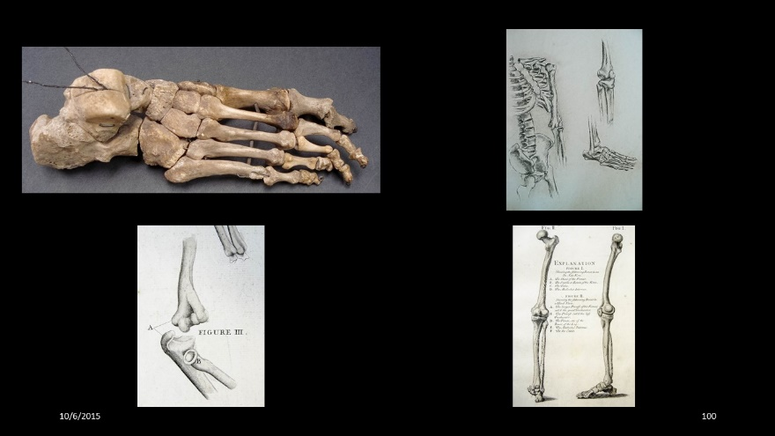
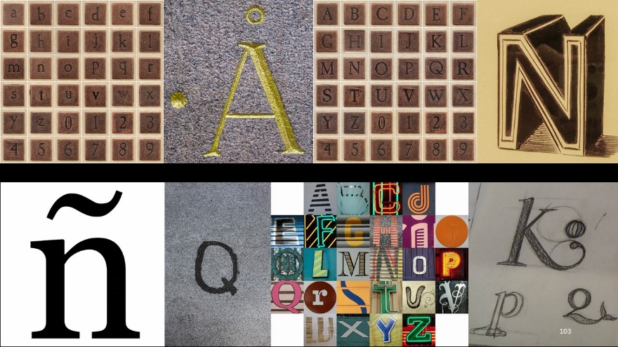
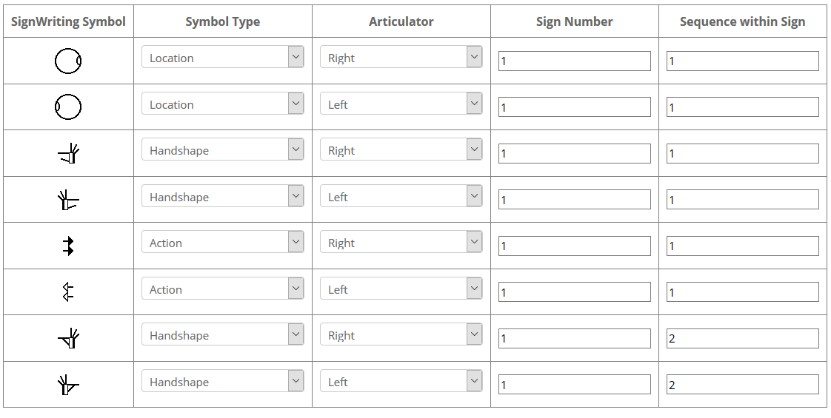
SignTyp: a cross linguistic database and dictionaries for sign languages
Harry van der Hulst
Rachel Channon
What is SignTyp?
SignTyp is a research tool – a database of phonological and phonetic information. It is also a set of online sign language dictionaries, and the prompts used to create the dictionaries.
Prompt Examples
Goals for Online Dictionaries
To collect 1000 signs each from 15+ sign languages (citation forms). Signers responds to the same prompts cross-linguistically
To transcribe each sign in SignWriting - a notation system for signs created by Valerie Sutton
To create 15+ sign online dictionaries
Goals for Research Database
To convert Sign Writing transcriptions into a more granular analytic coding to enable phonetic/phonological analysis of the structure of signs
To provide a comparative study of the phonological structure of 15+ globally diverse sign languages
To test and develop sign phonology models
To investigate the role of iconicity in phonological form
To develop a cognitive model that generalizes over ‘phonological’ form in signed and spoken languages
Dictionary Entry:
SignWriting + Signer Video + Prompt + glosses etc.
Each entry includes StructuredSignSpelling: information on hand-location-action relationships and sequence
Data Collection Process
Created more than 1000 prompts using over 5000 photos from personal collection or from Creative Commons licensed photos on Flickr. All prompts stored in pdfs on website. Multiple photos for each prompt helps clarify intended response.
Prompts are the same for all languages – no text.
Prompts cover numbers, letters, animals, nature, body, clothing, health, tools, buildings, roles, careers, recreation, vision, space, time, communication.
Signers are shown these prompts (by researchers or onsite collaborators) and their responses recorded. Sign languages collected to date from: Brazil, Croatia, Denmark, Ethiopia, France, Germany, Haiti, Honduras, Italy, Lithuania, Nepal, Nicaragua, Philippines, Portugal, Russia, Rwanda, Turkey, Uganda, United States. Videos stored on YouTube.
Signs are transcribed in SignWriting.
The SignWriting symbols and StructuredSignSpelling are used to create a phonological/phonetic database for researchers. A simplified version is shown below:
Country | entry id | Articulator | Seq | variable | SignWriting symbol | SignTyp translation
Nicaragua | 150100001 | right | 1 | location | S30006 | right cheek
Nicaragua | 150100001 | left | 1 | location | S30002 | left cheek
Nicaragua | 150100001 | right | 1 | handshape | S1d110 | index and thumb bent at first knuckle, all others extended
Nicaragua | 150100001 | left | 1 | handshape | S1d118 | index and thumb bent at first knuckle, all others extended
Nicaragua | 150100001 | right | 1 | action | S26a06 | move rightward
Nicaragua | 150100001 | left | 1 | action | S26a12 | move leftward
Nicaragua | 150100001 | right | 2 | handshape | S1d410 | index and thumb bent at first knuckle, all others extended, index contacts thumb
Nicaragua | 150100001 | left | 2 | handshape | S1d418 | index and thumb bent at first knuckle, all others extended, index contacts thumb
Nicaragua | 150100001 | sign | 0 | languagecode | NCS
Nicaragua | 150100001 | sign | 0 | signer | YSK
Nicaragua | 150100001 | sign | 0 | glosskey | Cat
Support from: NSF-grants: 0544944 (2006 – 2008); 1049510 (2011 – 2017)
Website: www.signtyp.uconn.edu

