Slide 1
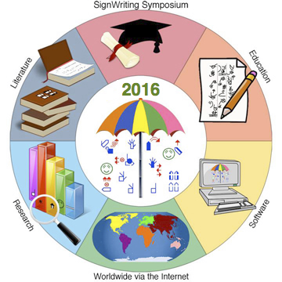
SignPuddle 3:
Front and Back
Presented at the SignWriting Symposium on July 21st, 2016
by Stephen E Slevinski Jr
in association with the Center for Sutton Movement Writing
http://www.signwriting.org/symposium/presentation0062.html

Slide 2
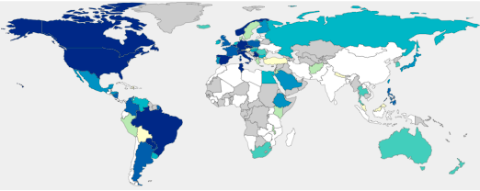
Connecting the world of SignWriters

Slide 3
Built on the SignWriting Stack
Formal SignWriting (FSW)
International SignWriting Alphabet 2010 (ISWA 2010)
Regular Expressions (Regex)
JavaScript (JS)
Cascading Style Sheets (CSS)
Scalar Vector Graphics (SVG)
TrueType Fonts (TTF)
Explorer
FireFox
Chrome
Safari
Opera
Windows
Linux
Android
OS X
iOS

Slide 4
SignPuddle Online Data
Dozens of sign languages with millions of signs.
SignPuddle Online is currently running SignPuddle 2. Every night, the SignPuddle Online data is imported into SignPuddle 3. SignPuddles 3 is actively being developed. The SignPuddle 3 data is primarily read-only.
The SignPuddle Online Data is also available in SignMaker.
http://signbank.org/signmaker.html

Slide 5
SignPuddle 3
The next iteration of SignPuddle Online uses two separate pieces of software: the front end for the users and the back end for the developers.

Slide 6
http://signpuddle.org
SignPuddle 3: Front
SignPuddle 3
Front End Preview
Formal SignWriting
HTML
SVG
CSS
TrueType Fonts
JavaScript
http://signbank.org/signpuddle3

Slide 7
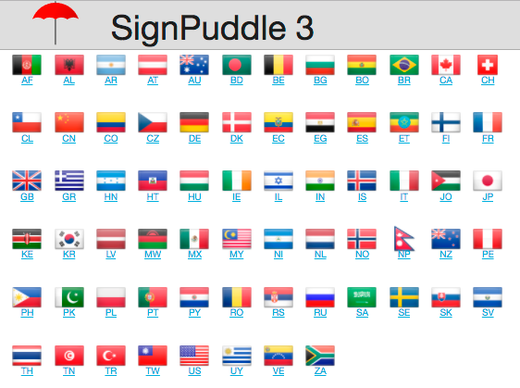
Flag Listing
http://signbank.org/signpuddle3/#/flags

Slide 8
Languages by Country Code
http://signbank.org/signpuddle3/#/flags/US

Slide 9
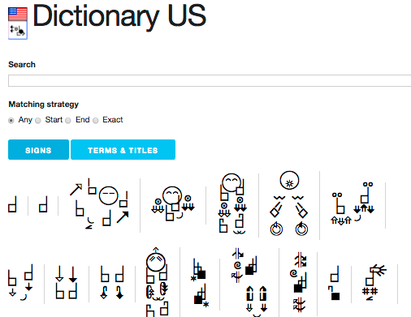
Dictionary by Language Code
http://signbank.org/signpuddle3/#/puddle/ase

Slide 10
Puddle Entry Information
http://signbank.org/signpuddle3/#/puddle/ase/5292

Slide 11
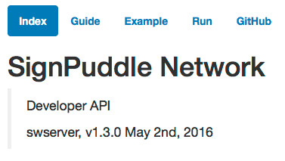
http://signpuddle.net
SignPuddle 3: Back
HTTP Resources
HTTP Methods
HTTP Responses
JSON Data
Formal SignWriting
SVG with fonts
SVG without fonts
https://github.com/Slevinski/swserver/

Slide 12
SignWriting Server
Access HTTP Resources
Tools for display and searching
Shared repository of user data with security
Communicate using HTTP methods
Interact with HTTP Resources through a URL
Use methods of GET, PUT, POST, and Delete
Receive HTTP Responses
Returns data in FSW, SVG, and JSON
User security, paging, and rate limiting may apply

Slide 13
API Blueprint
API Development Standard
https://apiblueprint.org/
Markdown text file
http://signpuddle.net/Guide.md
HTML Developer Guide
Automatic generation with “hiro”
http://signpuddle.net/Guide.html

Slide 14
SignWriting Server Examples
Example API Calls as JSON
http://signpuddle.net/Example.json
Documented API Responses
http://signpuddle.net/Example.md
http://signpuddle.net/Example.html
Run Examples Live
http://signpuddle.net/Run.html

Slide 15
Server Section
API Calls for Files
Call Guide
signpuddle.net/Guide.html#server
Documented Responses
signpuddle.net/Example.html#server
Run Examples Live
signpuddle.net/Run.html#server

Slide 16
SVG Section
API Calls for Images
Call Guide
signpuddle.net/Guide.html#svg
Documented Responses
signpuddle.net/Example.html#svg
Run Examples Live
signpuddle.net/Run.html#svg

Slide 17
Regex Section
API Calls for Regular Expressions
Call Guide
signpuddle.net/Guide.html#regex
Documented Responses
signpuddle.net/Example.html#regex
Run Examples Live
signpuddle.net/Run.html#regex

Slide 18
World Section
API Calls for Countries and Languages
Call Guide
signpuddle.net/Guide.html#world
Documented Responses
signpuddle.net/Example.html#world
Run Examples Live
signpuddle.net/Run.html#world

Slide 19
Puddle Section
API Calls for Signs and Entries
Call Guide
signpuddle.net/Guide.html#puddle
Documented Responses
signpuddle.net/Example.html#puddle
Run Examples Live
signpuddle.net/Run.html#puddle

Slide 20
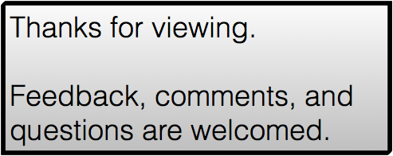
SignPuddle 3:
Front and Back
by Stephen E Slevinski Jr
slevinski@signwriting.org
http://signpuddle.com
http://www.signwriting.org/symposium/presentation0062.html

