Slide 1
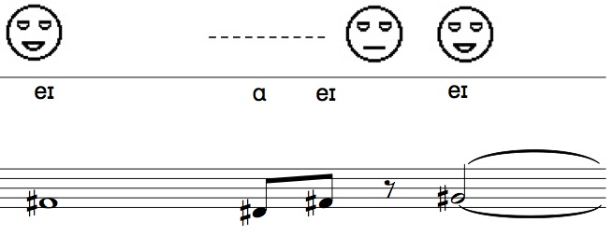
Thoughts on Sutton SignWriting as Musical Notation
Ron Shalom

Slide 2
Overview
Standard and non-standard musical notation
Notational techniques for composing movement and gesture
Problem Child and Sutton Signwriting
Possibilities for SSW in a musical context

Slide 3
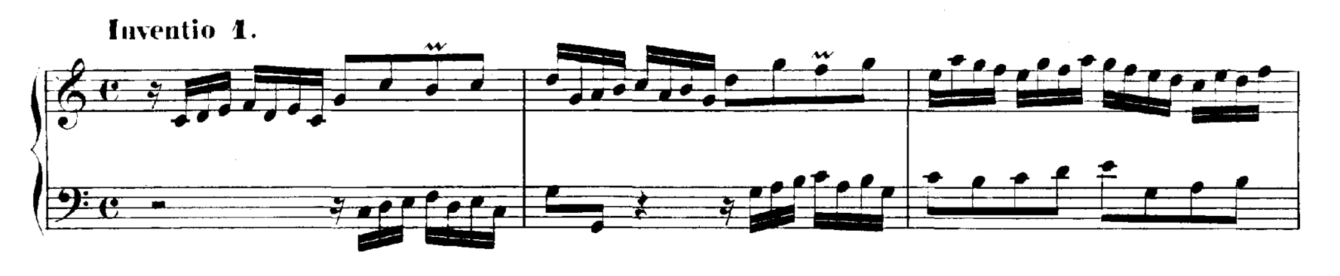
Standard Notation
Musical notation:
  To record instructions for a performer (e.g., score)
  To document musical activity in a non-musical modality (e.g., transcription)
Western art music notation:
  Visual notation predominates
  systematic, symbolic, iconographic and linguistic

Slide 4
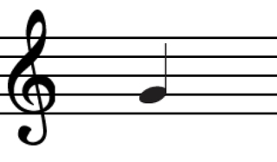
Standard Notation
Pitch: how “high” or “low” a sound is (e.g., on a keyboard)
Rhythm: when and for how long a sound occurs
A note conveys both pitch and rhythm
Common Practice Era music (ca. 1600-1900)

Slide 5
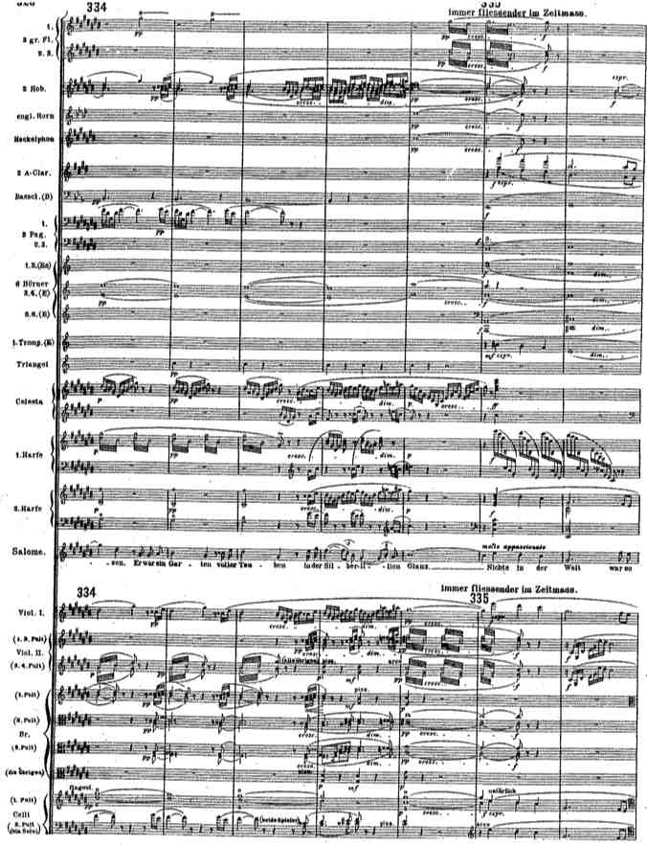

Slide 6
Non-standard Notation
Shift in musical practices:
  Changing interests and values in Western art music
  Growing use of Western notation in other musics
  Awareness of musical features and parameters not accommodated by traditional notation

Slide 7
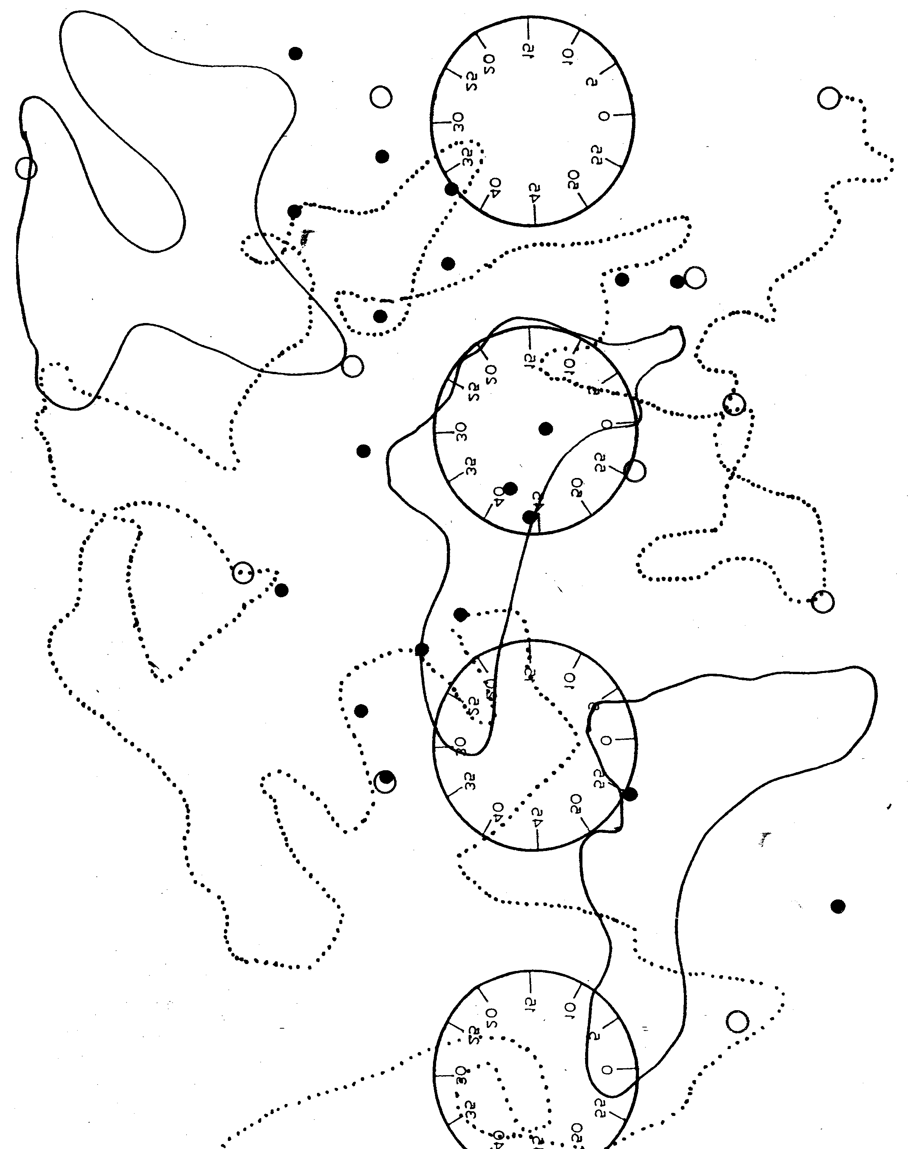

Slide 8
Composing for Movement and Gesture
Not readily incorporated into standard notation
No schema popularly favored among composers

Slide 9
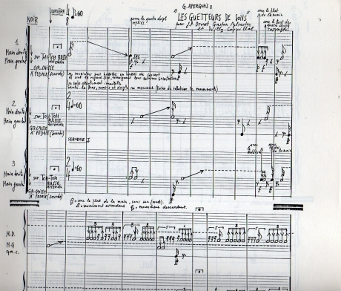
Composing for Movement and Gesture
George Aperghis, Les Guetteurs du Sons (1981)

Slide 10

Composing for Movement and Gesture
Marek Poliks, tress/burl (2012)
“All graphemes or other signs deployed in this work function prescriptively; they denote or inform a physical action. Given the normative hermeneutics of musical notation, prescription in this context must be defined negatively – the notation here does not describe the consequences of the activity it commands, nor does it bespeak a modality of performance oriented towards sonic ends. Conventional logographs positioned upon a staff mark positions and intensities of finger pressure along a string [or a tablature shorthand indicating fingerings], not sounding pitches. Conventional dynamic markings indicate a balance between bow speed and bow pressure [or a level of breath intensity and embouchure control]. Such compromises facilitate an intuitive or idiomatic execution of the score while, through a number of complicating factors, maintaining critical distance from the conventions of performance practice.”

Slide 11
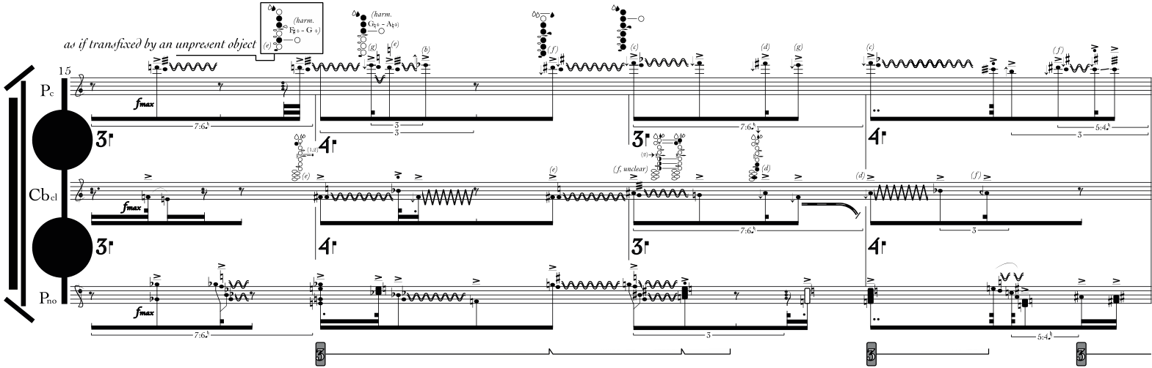
Marek Poliks, tress/burl (2012) (excerpt)

Slide 12
Composing with Sutton SignWriting
What SSW affords:
  Ready-made script system for nonmusical, paramusical or extramusical gestures
  Usable in relation to musical instruments
  Compatible with “horizontal” (temporally sequenced) and “vertical” (simultaneous) elements of standard musical notation

Slide 13
Composing with Sutton SignWriting
Limitations of SSW:
  SSW symbols retain vagueness
    Feature shared with all symbolic systems, including musical notation.
      Phonemes
      Pitch (in Western music)

Slide 14

Composing with Sutton SignWriting
Limitations of SSW:
  SSW symbols retain vagueness
    Also an advantage.
    “Eyes half open, open-mouthed smile, head tilted towards wall”
      Open how many millimeters? Tilt angle? Jaw position? Mouth shape? Etc.

Slide 15
Problem Child (2014)
Written for double bass and facial expression (two performers, with facial expressionist positioned in front of bassist). Score available online
Utilizes standard musical notation for bass, and SSW for face along with International Phonetic Alphabet for expressionist’s mouth shape
Intended to explore illusory effect of sounds coordinated with mouth shapes

Slide 16
Problem Child (2014)
“One of my compositional aims was that the facial expression observed by the audience would change their perception of the sound of the double bass occurring at that moment. Through a sort of suspension of disbelief, the audience might choose to ‘hear’ the sound of the bass as issuing from the expressionist's mouth, and thus 'hear' the formant of the vowel suggested by the expressionist's mouth shape. Likewise, they may also 'hear' sounds that the bassist is not making when the expressionist holds an expression for longer than the bassist holds a note.”

Slide 17
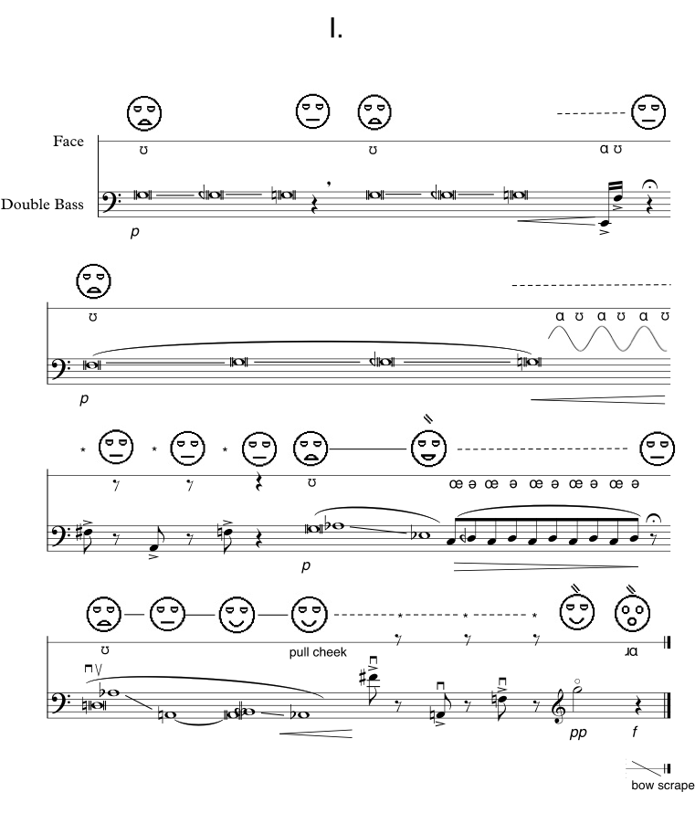

Slide 18
Problem Child (2014)
Challenges:
  Facial expressionist in front of bassist amplifies illusory effect, but requires that performance decisions be planned and internalized rather than spontaneous

Slide 19
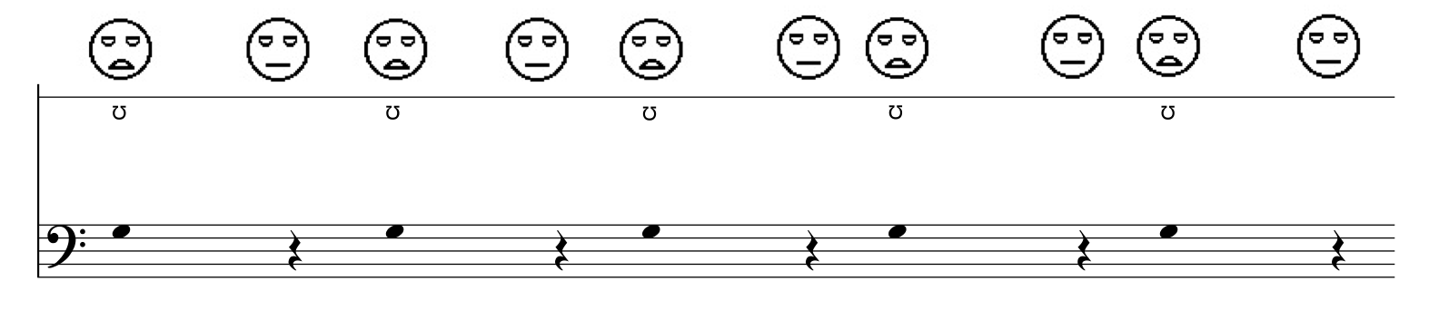
Problem Child (2014)
Challenges:
  Interest in composing musical situations rather than prescribed activities, leaving wide interpretive range.
    No temporal grid: trade-off of precise coordination between performers

Slide 20


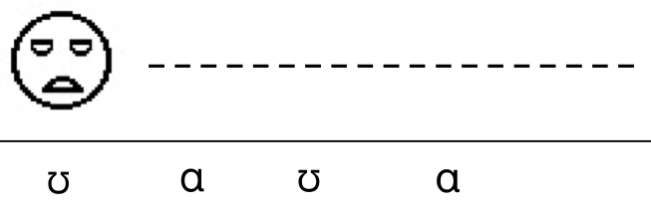
Problem Child (2014)
  Interest in composing musical situations rather than prescribed activities, leaving wide interpretive range.
  Vagueness of SSW symbols
    No established tradition of interpretation in a musical context
    What will be the difference between and ?
    Are ɑ and ʊ sufficiently visually distinct?

Slide 21
Problem Child - video

Slide 22
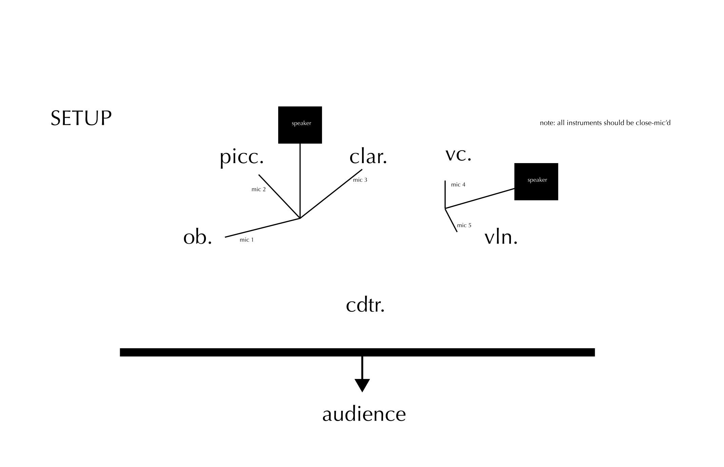
Possibilities for SSW in a musical context
Theatrical considerations, e.g. staging, directions, multi-performer instructions
Poliks, mrlrr (2010), staging instructions

Slide 23
Possibilities for SSW in a musical context
SSW as augmentation to standard musical notation, to indicate spatial or physical specifications

Slide 24
Possibilities for SSW in a musical context
Use of SSW symbols within a grid or other visual structure, appropriate to scale of body movements of musicians in relation to their instruments

Slide 25
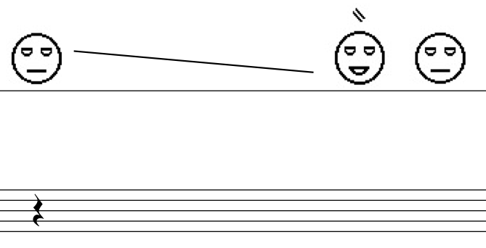
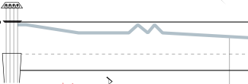
Possibilities for SSW in a musical context
Attention to range of mouthshape/head tilt in Problem Child
Poliks, a tabulation/an unmarking (2013), indication of bow placement on ‘cello

Slide 26
Thoughts? ron.c.shalom@gmail.com
Article available shortly at pabotadiku.com

