Slide 1
The relevance of SignWriting as a way of transcribing the phonology of Sign Languages
Msc. Roberto César Reis da Costa
Madson Barreto
Brazil, July, 23rd 2014.

Slide 2
Our Aim
This lecture aims at presenting the relevance of SignWriting (SW) as a way of transcribing the phonology of Sign Languages.
We will focus on the prosodic model of sign language phonology (BRENTARI, 1998), as well as the SignWriting system (SUTTON).

Slide 3
Notations’ Systems for Sign Language
Mimographie
Stokoe’s Notation
Hamburg Notation System – HamNoSys
Writing System for Sign Languages – ELiS
SignWriting

Slide 4
What is SignWriting?
“SignWriting is a direct visual writing system in which sign languages can be written with no prior need to translate into an oral language. As the letters of Latin alphabet are used to write in Portuguese, English, French, among other oral languages, SignWriting has a set of symbols that can be used to write any sign language”.
(BARRETO; BARRETO, 2012:42, our translation)

Slide 5
Transcription of Sign Languages: Why SignWriting (SW)?
Stokoe’s Notation
HamNoSys
ELiS
It is quite likely that most of the notations’ systems of sign languages seems to be arbitrary.

Slide 6
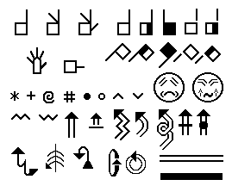
Transcription of Sign Languages: Why SignWriting (SW)?
SW depicts most of the iconicity inherent to each sign.

Slide 7
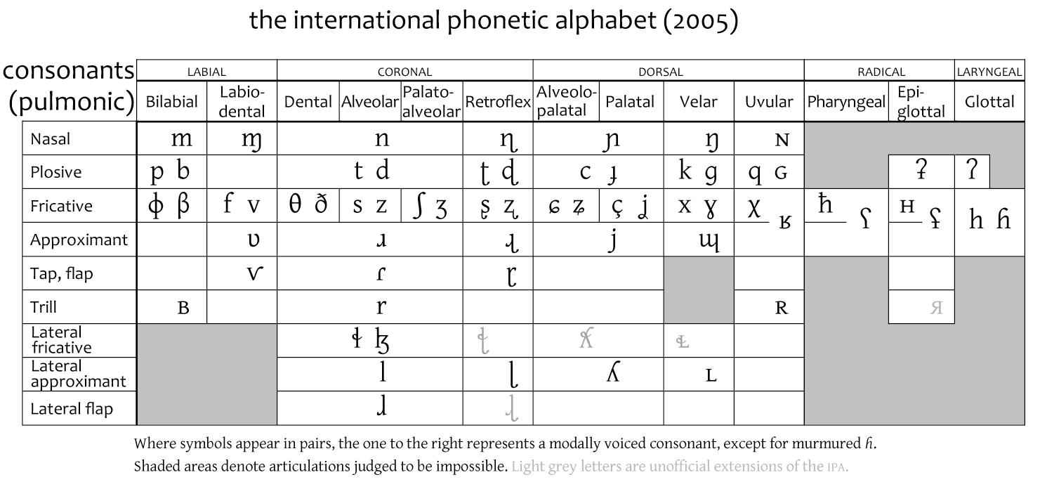
Transcription of Sign Languages: Why SignWriting (SW)?
If phonologists of spoken languages can use the IPA to transcribe any oral language, phonologists of signed languages can use SW to transcribe any sign language.

Slide 8
Phonological Patterns
Generality
Generalization
Design
Uniqueness
Scaffolding
(BERENT, 2013:8)
Notes:
Iris Berent is a Professor of Psychology at Northeastern University, Boston. Her research concerns phonology, morphology, and reading. She has published extensively in psychological and linguistic journals.
a. Generality: All established languages exhibit phonological patterns.
b. Generalization: Phonological patterns are not confined to the memorization of familiar patterns.
(i) People generalize the patterns of their language to novel words.
Phonological systems reemerge spontaneously.
c. Design: Phonological patterns manifest a shared design.
(i) The phonological patterns of different languages share a common design.
(ii) The design of phonological systems is partly shared across modalities – for signed and spoken language.
d. Uniqueness: The design of phonological systems is potentially unique.
It differs from the design of nonlinguistic auditory forms of communication.
It differs from the structure of auditory communication systems used by nonhuman species.
e. Scaffolding: The design of the linguistic phonological system lays the foundation for the invention of reading and writing.

Slide 9
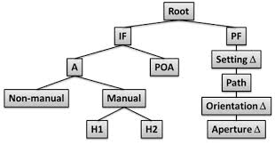
A Prosodic Model of Sign Language Phonology

Slide 10
Phonological Processes
The parts of signs may occur in different orders, and the parts of signs may influence each other. These variations are due to phonological processes (that is, the ways in which the parts of signs interact with each other).
(VALI; LUCAS & MULROONEY, 2005: 40)
Notes:
The phonological processes

Slide 11
Phonological Processes
Costa (2012) has observed phonological processes (assimilation, elision, epenthesis and metathesis) by analyzing signs through the use of SW.

Slide 12
Phonological Processes
Assimilation
This process involves the incorporation on a segment of the features from another which is adjacent to it.
(COSTA, 2012:168)

Slide 13
Phonological Processes
Elision
The process presupposes the erasing of a given trait, and hence the suppression of its all respective subnodes that are linked to the tier in the deleted node.
(COSTA, 2012:169)

Slide 14
Final Considerations
If SW is used to transcribe signs phonologically, phonologists from different countries will ‘speak’ the same language;
By speaking the same language, they will be able to find out linguistic universals in terms of phonology;
The set of handshapes designed for SW should be used to make up an “IPA” for sign languages.

Slide 15
Thanks for your attention.
Our Contacts:
Roberto Costa
roberto.fono@gmail.com
Madson Barreto
contato@librasescrita.com.br
www.librasescrita.com.br

Slide 16
References
BARRETO, M.; BARRETO, R. (2012) Escrita de Sinais sem mistérios. Belo Horizonte: edição do autor.
BERENT, I. (2013) The phonological mind. New York: Cambridge University Press, 2013.
BRENTARI, D. (1998) A prosodic model of Sign Language phonology. Cambridge, MA: MIT Press.
COSTA, R. C. R. (2012) Proposta de instrumento de avaliação fonológica da Língua Brasileira de Sinais: FONOLIBRAS. Dissertação (Mestrado). Salvador: Universidade Federal da Bahia, Instituto de Letras.
VALLI, C.; LUCAS, C.; MULROONEY, K. J. (2005) Linguistics of American Sign Language: an introduction. Washington, DC: Gallaudet University Press.

