Slide 1


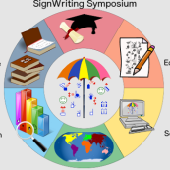
SignAnimating
By André Lemyre
Quebec, Canada
SignWriting Symposium 2014

Slide 2
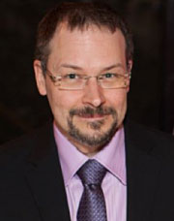
Author
I live in Quebec, Canada.
I am a Bachelor of Social Work and in Computer Sciences.
I worked as a counselor helping immigrants adjust to living in Canada, and now I work as a software tester in the medical field.
I developed an activity guide to teach SignWriting to children.
André Lemyre
andre-andre@hotmail.ca

Slide 3
Four Animation Guides
Four manuals are posted on the web:
http://www.signwriting.org/symposium/presentation0020.html
1-Techniques is a step-by-step instructions on how to produce SignAnimating video or GIF files.
2-Design is a reflection on several possible layouts and the advantages and limitations of each one.
3-Symbols suggests conventions on how SignWriting symbols may be converted to SignAnimating symbol sequences.
4-SpeechAnimating is a reflection on how to animate SpeechWriting.

Slide 4
1-Techniques

Slide 5

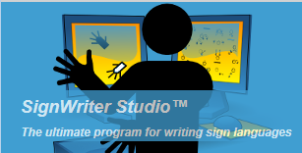


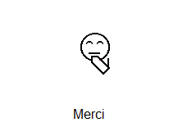


Animation Process Overview
1
4
2
5
or
3
or
or
Notes:
SignAnimating is performed in 5 main steps:
Export official signs from SignPuddle.
Import the signs in SignWriter Studio in a separate project. Create intermediary signs to animate.
Split the intermediary signs into several image files in Microsoft Paint.
Assemble the image files in one animation. There is a choice of several free software available for animation.
Verify the results in a web browser or in a PowerPoint presentation.

Slide 6
Free Softwares
http://www.signbank.org/signpuddle/
http://signwriterstudio.com/
http://windows.microsoft.com/fr-CA/windows/get-movie-maker-download
http://www.online-image-editor.com/gifmaker/
http://gifmaker.me
http://www.gimp.org/downloads/

Slide 7
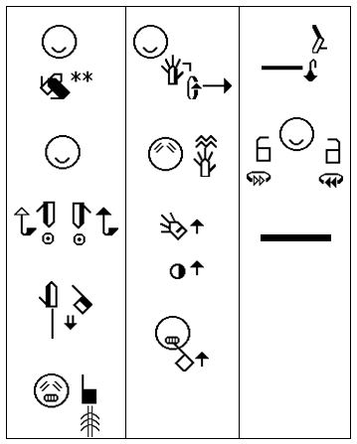
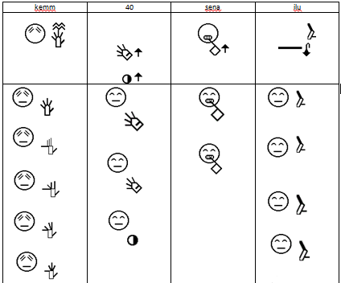
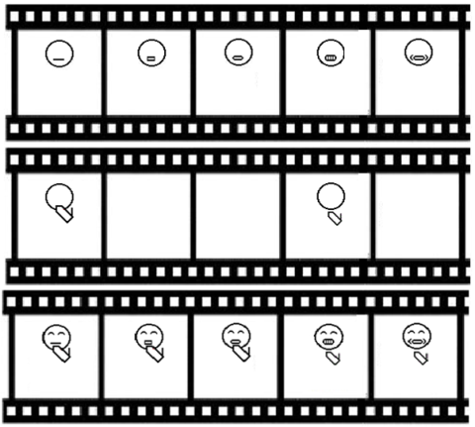
Storyboard
Notes:
Get a written copy of the complete text to animate.
A single sign modification may require realigning the whole animation if it is larger than the other signs.
A glosses transcription is required to name the image files and ease the reuse of signs animation.
Create a storyboard table with one gloss per column on the first line. Write each sign in the second line. In the third line, prepare a draft on how the animation will be performed.
This table can be handwritten.
This storyboard will be used to ensure the harmony of the animation: frame size, face and expressions, similar number of frame for each sign. Faster and slower or repeated signs will have a different amount of frames.
SpeechWriting may be used in animation. The amount of visible syllables combined with the amount of hand configuration or displacement determines the minimal number of frames required.

Slide 8
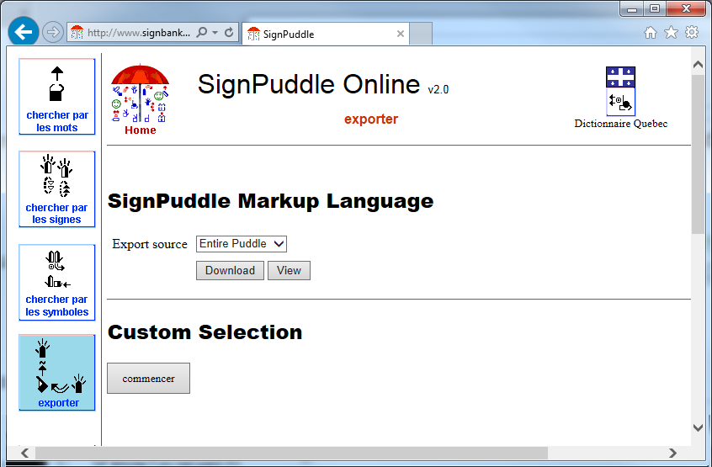
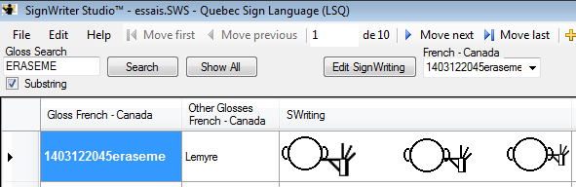
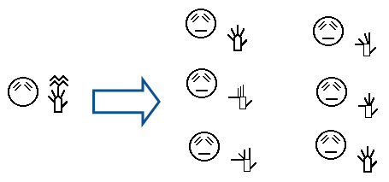
SignWriting Steps
Notes:
SignWriting steps:
It is preferable to use a dedicated local workspace on a personal computer to create entries that contain decomposed signs in sub-sequences of movements. This avoids cluttering SignPuddle online database and personal local databases.
Select and export the SignPuddle official dictionary or a subset in a file.
Import the dictionary in SignWriter Studio.
Select an existing sign.
Create a copy of the sign or create a new sign.
Edit the sign by selecting symbols to duplicate or to reposition.
If necessary, add a face. It defines where the hands will be located.
Zoom-in or zoom-out the hand shapes to represent depth.
Remove most movement symbols.

Slide 9
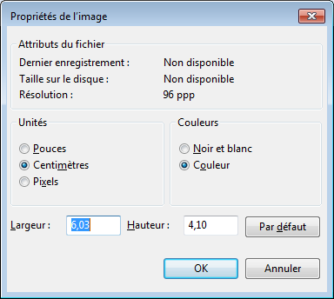
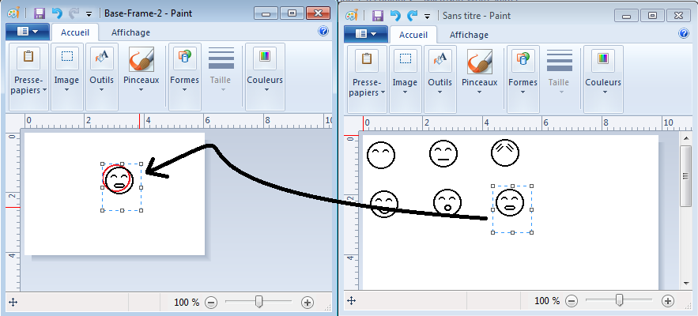
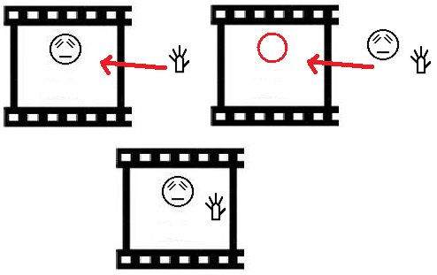
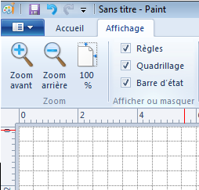
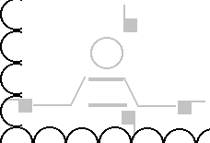
Frame Preparation Steps
Notes:
Frame Preparation Steps:
Launch 2 instances of Microsoft Paint.
One will be used as a source of symbols for the whole sign and the other will contain the frame currently edited.
Enable the display of the grid.
Resize the Microsoft Paint display so each sign of the animation will fit.
Suggestion: 6 cm by 4 cm. This represents 4 ½ head diameters by 6 ½ head diameters.
Save the file in .gif format.
Copy an image of SignWriter Studio symbols.
Paste the symbols’ image in Paint.
Paste with transparency the required symbols of the sign.
Always keep the head at the same location, otherwise it will move during the animation.
Create several copies of the file with the same name and a counter.
Edit each file to represent the movement.

Slide 10
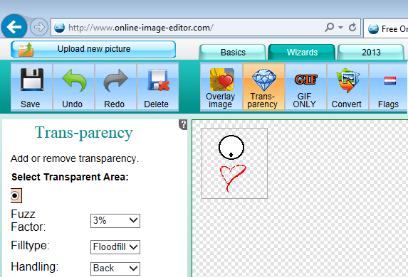



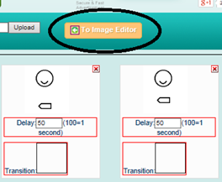
Animation steps
Maximum
15 images
Notes:
Animation steps:
Load the files in a gif animator.
Warning, only 15 images can be included in each animation with this editor, other accept 30 images or more.
Select the duration of each image.
Choose to Edit the images.
Apply the background transparency if desired.
Save the file on the computer.
Double click the file to open it in an internet browser. Verify that the intended result is obtained.
Insert the animation in PowerPoint with a colored background to verify its transparency.

Slide 11
2-Design
Notes:
This document suggests several alternative designs on how best to represent signs with SignWriting animation. It discusses the advantages and limitations of animations over static SignWriting.

Slide 12
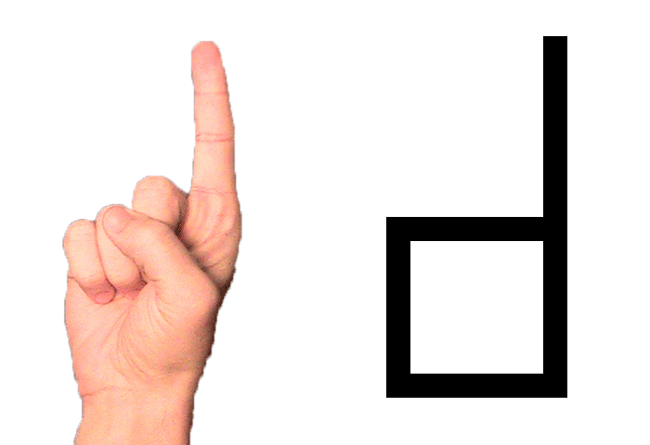
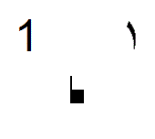

Designs
Frost, Adam (2010) ISWA 2010 Symbol. Lessons Online Web lessons show moving all hand shapes with symbols. http://www.signwriting.org/lessons/iswa/
Bonne journée (Good day):
1. LSQ: SignWrting
2. LSQ: SignAnimating
3. French SpeechWriting (bɔn ʒuʀne)
4. LPC Cued Speech with SpeechAnimating
Notes:
Animated gif images may be used on web pages, pop-up windows, buttons, e-mails, PowerPoint documents…

Slide 13
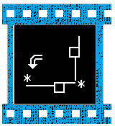
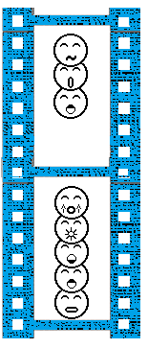
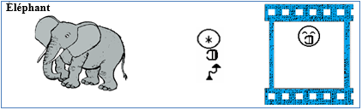
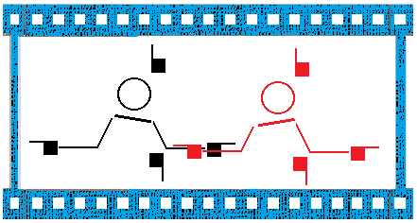
Designs
Notes:
SignWriting is more abstract and concise; it uses Movement symbols and leave out unnecessary details.
In SignAnimating only a fraction of the SignWriting text is displayed at a given moment with a smaller surface.
The animation tends to contain facial expressions and shoulder line that are not required in SignWriting.

Slide 14
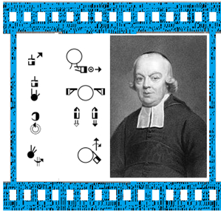
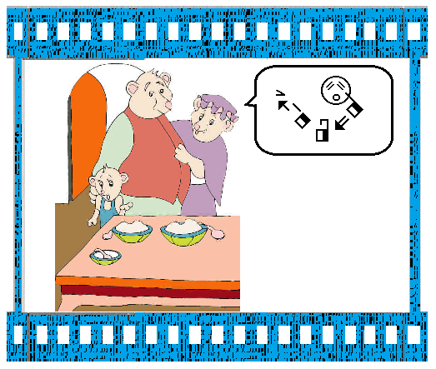
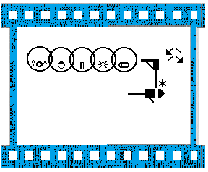
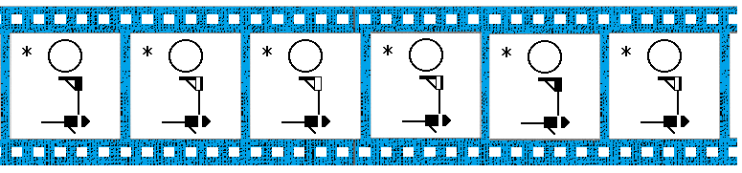
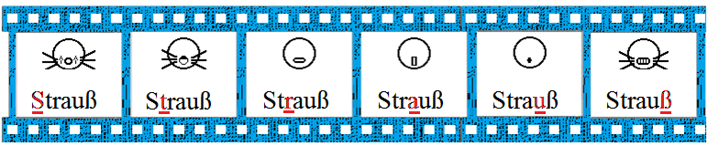
Designs
Notes:
SignWriting videos can be used for long texts. SignAnimating focuses on hand shapes and facial expressions.

Slide 15
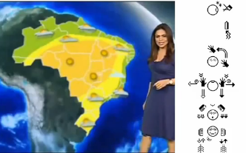
Designs
See the following video from Brazil on You Tube, about captioning video in SignWriting using software developed in Brazil: Previsão do tempo com SW by Ronnie Fagundes de Brito.
https://www.youtube.com/watch?v=gvtdzaOVj-I

Slide 16
Symbols

Slide 17
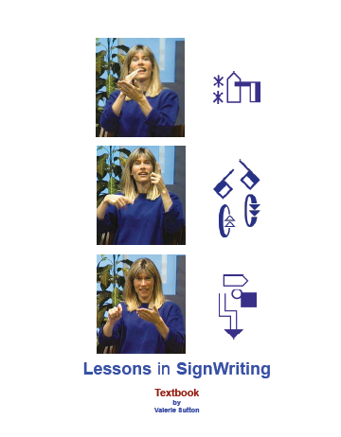
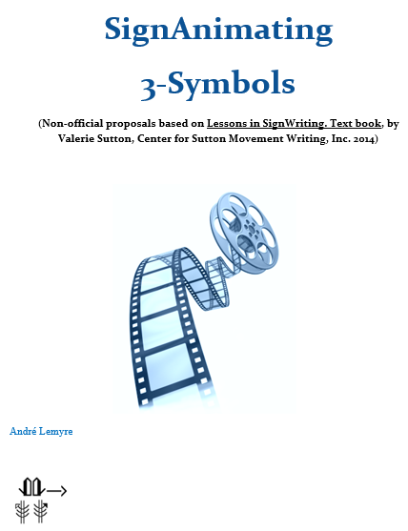
Same Rules
Notes:
A good animation should be complete enough to allow reverting to SignWriting without ambiguity.
SignAnimating is like a form of subtitling; it remains based on SignWriting rules.
Most movement and speed symbols are replaced by displacement of symbols during the animation.
SignAnimating, like SignWriting, is written from the Expressive view point. It is the view point of the signing person seeing her/his own hands.

Slide 18
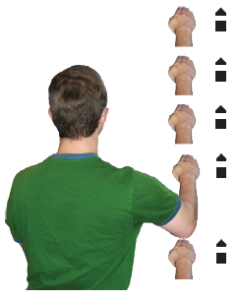
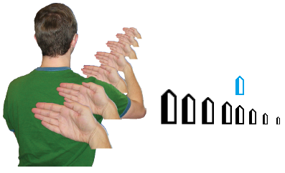

Difference: Zoom
Do not invent symbols!
Notes:
SignAnimating follows all SignWriting rules except for one: symbols change of size depending of their proximity to the body.
Contact symbols may be confined always at the top left corner of the animation. It corresponds to the non-dominant hand side. This corner is less used for hand shapes. This provides uniformity through the animation.

Slide 19
Wöhrmann´s SpeechWriting

Slide 20


Wöhrmann´s SpeechWriting
The SpeechWriting system was invented by Stefan Wöhrmann.
He integrated it in animations.
1- Mundbildschrift
Phonetic sound-production
(Ostrich in German)
2- Mundbilder in GebärdenSchrift
articulatory movement writing
(Ostrich in German)
http://www.signwriting.org/symposium/presentation0002.html
http://www.gebaerdenschrift.de/

Slide 21
Mundbildschrift
Mundbildschrift
(exact translation: Mouth Picture Writing)
A standardized writing system for picturing the sounds of human spoken language (speech).
Compared to the International Phonetic Alphabet, Mundbildschrift is not as detailed and complete but easy to read and sufficient enough to support even young deaf students in their articulation process to develop better spoken language skills.
It is used like a spelling system for writing complete words in mouth pictures, and can be applied to any spoken language.

Slide 22
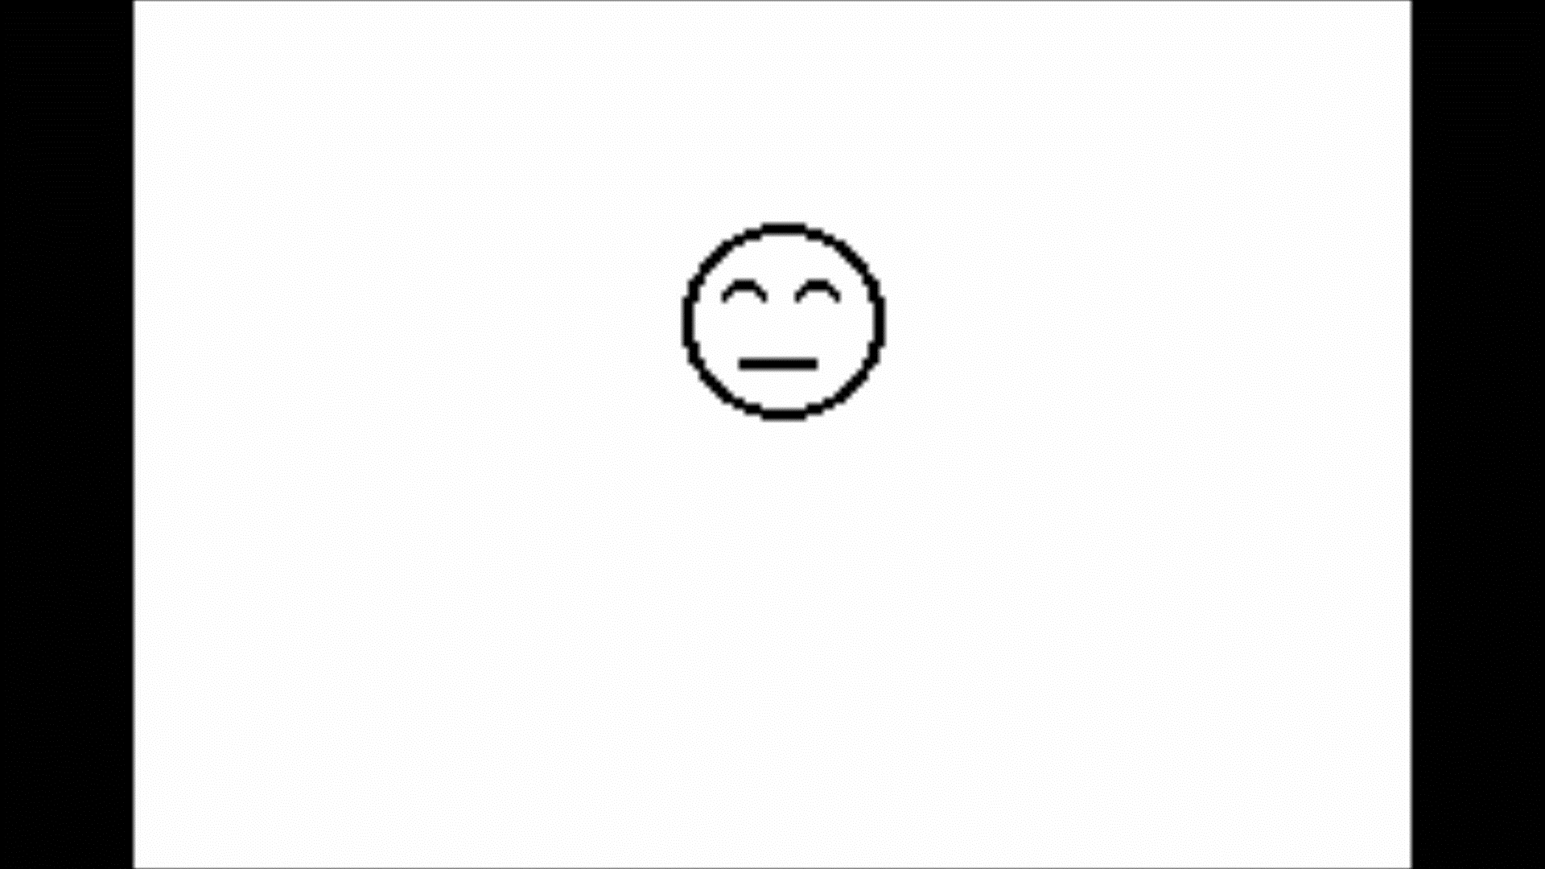
Mundbildschrift
Phonetic sound-production
Video
Animated gif
Merçi beaucoup (Thank you in French and LSQ)

Slide 23

Mundbilder
Mundbilder
(writing what is seen, when Lip Reading)
A standardized writing system for picturing the way the lips look when a person speaks words.
These symbols do not represent sounds but can be associated with spoken words, that are seen on the lips when “Lip Reading”.

Slide 24
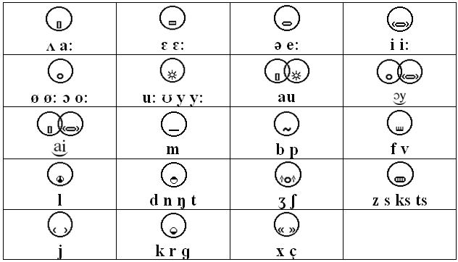
Wöhrmann´s SpeechWriting Symbols
Notes:
An online phonetic translator can help preparing the conversion from text to phonetic.
Then the phonetic can be converted in SpeechWriting symbols.

Slide 25
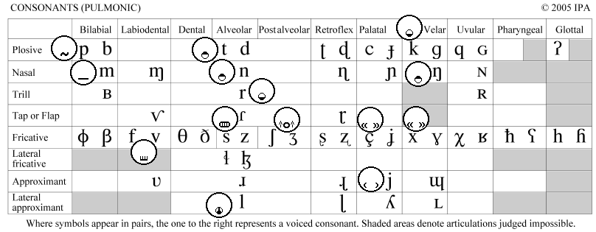
Wöhrmann´s SpeechWriting Consonants
Notes:
I overlapped the Wöhrmann´s SpeechWriting symbols to the International Phonetic Table to identify the subset applicable to other languages.

Slide 26
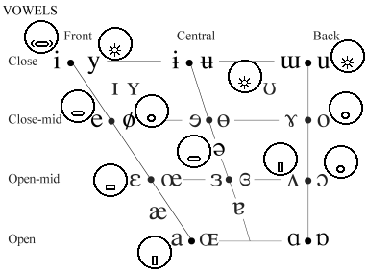
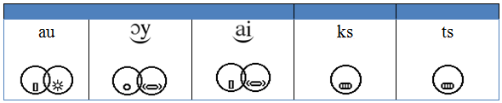
Wöhrmann´s SpeechWriting Vowels

Slide 27
Cued Speech
Notes:
Cued speech can be animated if it is combined with Wöhrmann’s SpeechWriting system.

Slide 28
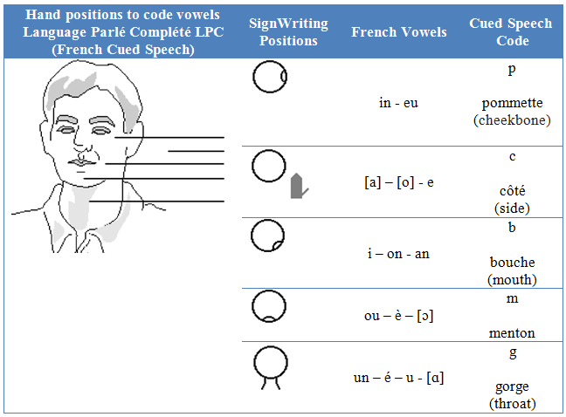
Vowels
Notes:
Cued speech was invented by the Dr. Orin Cornett in the United States in 1966. Speech has many phonemes that look the same by lip reading. Several phonemes are not visible by lip reading. Cued speech combines the visemes information with hand configurations and position. This allows distinguishing each phoneme.
It is a syllabic system where:
Oral syllables are displayed by the movement of the lips and the tongue,
The oral consonants are distinguished by hand configuration,
The oral vowels are distinguished by the hand positions relatively to the face.
Cued speech differs from sign language. It is not a language.

Slide 29
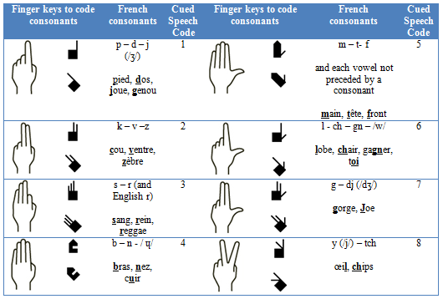
Consonants

Slide 30
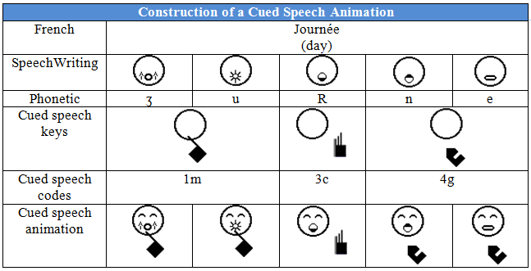
Animations Analysis

Slide 31
Conclusion
With this series of 4 SignAnimating documents, we demonstrated that the SignWriting symbol set is complete and sufficient. It can be used for accurate animations of sign languages and spoken visemes when combined with SpeechWriting.
Merçi beaucoup
(Thank you in French and LSQ)
Notes:
With this series of 4 SignAnimating documents, we demonstrated that SignWriting symbol set is complete and sufficient. It can be used for accurate animations of sign languages and spoken visemes when combined with SpeechWriting.
Just like radio, television, books and handwriting are different forms of communication; SignWriting, SignAnimating, subtitles, avatars and videos are different ways to communicate with Deaf people. Each of these media has its benefit and cannot be fully replaced by the others.

Slide 32
Bibliography
Documents can be downloaded for free at:
http://www.signwriting.org/archive/docs2/sw0116-Lessons-SignWriting.pdf
http://www.signwriting.org/lessons/books/
http://www.signwriting.org/lessons/web/
http://www.signwriting.org/lessons/elessons/
http://www.signwriting.org/archive/docs5/sw0493-SWLessonsBook-Parkhurst-EngLSE.pdf
http://www.signwriting.org/lessons/iswa/
http://std.dkuug.dk/jtc1/sc2/wg2/docs/n4090.pdf

Slide 33
Bibliographie Française
Leçons en français pour apprendre à écrire les signes:
Sutton, Valerie (2002) Leçons en SignWriting... lire et écrire les mouvements des langues des signes. Les langues des signes sont des langues écrites. Center for Sutton Movement Writing, Inc. La Jolla, California. USA. Disponible en téléchargement gratuit:
http://www.signwriting.org/archive/docs3/sw0221-Lecons-SW-Francais-1.pdf
http://www.signwriting.org/archive/docs3/sw0222-Lecons-SW-Francais-2.pdf
http://www.signwriting.org/archive/docs3/sw0223-Lecons-SW-Francais-3.pdf
http://www.signwriting.org/archive/docs3/sw0224-Lecons-SW-Francais-4.pdf

