Slide 1
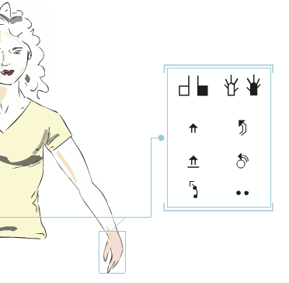

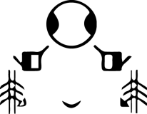
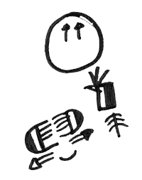
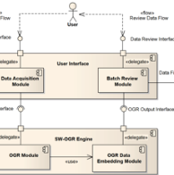
A proposal for the recognition of handwritten SignWriting for SWORD project
Fabrizio Borgia^{1,2}, Maria De Marsico²
¹ Université Toulouse III - Paul Sabatier
² Sapienza Università di Roma
Notes:
Greetings.
Expertise.

Slide 2
Outline
Introduction
The SWORD project
A new generation of SignWriting editors
SW-OGR - Concept
SW-OGR - Challenges
SW-OGR - Design
SW-OGR – In action
Conclusions and Future
Notes:
Brief summary.

Slide 3
Introduction
A pencil and a piece of paper are the only required items to produce signs using SignWriting
Since the early years the need to produce a digital version of the system was evident
The informatization of the system, started in 1986 with the SignWriter computer program, allowed SignWriting to achieve a wider diffusion through:
  Newspaper
  Books
  Websites
  Other digital resources

Slide 4
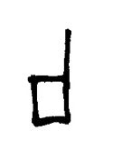
Introduction
Digital version of the glyphs were created
The conceptual organization of glyph images was ensured by assigning to each of them a unique ISWA code

Slide 5
Introduction
SignWriting digital editors are the tools that enable the creation of digital resources written in SignWriting
In other words, they are critical for the informatization of SignWriting and therefore the “digital transcription” of SLs
Many applications have been produced by different teams, delivered in different ways, ranging from desktop to web applications

Slide 6
Introduction
Most SignWriting digital editors basically provide the same functionalities
Despite differences in design and implementation existing from one editor to another, such functionalities are:
  Search for (or type) glyphs which belong to the ISWA
  Insert the chosen glyphs onto an area which is designated for the composition of the sign
  Manage the glyphs on the sign composition area
  Save the sign in one (or more) formats
  See SignMaker and SWift

Slide 7
Introduction
Despite their increasing capabilities, SignWriting digital editors are still far from the simplicity of the handwriting approach.

Slide 8
Introduction
Any SignWriting digital editor developed so far relies heavily on “Windows, Icons, Menus, Pointer” (WIMP) interfaces
They require a navigation/selection process in a huge amount of digital images that, though facilitated, may become long and cumbersome
SignWriting users are more fast and comfortable when using handwriting, rather than when dealing with the complex interaction style of a SignWriting digital editor
Writing is easier than understanding and using a User Interface

Slide 9
The SWORD project
SignWriting Oriented Resources for the Deaf (SWORD)
A project towards the full SignWriting-based integration of deaf people in the digital society
The project aims at producing digital artifacts (applications, websites, etc.) featuring deaf-oriented accessibility via written Sign Language
A SignWriting digital editor, namely SWift, was produced within SWORD

Slide 10
A new generation of SignWriting editors
SWift still carries most intrinsic shortcomings of its peers, including the strict dependency on WIMP interfaces.

Slide 11
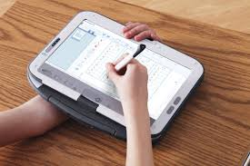
SW-OGR
Concept
We designed a new generation of SignWriting editors, able to partially overcome the concept of the WIMP interface and to move along the line of the so called “natural interfaces”.
No click, drag, search and browse on the UI during the SW production process

Slide 12
SW-OGR
Concept
Introducing a SW-OGR engine within an existing SW editor, such as SWift:
  The user will handwrite glyphs rather than searching them among thousands others
  Each handwritten symbol will be processed and replaced with its standard ISWA version by SW-OGR
We maintain the advantages of a digital editor
  Multiple save options: PNG, XML and remove save
  Each sign is saved in a database with the list of its component glyphs: support for linguistic analysis

Slide 13
SW-OGR
Challenges
WIMP is currently the most common interface style, it cannot be totally left behind
  The interaction with most application is still firmly grounded on it
Nevertheless, our aim is to limit its use, or to dismiss it whenever possible, during the SW production process

Slide 14
SW-OGR
Challenges
Very high number of glyphs (tens of thousands)
Multilinear/two-dimensional arrangement
No rigid rules for composition
Complex segmentation, particularly when handwritten
OCR-like pattern-recognition approach not feasible
  Large amount of patterns to recognize, and consequently very long machine training

Slide 15
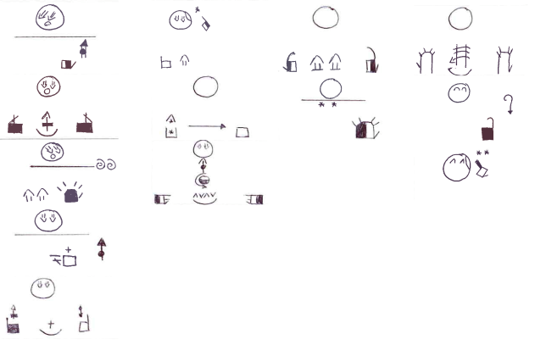
SW-OGR
Design
SignWriting Optical Glyph Recognition (SW-OGR)
An application module designed to operate the electronic conversion (recognition) of user-produced images containing handwritten (or printed) SignWriting symbols into machine-encoded (ISWA) SW text.

Slide 16
SW-OGR
Design
The SW-OGR approach is based on:
  Geometric features of the glyphs
  Topologic information about the glyphs
  Contextual information about the organization of the ISWA

Slide 17
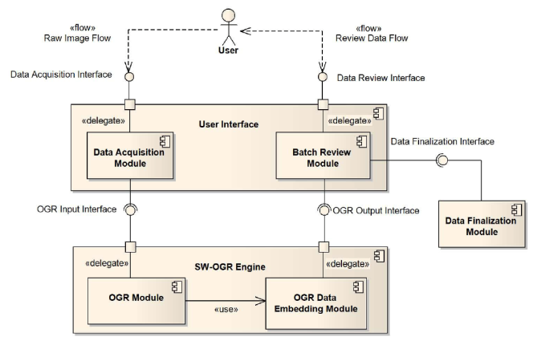
SW-OGR
Design

Slide 18
SW-OGR
Design
Image (SignWriting text) production by the User
Image acquisition interface

Slide 19
SW-OGR
Design
Optical glyph recognition by SW-OGR module

Slide 20
SW-OGR
Design
Human-assisted review of the recognition

Slide 21
SW-OGR
Design
The recognition by SW-OGR is composed by different analyses of the image (SignWriting text):
  Image pre-processing and binarization
    Noise reduction, thresholding
  Detection of geometric shapes within the image
    Circles, rectangles, trapeziuses, etc...
  Category inference on geometric shapes
    Topological and contextual information
  Glyph recognition
    OGR coding to ISWA coding conversion

Slide 22
SW-OGR
Design
OGR Coding
  An alternative coding for SignWriting symbols able to guide the recognition process
  Only takes into account geometric/topoligical features of the glyphs
  It does not substitute ISWA: it is a “process coding”
OGR Coding of a handwritten glyph can be automatically calculated by SW-OGR
OGR to ISWA mapping tables are required to complete the recognition
ISWA Bianchini was employed for the conversion, but the recognition output can also be encoded in ISWA 2010

Slide 23
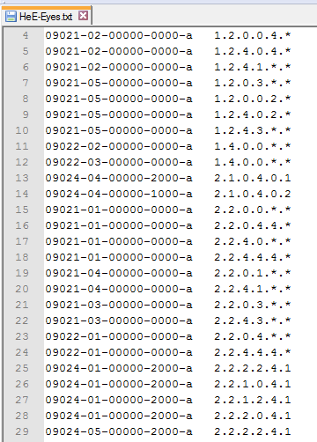
SW-OGR
Design
OGR to ISWA mapping table
ISWA Bianchini codes
OGR codes

Slide 24
SW-OGR
In action
  Image pre-processing and binarization

Slide 25
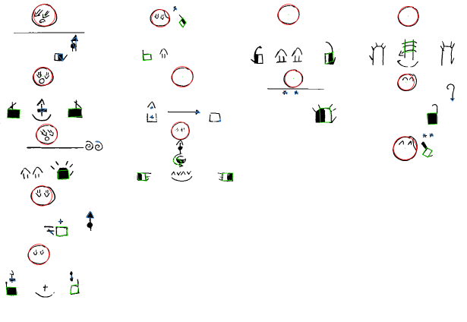
SW-OGR
In action
  Detection of geometric shapes within the image

Slide 26
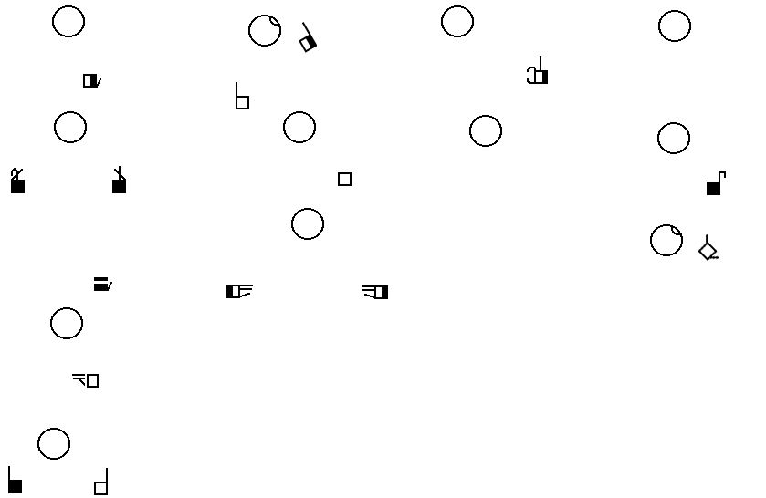
SW-OGR
In action
Recognition output (in development)

Slide 27
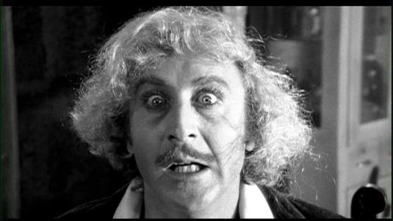
Conclusions and Future
“IT... COULD... WORK!”
(Dr. Frederick Frankenstein)

Slide 28
Conclusions and Future
SignWriting Optical Glyph Recognition is possible
SW-OGR makes digital handwriting of SignWriting texts real
Overcoming WIMP interface in digital editors will make the sign composition process real
SW-OGR needs to be expanded adding support for more and more ISWA categories and groups
Real-time text recognition and batch corpora digitalization
Next step: transcription from videos

