Slide 1
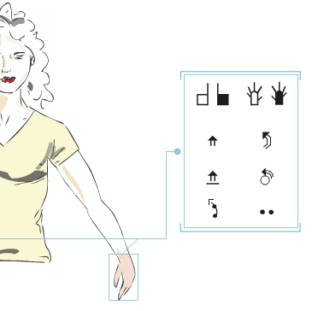
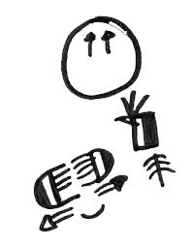
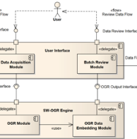
SWift, a user-centered digital editor for SignWriting within SWORD project
Fabrizio Borgia^{1,2}, Claudia S. Bianchini³, Maria De Marsico²
¹ Université Toulouse III - Paul Sabatier
² Sapienza Università di Roma
³ Université de Poitiers
Notes:
Greetings.
Expertise.

Slide 2
Outline
Introduction
SignWriting digital editors - Overview
SignWriting digital editors - Challenges
SWift - Introduction
SWift – Overview
SWift - Advanced features
SWift – Supporting different ISWA versions
SWift - Testing
Conclusions and Future
Notes:
Brief summary.

Slide 3
Introduction
A pencil and a piece of paper are the only required items to produce signs using SignWriting
Since the early years the need to produce a digital version of the system was evident
The informatization of the system, started in 1986 with the SignWriter computer program, allowed SignWriting to achieve a wider diffusion through:
Newspaper
Books
Websites
Other digital resources

Slide 4
Introduction
Digital versions of the glyphs were created
The conceptual organization of the glyph images was ensured by assigning to each of them a unique ISWA code

Slide 5
SignWriting digital editors Overview
SignWriting digital editors are the tools that enable the creation of digital resources written in SignWriting
In other words, they are critical for the informatization of SignWriting and therefore the “digital transcription” of SLs
Many applications have been produced by different teams, delivered in different ways, ranging from desktop to web applications

Slide 6
SignWriting digital editors Overview
Most SignWriting digital editors basically provide the same functionalities
Despite differences in design and implementation existing from one editor to another, such functionalities are:
Search for (or type) glyphs which belong to the ISWA
Insert the chosen glyphs onto an area which is designated for the composition of the sign
Manage the glyphs on the sign composition area
Save the sign in one (or more) formats

Slide 7
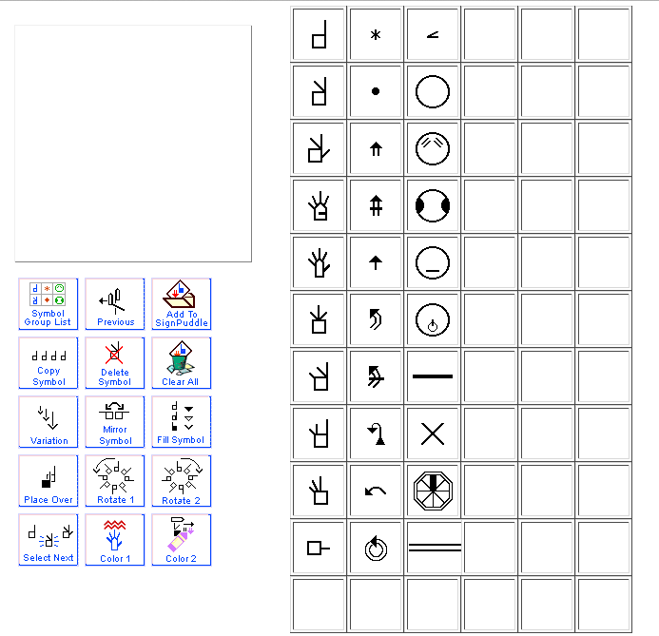
Digital SignWriting Overview
Sign Composition
Glyph Search

Slide 8
Digital SignWriting Challenges
General:
The system should provide at least:
An area to compose the desired sign(s)
An area to search for the desired glyphs(s)
Achieve the best possible level of usability
Achieve the best possible level of accessibility (at least deaf-oriented accessibility)
Minimize the use of text (Vocal Language)
Visual-oriented organization

Slide 9
Digital SignWriting Challenges
Glyph Search Area:
The large amount of glyphs requires a robust yet intuitive organization of the glyph search area
The organization of the glyph search area should reflect the organization of the International SignWriting Alphabet (ISWA)
The glyph search area should provide a user-friendly navigation context for finding and fetching glyphs
SignWriting beginners should be able to find their orientation within the glyph search area too

Slide 10
SWift Introduction
SignWriting improved fast transcriber
Provides all the features of a SignWriting digital editor
Produced by “Sapienza” University of Rome, in partnership with the research team at ISTC-CNR (which includes many deaf people)
New features with respect to other digital editors
Key requirements: usability and accessibility
Application tested with deaf participants

Slide 11
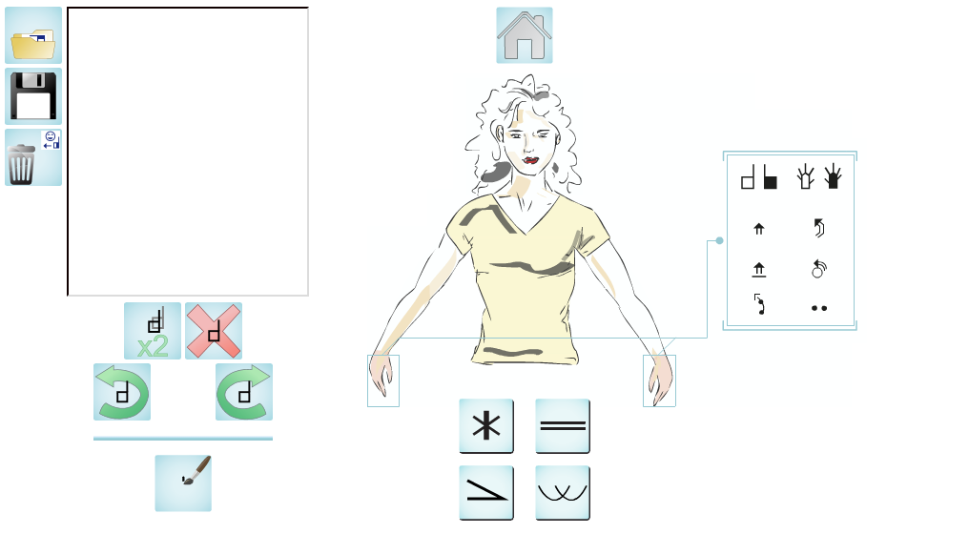
SWift

Slide 12
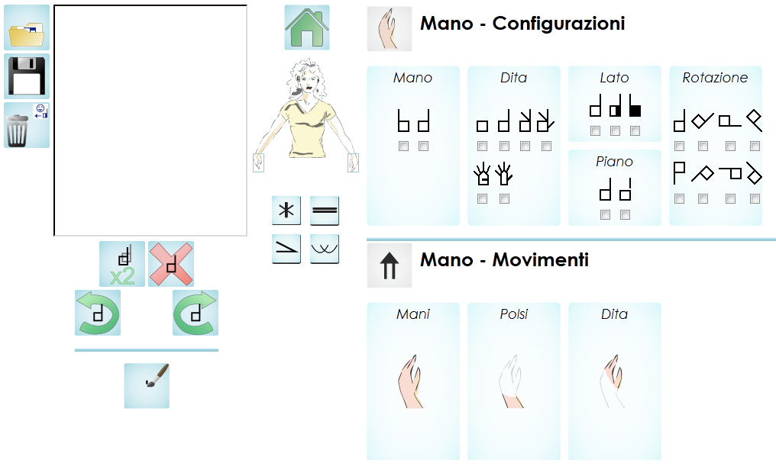
SWift
Sign Composition
Glyph Search

Slide 13
SWift Basic features
Sign composition area and glyph search areas
Interaction via click, and drag-and-drop
Natural organization of the search space according to intuitive criteria (e.g., the part of body involved)
Functionalities for glyph editing
Rotation, duplication, deletion, etc.
Multiple save options
PNG, XML and remote save
“Open” functionality to edit signs composed previously
Each sign is save in a database with the list of its component glyphs
Support for linguistic analysis

Slide 14
SWift Overview

Slide 15
SWift Overview
Support for SignWriting beginners
Presence of graphic elements within the glyph search area, to guide the user towards the correct glyph
Buttons that are used to modify glyphs have very simple icons
Use of mouseover-activated animations (instead of textual labels) to provide additional information to the user (e.g., the meaning of buttons to modify glyphs in the composition area)

Slide 16
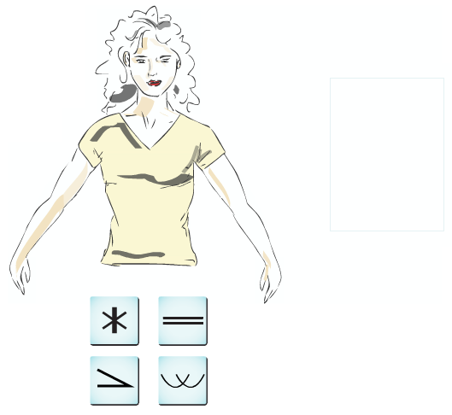
SWift Overview
Support for SignWriting beginners
The puppet: a stylized human figure helps the user to choose the appropriate anatomic area (head, hands, etc.) of the glyph
Animations on mouseover show a set of example glyphs for any area

Slide 17
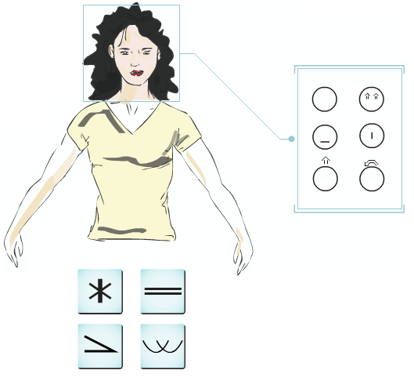
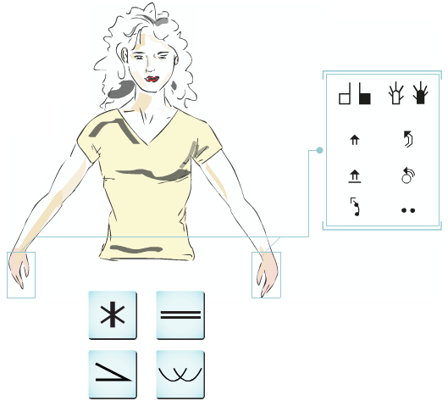
SWift Overview
Support for SignWriting beginners
The puppet: a stylized human figure helps the user to choose the appropriate anatomic area (head, hands, etc.) of the glyph
Animations on mouseover show a set of example glyphs for any area

Slide 18
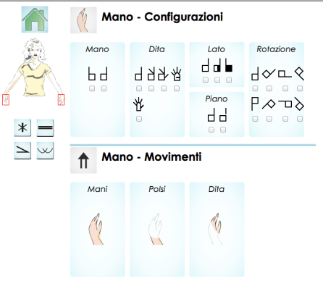
SWift Overview
As the user chooses a glyph area, he/she is presented with a search interface customized for that particular area
Navigation Menu
Glyph Search

Slide 19
SWift Overview
A label and an icon explain the user what kind of glyphs are available through the group of boxes beneath

Slide 20
SWift Overview
A label and an icon explain the user what kind of glyphs are available through the group of boxes beneath
Choose Boxes:
Provide independent choices for a certain glyph feature
The user can use any number of combined criteria
No predefined order of choice

Slide 21
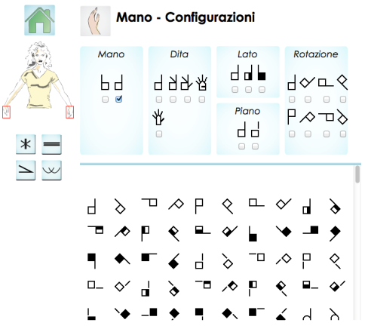
SWift Overview
As the user performs a choice…
The set of glyphs meeting the requirements of the user is updated.

Slide 22
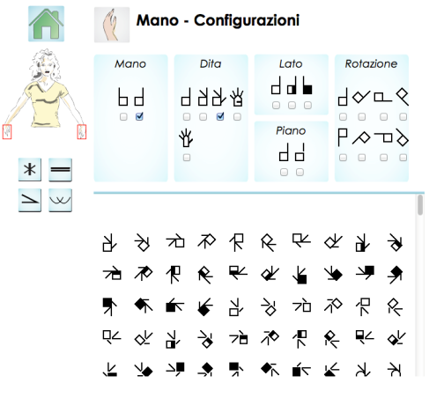
SWift Overview
The more choices the user makes…
The more accurate and restricted becomes the set of result glyphs

Slide 23
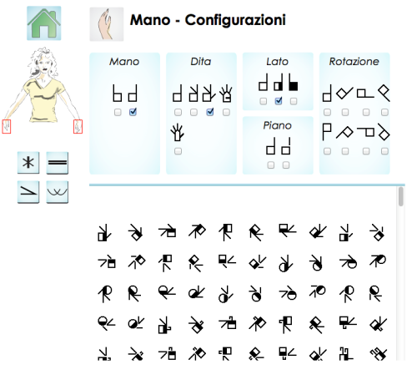
SWift Overview
The more choices the user makes…
The more accurate and restricted becomes the set of result glyphs

Slide 24
SWift Advanced features
Glyph Hint Panel
Shows a set of glyphs that are compatible with those the user inserted in the sign composition area.
The glyphs are immediately draggable on the sign composition area.
Hints come from an analysis based on the frequency of co-occurrences of the glyphs in the sign database.
Statistics are updated immediately after any sign is saved in SWift format.
The proposed glyph exclusively belong to the anatomical area the user is currently searching.
Sign Hint Panel implemented but untested

Slide 25
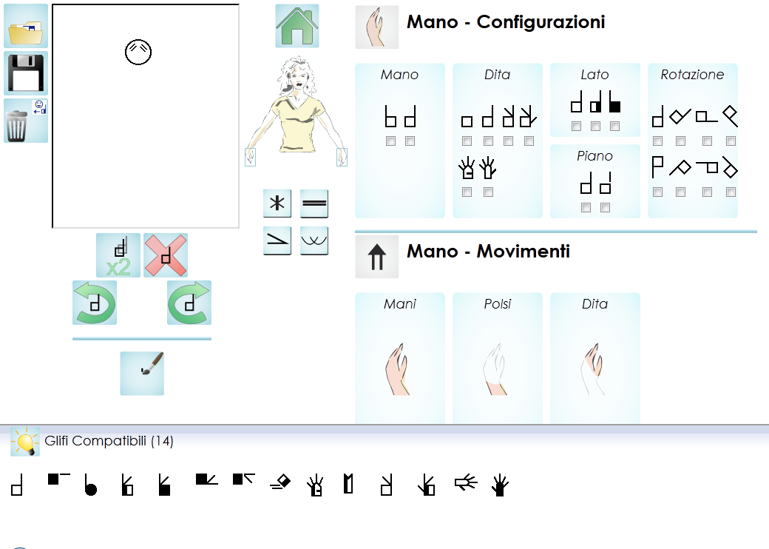
SWift Advanced features
Glyph Hint Panel
Compatible glyphs belonging to the current area (hands).
Immediately draggable on the sign composition area

Slide 26
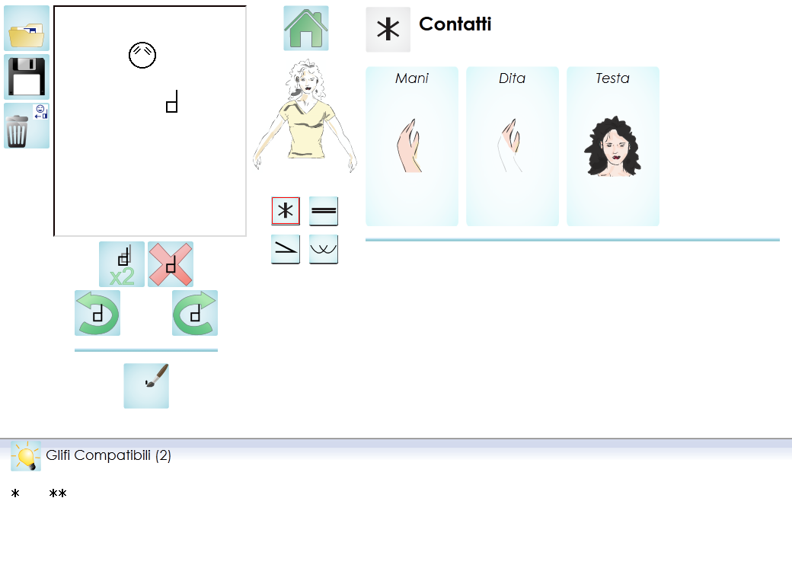
SWift Advanced features
Glyph Hint Panel
Compatible glyphs belonging to the current area (contacts).
Immediately draggable on the sign composition area

Slide 27
SWift Advanced features
Custom glyphs handwriting support.
Many SignWriting users tend to “invent” ad hoc glyphs during the writing process
This happens when the user is not able to find the glyph he/she is looking for
The ad hoc glyphs are consistent with the rules and organization of SignWriting, so they can be understood by other users
We designed and developed a functionality to support the handwriting of ad hoc glyphs

Slide 28
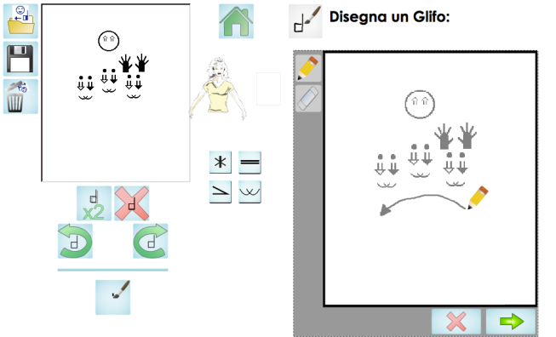
SWift Advanced features
Custom glyphs handwriting support.
0
The user handwrites a ad hoc glyph

Slide 29
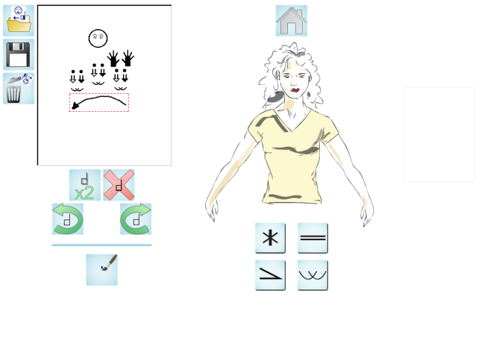
SWift Advanced features
Custom glyphs handwriting support.
0
The ad hoc glyph is inserted onto the sign composition area

Slide 30
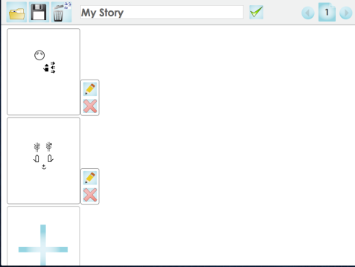
SWift Advanced features
Signed Stories Support
SWift can be used to compose whole signed stories, rather that single signs

Slide 31
SWift Supporting different ISWA versions
SWift can support multiple ISWA versions:
ISWA2008
ISWA2010
ISWA Bianchini
However, the business logic of the glyph search area is based on ISWA Bianchini

Slide 32
SWift Testing
SWift has been tested with a number of SignWriting-proficient participants
A deaf-oriented adaptation of the Think-Aloud Protocol (by C. Lewis and J. Rieman) was necessary in order to perform the test
The devised test was named “Think by Signs” protocol
The results of the test underlined a very good usability level
Critical areas of intervention were identified within the application

Slide 33
SWift Testing
For more information about the testing of SWift, and for detailed result, please refer to:
Bianchini, C.S., Borgia, F., Bottoni, P., De Marsico, M. (2012).
SWift - A SignWriting improved fast transcriber.
In Proceedings of AVI2012 (Capri, 21-25 May 2012)
Bianchini, C.S., Borgia, F., De Marsico, M. (2012).
SWift - A SignWriting editor to bridge between deaf world and e-learning.
In Proceedings of ICALT2012 (Rome, 7-10 July 2012)

Slide 34
Conclusions and Future
SWift is a new digital editor with novel capabilities with respect to other digital editors
SWift is framed within the SWORD (SignWriting Oriented Resources for the Deaf) project
SWORD will represent a step towards full integration of deaf people in digital society

