Slide 1
Ways to Write Sign Languages by Hand with SignWriting
Adam Frost

Slide 2
When did writing by hand start (for SignWriting)?

Slide 3
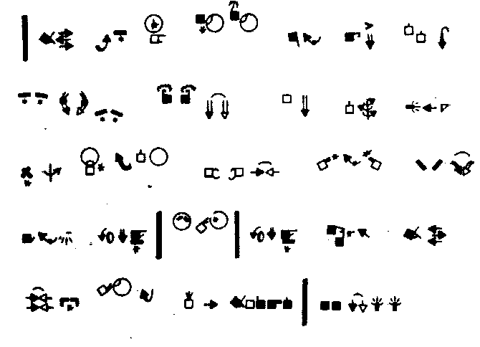
American Deaf Adult
1983

Slide 4
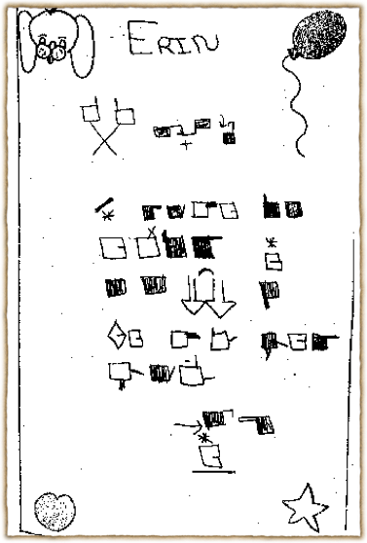
Deaf child, age 7 or 8, after a
45-minute introduction to SignWriting
1984
LaFayette Elementary School, San Diego

Slide 5
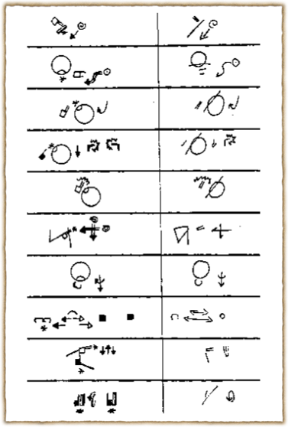
Example of two forms of writing by hand
1982
Left: Handwriting
Right: Shorthand

Slide 6
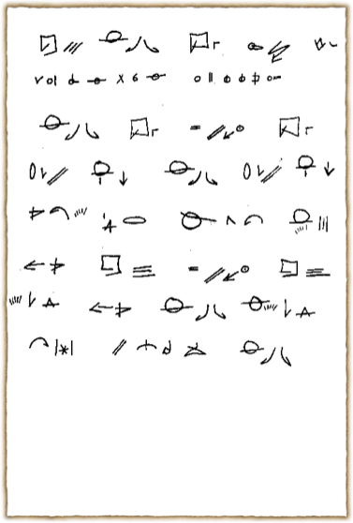
“Silent Night” written in shorthand
1982
by Valerie Sutton

Slide 7
But that was before computers

Slide 8
No one writes by hand anymore, right?

Slide 9
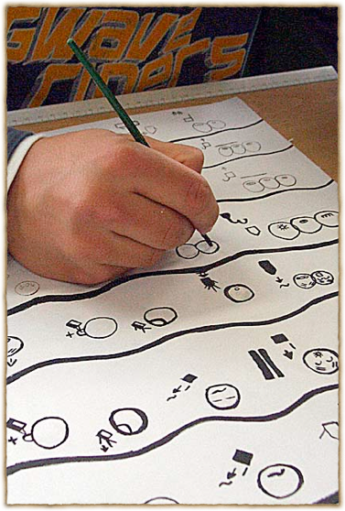
Creating SignWriting Art Mural
2008
Osnabrück School for the Deaf, Germany

Slide 10
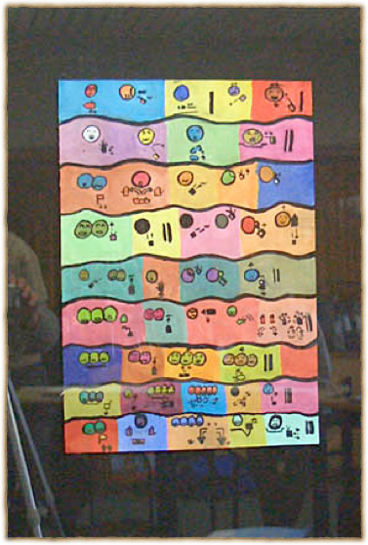
Artist: Deaf Student Eduard Schmidt
2008
Osnabrück School for the Deaf, Germany

Slide 11
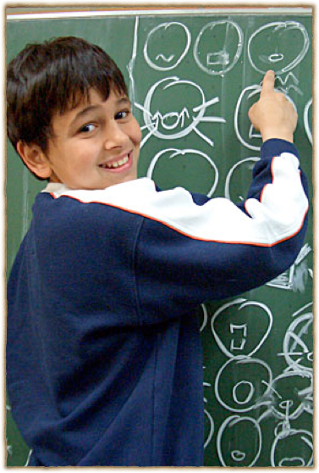
Deaf Student Eduard Schmidt writing
2008
Osnabrück School for the Deaf, Germany

Slide 12
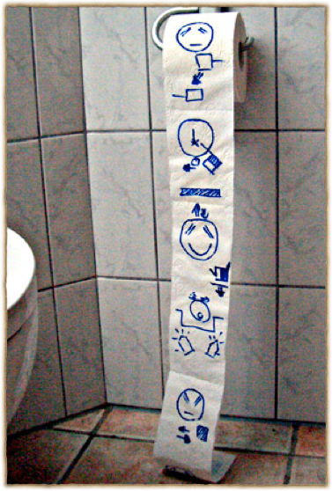
Handwriting in the bathroom
2008
Osnabrück School for the Deaf, Germany

Slide 13
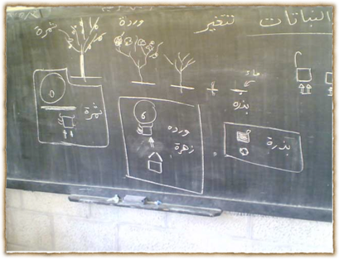
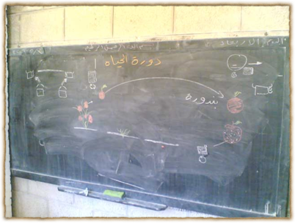
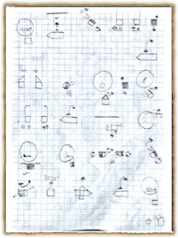
In Saudi Arabia

Slide 14

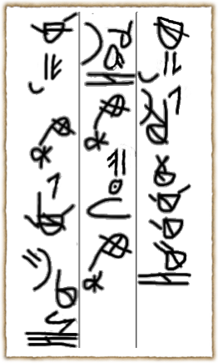
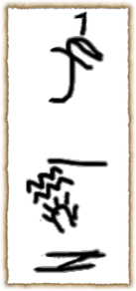
Some from my phone
*Lines added for readability

Slide 15

Different Types of
Writing by Hand
Block Printing: looks like how a computer would print it
Handwriting: looks close to print except it is simplified to be easily written by hand
“Cursive”: further reduces to make writing faster
Shorthand: a system for writing at expressive speed (rarely used anymore due to computer inputing)

Slide 16
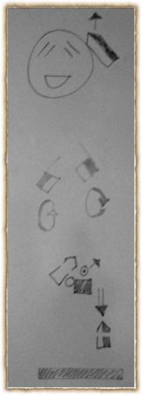
Block Printing
The most common
Takes time to write
  Mostly due to fill-ins
  Probably why people think writing by hand is cumbersome

Slide 17
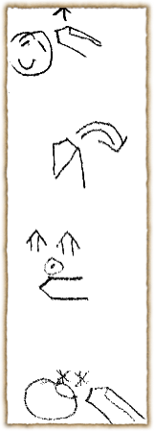
Handwriting
Very close to Block Printing
For this reason, a student must learn Block Printing before learning Handwriting
Once Block Printing is mastered, Handwriting can be learned quickly
There are several variations among experienced SignWriters just as there are variations is handwriting in other languages

Slide 18
“Cursive”
My own personal simplified handwriting
  Use some handwriting variations from other writers as well as my own
Only the dominant hand is written
  Timing symbols are used to signify non dominant hand
*Lines added for readability

Slide 19
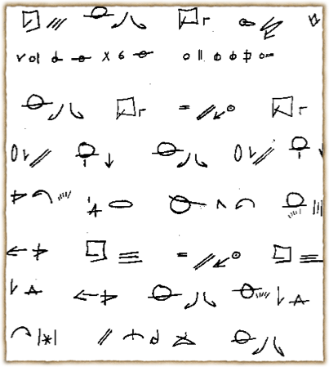
Shorthand
Started in the 1980’s
Most documents were written in that time
Mostly used for transcription
Very language-specific
Often for a quick writing of something for later use

Slide 20
Let’s learn how to use Handwriting

Slide 21
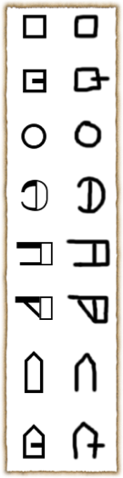
Root Shapes
There are 8 basic root shapes
Make sure that thumb lines crosses
Make sure angle and hinge roots are thinner than the square roots

Slide 22
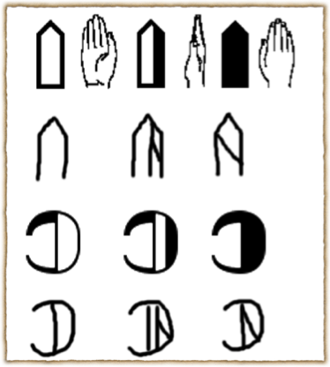
Palm Facings
Palm shadings are written with a diagonal line
Take care that the line is truly diagonal

Slide 23
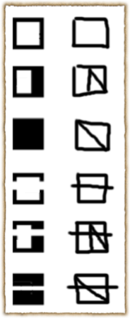
Palm Facings
The Top View is written with a line striking through the root shape
Make sure that it is crossing outside of the shape on both sides

Slide 24
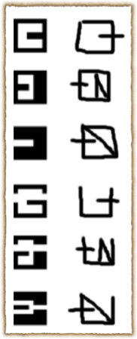
Palm Facings
Squares with thumbs lines across have a little different approach to the Top View
Top Views are written without the top of the root shape written

Slide 25
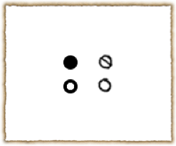
Finger Movements
Just like shading is done with a diagonal for handshapes
Be careful to write so the size isn’t the same as a circle root shape

Slide 26
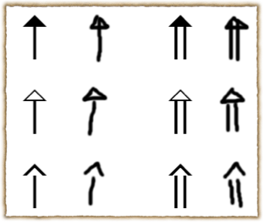
Arrowheads
Filled in arrowheads must have a line going through it
Draw the stem through the arrowhead for filled in arrowheads

Slide 27
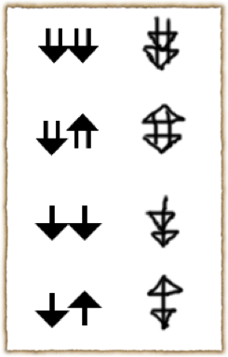
Arrowheads
Double movements are written as double arrowheads on the same stem
Back and forth movements are written with the arrowheads on the ends of the stem
Details of order are lost, but I personally haven’t noticed any meaning lost as a result

Slide 28
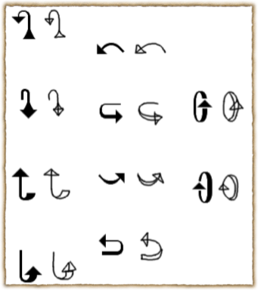
Arrows
Stems with gradual thickness have their outlines written, but no shading in

Slide 29
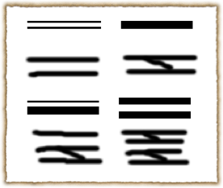
Punctuations
Punctuations do not have a “closed” shape
Thin lines are written as a thin line
Thick lines are written as two thin lines with a diagonal line to “shade-in”

Slide 30
You now know the basics of how to Handwrite

Slide 31
Now, let’s move on to what I call “Cursive” writing

Slide 32
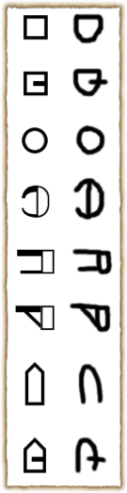
Root Shapes
Slight differences have been made to some of the shapes to make them easier and quicker to write
Note the rounding of root shapes make it easier to write than the shapes from the handwritten forms

Slide 33
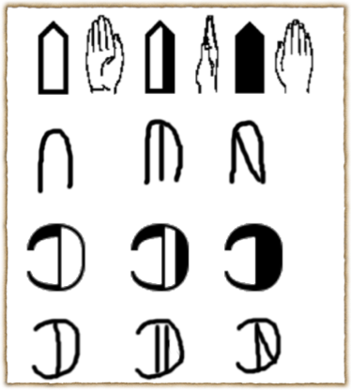
Palm Facings
Palm shading is still done with a diagonal line
Side facing only have one vertical line without a diagonal line
The side facing diagonal is reserved for when the palm is facing outward from the body

Slide 34

Palm Facings
The Top View is written with a line striking through the root shape
This is the same as the handwritten form

Slide 35
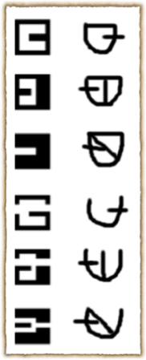
Palm Facings
Squares with thumbs lines across in the Top Views are written without the top of the root shape written
This is also the same as the handwriting form

Slide 36
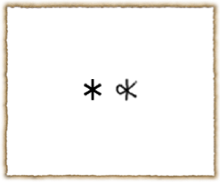
Contact Star
This is the only contact symbol that is different from the printed form
The connecting line makes it so it is quicker to write compared to the printed form

Slide 37
Finger Movements
Just like shading is done with a diagonal for handshapes
Be careful to write so the size isn’t the same as a circle root shape

Slide 38
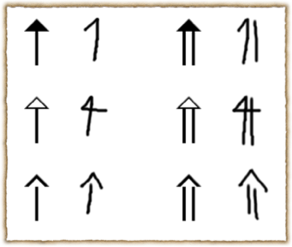
Arrowheads
A diagonal line is used to represent where the arrowhead is
It doesn’t matter which side the diagonal line is on
While it is true that only the dominant hand is written, the line crossing the stem represents the left hand

Slide 39
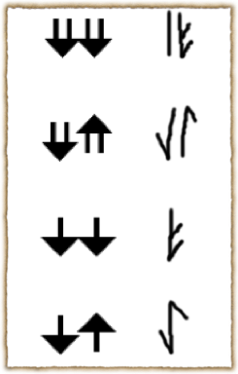
Arrowheads
Double movements are written as double arrowheads on the same stem
Back and forth movements are written with the arrowheads on the ends of the stem
The side the arrowhead is on indicates which back and forth movement is first

Slide 40
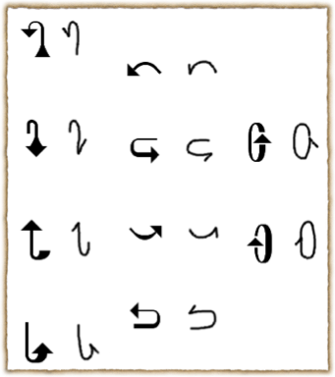
Arrows
Stems with gradual thickness do not have their outlines written, but the general shape is
The thickness is always assumed to be on the “outside” and bottom
Meaning if the right hand’s movement is written, the right side of the stem is the thicker side

Slide 41
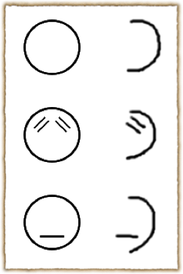
The Head
Only the dominant half of the head is written
This means that only one eye is also written
Since there is only one mouth, there is no dominant half that can only be written

Slide 42
Punctuations
Punctuations are also the same as handwritten forms
Thin lines are written as a thin line
Thick lines are written as two thin lines with a diagonal line to “shade-in”

Slide 43
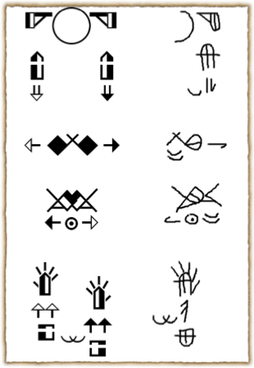
Some Final Notes
As mentioned before, “Cursive” writing is only writes the dominant hand
Timing symbols are used for when both hands are doing the movement

Slide 44
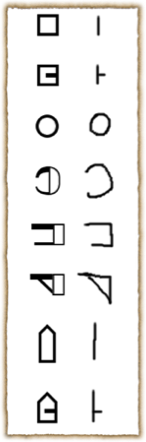
Non Dominant Base Hands
If the non dominant hand is a root handshape, the symbols on the right are used
Otherwise, the active fingers can be written

Slide 45
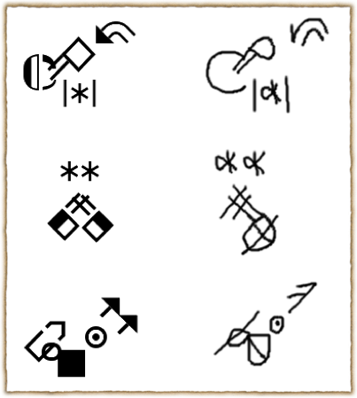
Some Examples
Non dominant base hands are not completely written
It is possible to write them if the palm facing is important, but I have found it usually isn’t

