Slide 1


Sutton SignWriting
Standard of 2017
Demo
by Stephen E Slevinski Jr
the Center for Sutton Movement Writing
http://www.signwriting.org/symposium/presentation0066.html

Slide 2
SignMaker on SignBank with International Dictionaries
http://www.signbank.org/signmaker.html
GitHub Pages Demo
http://slevinski.github.io/signmaker
Repository Page:
https://github.com/Slevinski/signmaker/

Slide 3
Sutton SignWriting Fonts
2017 Edition
The Sutton SignWriting fonts are available for download and installation.
Installing the fonts is not required, but it will improve the user experience and allow the fonts to be used throughout the user’s computer.
https://slevinski.github.io/SuttonSignWriting/components/fonts.html

Slide 4
Sutton SignWriting Fonts
Downloads for Windows, OS X, and Linux
These fonts can be downloaded and installed, the same as other fonts.
https://cdn.rawgit.com/Slevinski/SuttonSignWriting/master/ assets/SuttonSignWritingLine.ttf
https://cdn.rawgit.com/Slevinski/SuttonSignWriting/master/ assets/SuttonSignWritingFill.ttf
https://cdn.rawgit.com/Slevinski/SuttonSignWriting/master/ assets/SuttonSignWritingOneD.ttf

Slide 5
Sutton SignWriting Profiles
Downloads for OS X and iOS
Rather than downloading and installing the individual fonts, both OS X and iOS allow for fonts to be installed through a configuration profile. Both profiles need to be installed.
https://cdn.rawgit.com/Slevinski/SuttonSignWriting/master/ assets/SuttonSignWritingSymbol.mobileconfig
https://cdn.rawgit.com/Slevinski/SuttonSignWriting/master/ assets/SuttonSignWritingOne.mobileconfig

Slide 6
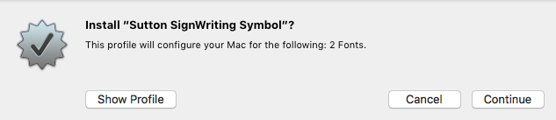
Sutton SignWriting Profiles
Installing on OS X
Installing the configuration profiles on OS X is straight forward. Simply download the files and use the finder to open the profiles.

Slide 7
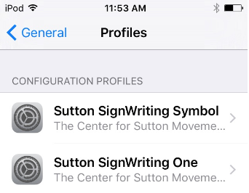
Sutton SignWriting Profiles
Installing on iOS
Installing the configuration profiles on iOS is possible, but may take several attempts. On the iOS device, simply click the profile links.
The profiles will appear in the profile list when they are successfully installed.
It will take several attempts to install the profiles. Your patience will be rewarded.

Slide 8
Sutton SignWriting Fonts
Android Considerations
Android does not allow users to install fonts directly on the Android device.
Android in the browser can use a CSS font-face statement to download the fonts in real-time and install the fonts in the browser cache.
The fonts can be embedded in Android apps and browser extensions.

Slide 9





SignWriting in Unicode
SWU
Experimental Unicode design
One-Dimensional Fonts available
Two-Dimensional Font being developed
Endorsed by the Center for Sutton Movement Writing
Submitted to the UTC July 2017
http://www.unicode.org/L2/L2017/17220-signwriting-design-opt.pdf

Slide 10
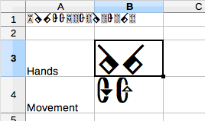
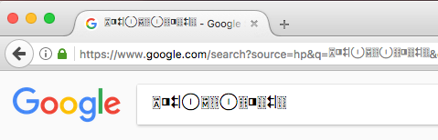
SignWriting in Unicode
One-Dimensional Font
The Sutton SignWriting One-D font makes it possible to use SWU on a variety of operating systems and across applications with a visual representation rather than data.
font-family: “SuttonSignWritingOneD”;

Slide 11

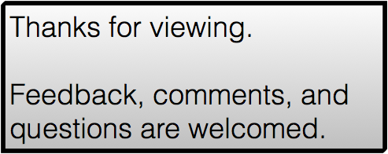
Sutton SignWriting
Standard of 2017
Demo
by Stephen E Slevinski Jr
slevinski@signwriting.org
https://slevinski.github.io/SuttonSignWriting/

